Slide 1
IoT Edge to Cloud Protocols
By: Mahmood Ahmadi

Slide 2
Protocols
Why are there any protocols outside of HTTP to transport data across the WAN?
  HTTP has provided significant services and abilities for the internet for over 20 years, yet was designed and architected for general purpose computing in client/server models. IoT devices can be very constrained, remote, and bandwidth limited. Therefore, more efficient, secure, and scalable protocols are necessary to manage a plethora of devices in various network topologies such as mesh networks.
Message Orientated Middleware (MOM)
  The basic idea of a MOM is that communication between two devices takes places using distributed message queues.
  Some devices produce data to be added to a queue while others consume data stored in a queue.
  Some implementations require a broker or middleman be the central service.
  AMQP, MQTT, and STOMP are MOM implementations;
  The alternative to MOM implementation is RESTful.

Slide 3
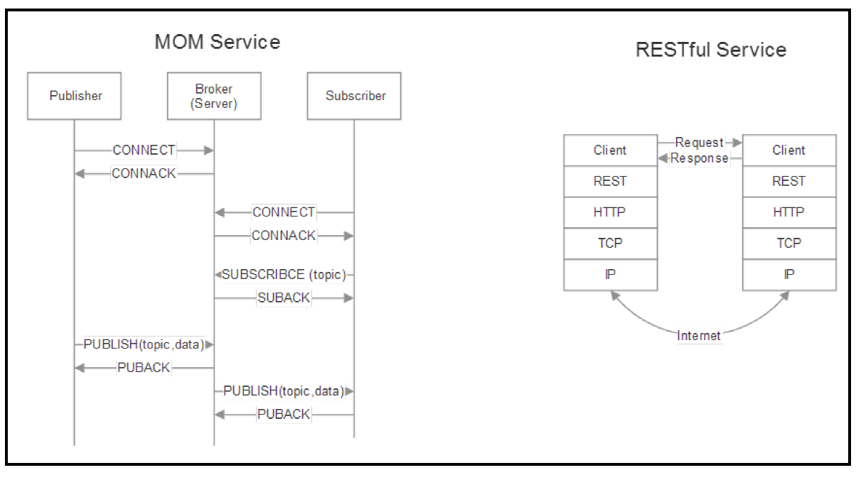
Comparing a MOM to a RESTful implementation

Slide 4
Message Queue Telemetry Transport (MQTT)
The goals of this IP-based transport protocol are:
  It must be simple to implement
  To provide a form of quality of service
  To be very lightweight and bandwidth efficient
  To be data agnostic
  To have continuous session awareness
  To address security issues
"MQTT stands for MQ Telemetry Transport. It is a publish/subscribe, extremely simple and lightweight messaging protocol, designed for constrained devices and low-bandwidth, high-latency or unreliable networks. The design principles are to minimize network bandwidth and device resource requirements whilst also attempting to ensure reliability and some degree of assurance of delivery. These principles also turn out to make the protocol ideal of the emerging “machine-to-machine” (M2M) or “Internet of Things” world of connected devices, and for mobile applications where bandwidth and battery power are at a premium."

Slide 5
MQTT publish-subscribe
Publish-subscribe models represent an alternative that is useful for IoT uses.
Publish-subscribe, also known as pub/sub, is a way to decouple a client transmitting a message from another client receiving a message.
Unlike a traditional client-server model, the clients are not aware of any physical identifiers such as the IP address or port.
MQTT is a pub/sub architecture, but is not a message queue. Message queues by nature store messages while MQTT does not. In MQTT, if no one is subscribing (or listening) to a topic, it is simply ignored and lost. Messages queues also maintain a client-server topology where one consumer is paired with one producer.
A client transmitting a message is called a publisher; a client receiving a message is called a subscriber. In the center is an MQTT broker who has the responsibility of connecting clients and filtering data.

Slide 6
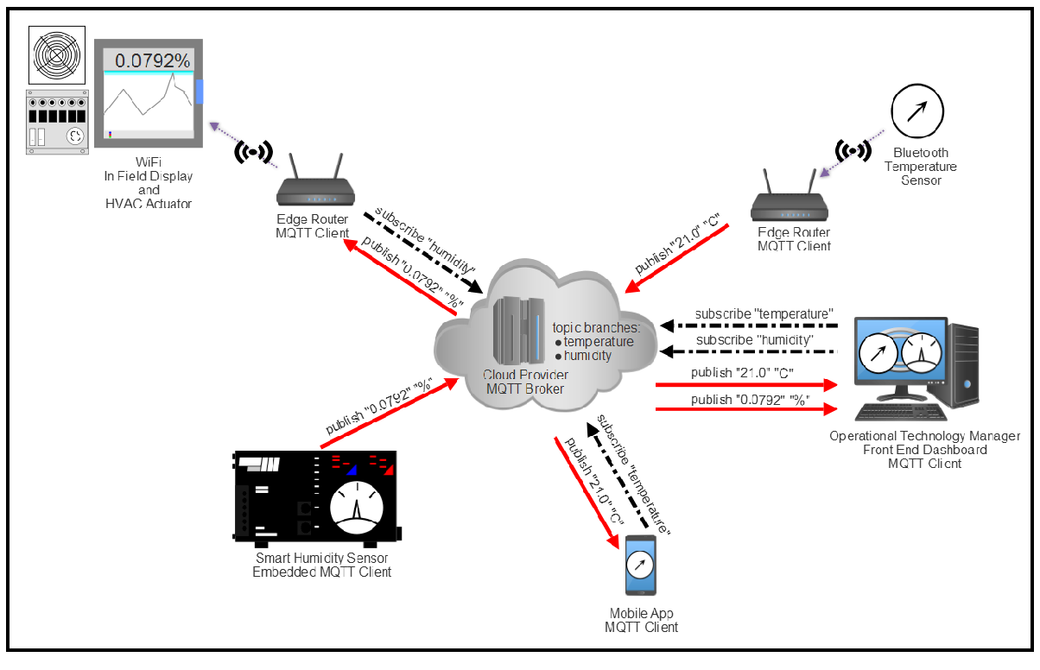
MQTT publish-subscribe model and topology
MQTT successfully decouples publishers from consumers. Since the broker is the governing body between publishers and consumers there is no need to directly identify a publisher and consumer based on physical aspects (such as an IP address).
MQTT and other pub/sub models are also time-invariant. This implies that a message published by one client may be read and responded to at any time by a subscriber.

Slide 7
MQTT publish-subscribe model and topology
A subscriber could be in a very low power/bandwidth-limited state (for example, Sigfox communication) and respond minutes or hours later to a message. Because of the lack of physical and time relationships, pub/sub models scale very well to extreme capacity.
Cloud-managed MQTT brokers typically can ingest millions of messages per hour and support tens of thousands of publishers.
MQTT is data format agnostic. Any type of data may reside in the payload which is why both the publishers and subscribers must both understand and agree to the data format. It is possible to transmit text messages, image data, audio data, encrypted data, binary data, JSON objects, or virtually any other structure in the payload. JSON text and binary data, however, are the most common data payload types.
The maximum allowable packet size in MQTT is 256 MB, which allows for an extremely large payload.

Slide 8
MQTT architecture details
MQTT is TCP based, and therefore includes some guarantee that a packet is transferred reliably.
MQTT can retain a message on a broker indefinitely.
MQTT defines an optional facility called Last Will and Testament (LWT).
An LWT is a message a client specifies during the connect phase. The LWT contains the Last Will topic, QoS, and the actual message. If a client disconnects from a broker connection ungracefully (for example, keep-alive timeout, I/O error, or the client closing the session without a disconnect), the broker is then obligated to broadcast the LWT message to all other subscribed clients to that topic.
Even though MQTT is based on TCP, connections can still be lost, especially in a wireless sensor environment. A device may lose power, lose signal strength, or simply crash in the field, and a session will enter a half-open state. Here, the server will believe the connection is still reliable and expect data. To remedy this half-open state, MQTT uses a keep-alive system.

Slide 9
QoS of MQTT
There are three levels of quality of service in MQTT:
  QoS-0 (non-assured transmission): This is the minimal QoS level. This is analogous to a fire-and-forget model detailed in some of the wireless protocols. It is a best-effort delivery process without the receiver acknowledging a message or the sender reattempting transmission.
  Qos-1 (assured transmission): This mode will guarantee delivery of the message at least once to the receiver. It may be delivered more than once, and the receiver will send an acknowledgment back with a PUBACK response.
  QoS-2 (assured service on applications): This is the highest level of QoS that ensures and informs both the sender and receiver that a message has been transmitted correctly. This mode generates more traffic with a multi-step handshake between the sender and receiver. If a receiver gets a message set to QoS-2, it will respond with a PUBREC message to the sender. This acknowledges the message and the sender will respond with a PUBREL message. PUBREL allows the receiver to safely discard any re-transmissions of the message. The PUBREL is then acknowledged by the receiver with a PUBCOMP. Until the PUBCOMP message is sent, the receiver will cache the original message for safety.

Slide 10
MQTT-SN
A derivative of MQTT is called MQTT-SN (sometimes called MQTT-S) for sensor networks.
It keeps to the same philosophy of MQTT as a lightweight protocol for edge devices
It supports low-bandwidth links, link failure, short message length, and resource-constrained hardware. MQTT-SN is, in fact, so light that it can be run successfully over BLE and Zigbee.

Slide 11
MQTT-SN architecture and topology
There are four fundamental components in an MQTT-SN topology:
  Gateways: In MQTT-SN, a gateway has the responsibility of protocol conversion from MQTT-SN to MQTT and vice versa.
  Forwarders: A route between a sensor and an MQTT-SN gateway may take many paths and hop across several routers along the way. Nodes between the source client and the MQTT-SN gateway are called forwarders and simply re-encapsulate MQTT-SN frames into new and unchanged MQTT-SN frames that are sent to the destination until they arrive at the correct MQTT-SN gateway for protocol conversion.
  Clients: Clients behave in the same way as in MQTT and are capable of subscribing and publishing data.
  Brokers: Brokers behave in the same way as in MQTT.

Slide 12
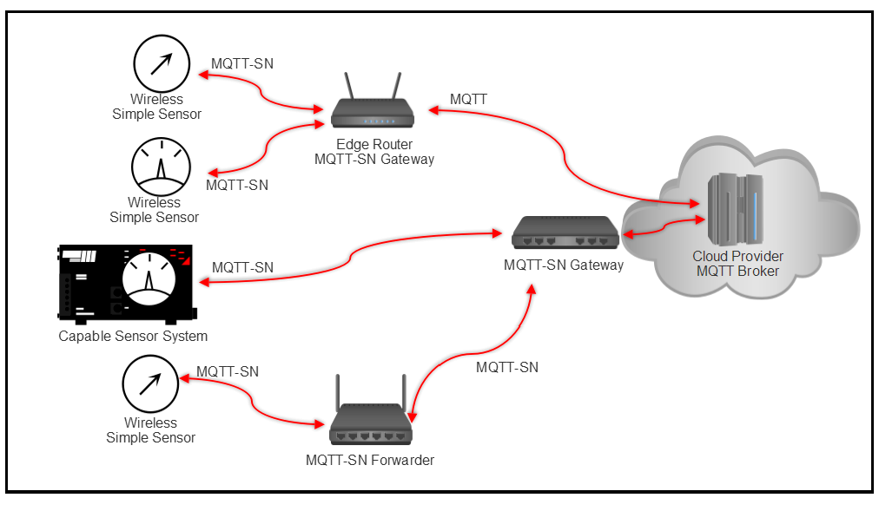
MQTT-SN topology

Slide 13
Differences between MQTT and MQTT-SN
The main differences between MQTT-SN and MQTT are as follows:
  There are three CONNECT messages in MQTT-SN versus one in MQTT.
  MQTT-SN can run over simplified medium and UDP.
  Topic names are replaced by short, two-byte long topic ID messages. This is to assist with bandwidth constraints in wireless networks.
  Pre-defined topic IDs and short topic names can be used without any registration.
  A revised keepAlive procedure is used in MQTT-SN. This is to support sleeping clients in which all messages destined for them are buffered by a server or edge-router and delivered upon awakening.

Slide 14
Constrained Application Protocol
The Constrained Application Protocol (CoAP) is the product of the IETF (RFC7228).
CoAP is excellent at providing a similar and easy structure of resource addressing familiar to anyone with experience of using the web but with reduced resources and bandwidth demands.
CoAP provides a similar functionality with significantly less overhead and power requirements.
Some implementations of CoAP perform up to 6x better than HTTP equivalents on similar hardware.

Slide 15
CoAP architecture details
CoAP features can be summarized as follows:
  HTTP-like
  Connection-less protocols
  Security through DTLS rather than TLS in a normal HTTP transmission
  Asynchronous message exchanges
  Lightweight design and resource requirements and low header overhead
  Support for URI and content-types
  Built upon UDP versus TCP/UDP for a normal HTTP session
  A stateless HTTP mapping allowing for proxies top bridge to HTTP sessions
CoAP is based on the concept of mimicking and replacing heavy HTTP abilities and usage with a lightweight equivalent for the IoT.

Slide 16
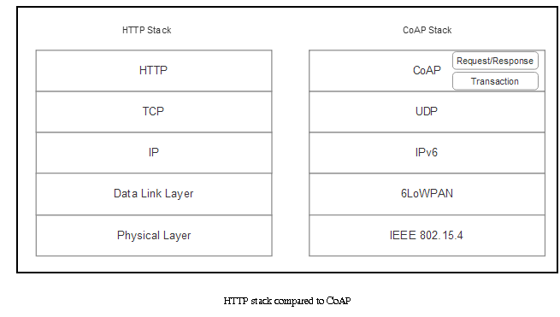
CoAP layers
CoAP has two basic layers:
  Request/Response layer: Responsible for sending and receiving RESTful-based queries. REST queries are piggybacked on CON or NON messages. A REST response is piggybacked on the corresponding ACK message.
  Transactional layer: Handles single message exchanges between endpoints using one of the four basic message types. The transaction layer also supports multicasting and congestion control

Slide 17
COAP details
CoAP shares context, syntax, and usage similarly to HTTP. Addressing in CoAP is also styled like HTTP. An address extends to the URI structure. As in HTTP URIs, the user must know the address beforehand to gain access to a resource. At the top-most level, CoAP uses requests such as GET, PUT, POST, and DELETE, as in HTTP. Similarly, response codes mimic HTTP, such as:
  Created, Deleted, Changed, Content, Not found (resource), Method not allowed
The form of a typical URI in CoAP would be:
  coap://host[:port]/[path][?query]
CoAP makes use of port 5683. This port must be supported by a server that offers resources since the port is used for resource discovery. Port 5684 is used when DTLS is enabled.

Slide 18
CoAP Main Actors
A CoAP system has seven main actors:
  Endpoints: These are the sources and destinations of a CoAP message.
  A CoAP endpoint that is tasked by CoAP clients to perform requests on its behalf.
  Client: The originator of a request. The destination endpoint of a response.
  Server: The destination endpoint of a request. The originator of a response.
  Intermediary: A client acting as both a server and client towards an origin server. A proxy is an intermediary.
  Origin servers: The server on which a given resource resides.
  Observers: An observer client can register itself using a modified GET message.
Observers are unique in CoAP and allow a device to watch for changes to a particular resource. In essence, this is similar to the MQTT subscribe model where a node will subscribe to an event.

Slide 19
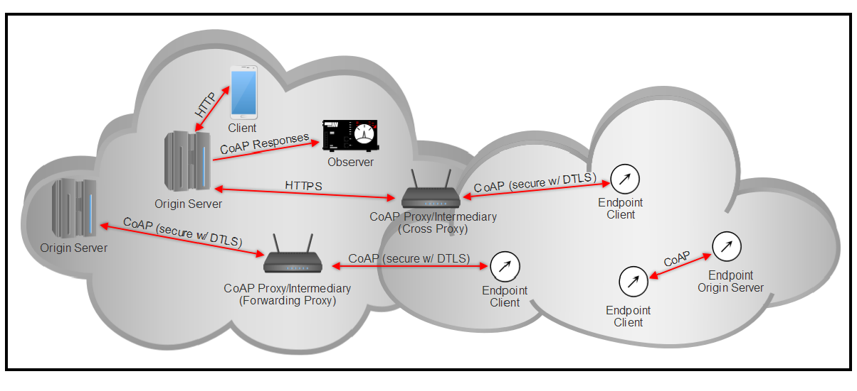
CoAP Architecture
CoAP endpoints can establish relationships with each other, even at the sensor level.
The two proxies allow for CoAP to perform HTTP translation or allow forwarding requests on behalf of a client.

Slide 20
STOMP
STOMP stands for Simple (or Streaming) Text Message-Oriented Middleware Protocol.
It is a text-based protocol designed by Codehaus to operate with message-oriented middleware.
A broker developed in one programming language can receive messages from a client written in another.
The protocol has similarities to HTTP and operates over TCP. STOMP consists of a frame header and a frame body.
It simply uses HTTP-like semantics such as SEND with a destination string. A broker must dissect the message and map to a topic or queue for the client. A consumer of the data will SUBSCRIBE to the destinations provided by the broker.
STOMP has clients written in python (Stomp.py), TCL (tStomp), and Erlang (stomp.erl). Several servers have native STOMP support, such as RabbitMQ (via a plugin), and some servers have been designed in specifics languages (Ruby, Perl, or OCaml).

Slide 21
AMQP
AMQP stands for Advanced Message Queuing Protocol.
It is a hardened and proven MOM protocol used by massive data sources such as JP Morgan Chase in processing over 1 billion messages per day, and the Ocean Observatory Initiative in collecting over 8 terabytes of oceanographic data each day.
Today it is well established in banking and credit transaction industries but has a place in IoT as well.
The AMQP protocol resides on top of the TCP stack and uses port 5672 for communication.
AMQP is a flow-controlled, message-orientated communication system.
It is a wire-level protocol and a low-level interface. A wire protocol refers to APIs immediately above the physical layer of a network. A wire-level API allows for different messaging services such as .NET (NMS) and Java (JMS) to communicate with each other.
AMQP attempts to decouple publishers from subscribers.

Slide 22
AMQP
Unlike MQTT it has mechanisms for load balancing and formal queuing.
A well-used protocol that is based on AMQP is RabbitMQ. RabbitMQ is an AMQP message broker written in Erlang. Additionally, several AMQP clients are available, such as the RabbitMQ client written in Java, C#, Javascript, and Erlang, as well as Apache Qpid written in Python, C++, C#, Java, and Ruby.

Slide 23
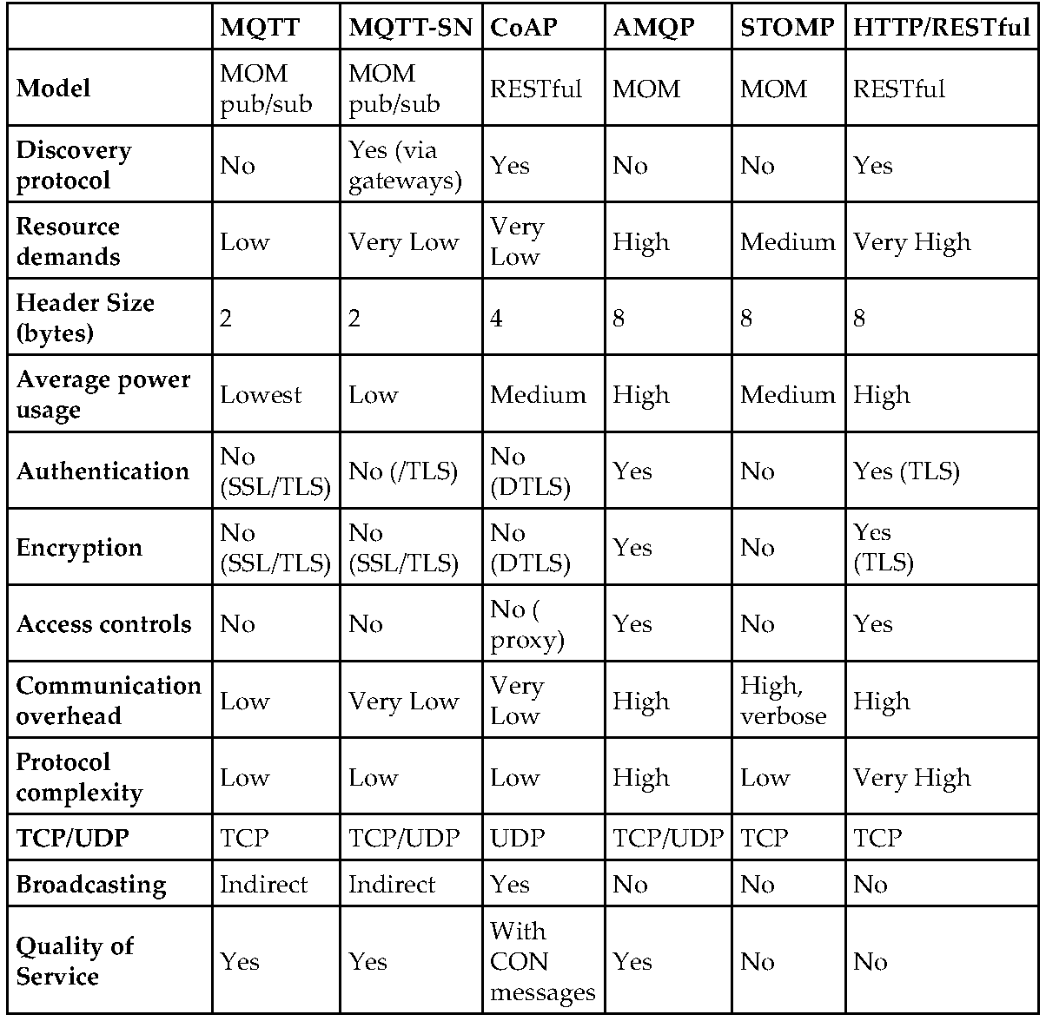
Protocol summary and comparison

