Slide 1
Long-Range Communication
Systems and Protocols (WAN)
By: Mahmood Ahmadi

Slide 2
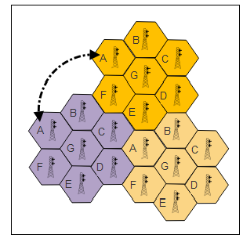
Cellular connectivity

Slide 3
Governance models and standards
The International Telecommunication Union (ITU) is a UN specialized agency and was founded in 1865; it took its present name in 1932.
It plays a significant role worldwide in wireless communication standards, navigation, mobile, internet, data, voice, and next-gen networks.
It includes 193 member nations and 700 public and private organizations.
It too has a number of working groups called sectors. The sector relevant to cellular standards is the Radiocommunication Sector (ITU-R).
The ITU-R has produced two fundamental specifications:
  International Mobile Telecommunications-2000 (IMT-2000), which specifies the requirements for a device to be marketed as 3G.
  International Mobile Telecommunications-Advanced (IMT-Advanced): The IMT-Advanced system is based on an all-IP mobile broadband wireless system.
The IMT-Advanced defines what can be marketed as 4G worldwide, Long-Term Evolution (LTE) and 5G.

Slide 4
Governance models and standards
The ITU-Advanced set of requirements for a cellular system to be labeled 4G include:
  Must be an all-IP, packet-switched network
  Interoperable with existing wireless
  A nominal data rate of 100 Mbps when the client is moving and 1 GBps while the client is fixed
  Dynamically share and use network resources to support more than one user per cell
  Scalable channel bandwidth of 5 to 20 MHz
  Seamless connectivity and global roaming across multiple networks

Slide 5
Eqvdxists naming and branding
20Gbs
6G, 2030, 1Tbs

Slide 6
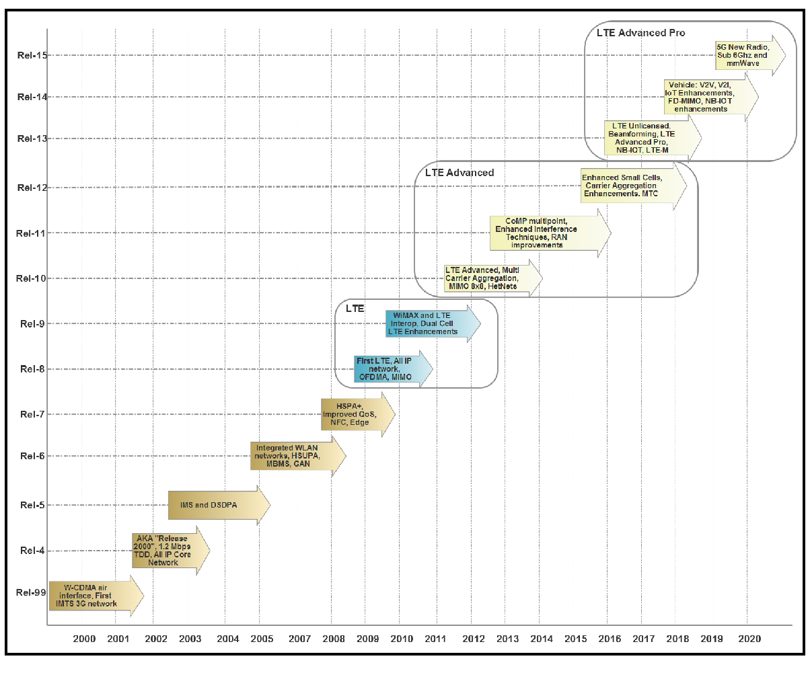
The LTE evolution technologies.

Slide 7
4G-LTE topology and architecture
In release 8 of the 3GPP roadmap, LTE was introduced. Since the network is entirely composed of IP packet-switched components, that means that voice data is also sent across as digital IP packets.
3G topology used circuit switching for voice and SMS traffic and packet switching for data.
The typical 4G-LTE network has three components: a client, a radio network, and a core network.
  The client is simply the user's radio device. The radio network represents frontend communication between the client and the core network and includes radio equipment such as the tower. The core network represents the management and control interface of the carrier and may manage one or more radio networks.

Slide 8
4G-LTE topology and architecture
The architecture can be decomposed as follows:
  Evolved Universal Terrestrial Radio Access Network (E-UTRAN): This is 4GLTE air interface to LTE UE devices. E-UTRAN uses OFDMA for the downlink portion and SC-FDMA for the uplink.
  eNodeB: This is the core of the radio network. It handles communications between the UE and the core (EPC).
  User Equipment (UE): This is the client hardware and is composed of Mobile Terminations (MT)
  Evolved Packet Core (EPC): In the design of LTE, the 3GPP decided to build a flat architecture, and separate user data (called the user plane) and control data (called the control plane).
    The EPC has five basic components listed here: Mobility Management Equipment (MME), Servicing Gateway (SGW), Public Data Network Gateway (PGW), Policy Control and Charging Rules Function (PCRF)
  Public Data Network (PDN): This is the external interface, and for the most part, the internet.

Slide 9
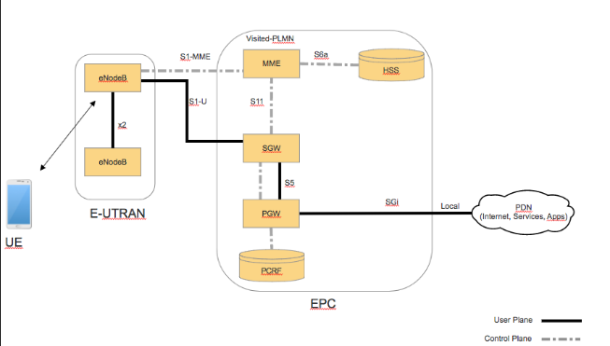
4G-LTE topology and architecture

Slide 10
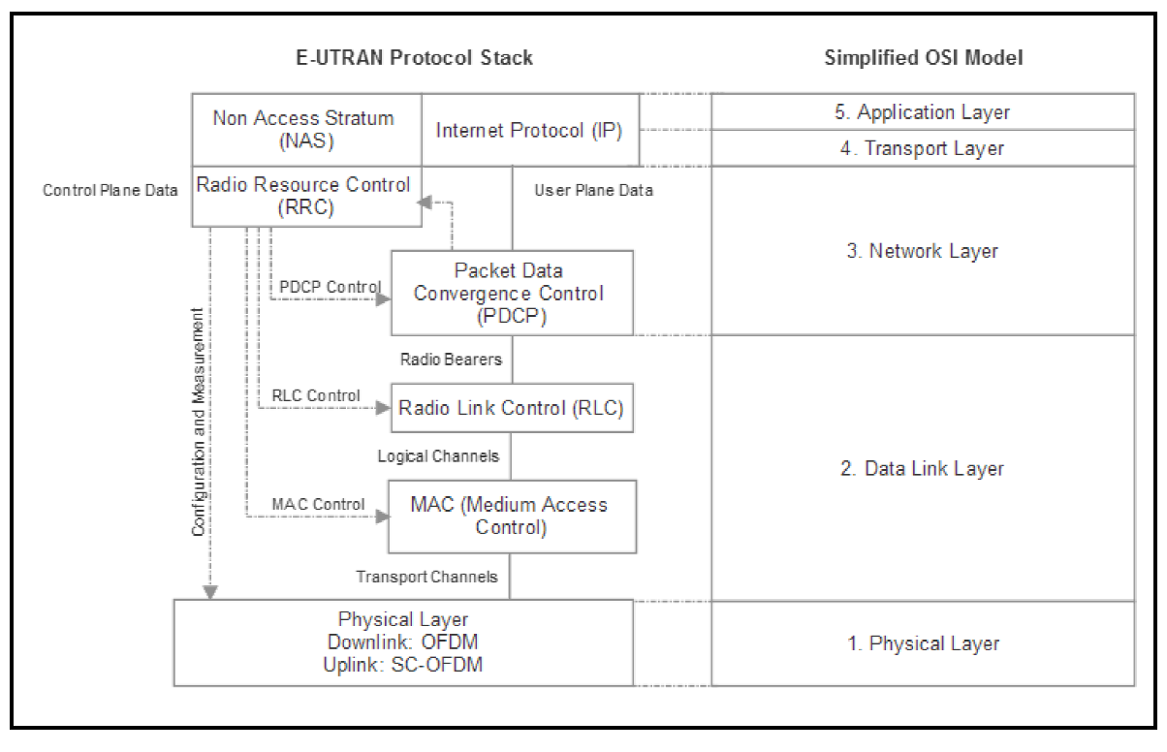
4G-LTE E-UTRAN protocol stack
Radio Link Control (RLC): RLC transfers upper layer PDUs, performs error correction via ARQ, and handles the concatenation/segmentation of packets.
Packet Data Convergence Control Protocol (PDCP): This layer is responsible for
packet compression and decompression. cipher and deciphering, integrity protection, timer-based discarding of data, and reestablishment of channels.
Radio Resource Control (RRC):manages security keys, configurations, and the control of radio bearers.
Non-Access Stratum:The principal role is session management, therefore the mobility of the UE is established at this level.

Slide 11
Cat 0, Cat 1, Cat M1, and NB-IoT
The connectivity of an IoT device to the internet is different from typical consumer-based cellular devices like a smartphone. A smartphone mainly pulls information off the internet in a downlink. Often that data is large and streaming in real time, such as video data and music data. In an IoT deployment, the data can be very sparse and arrive in short bursts. More often than not, the majority of data will be generated by the device and travel over the uplink.
Cat-M1, also known as enhanced Machine-Type Communication (and sometimes just called Cat-M), was designed to target IoT and M2M use cases with low cost, low power, and range enhancements.
The single largest difference is that the channel bandwidth is reduced from 20 MHz to 1.4 MHz. Reducing the channel bandwidth from a hardware point of view relaxes timing constraints, power, and circuitry. Costs are also reduced by up to 33% compared to Cat-0

Slide 12
LTE Cat-NB
Cat-NB, also known as NB-IoT, NB1, or Narrow Band IoT, is another LPWAN protocol.
The goal is to reduce power (10-year battery life), extend coverage (+20 dB), and reduce cost ($5 per module).
Significant differences between Cat-NB and Cat-M1 include:
  Very narrow channel bandwidth: As with Cat-M1, which reduced the channel width to 1.4 MHz, Cat-NB reduces it further to 180 kHz.
  No VoLTE: As the channel width is so low, it does not have the capacity for voice or video traffic.
  No mobility: Cat-NB will not support handover and must remain associated with a single cell or remain stationary

Slide 13
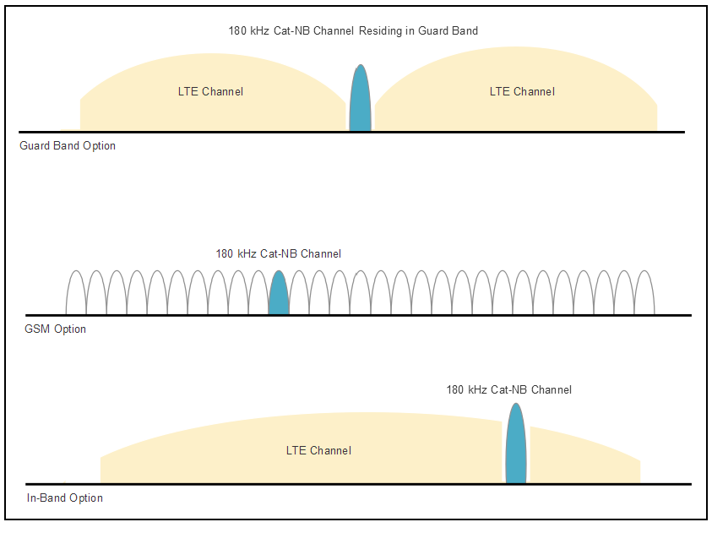
NB-IoT bands
200,000 devices in theory per cell

Slide 14
5G
5G promises to deliver substantial abilities for IoT, commercial, mobile, and vehicular use cases. 5G also improves bandwidth, latency, density, and user cost.
5G is aiming for initial customer launch in 2020.
The general consensus of features in 5G:
  Enhanced Mobile Broadband (eMBB):
    1 to 10 GBps connections to UEs/endpoints in the field (not theoretical)
    100% coverage across the globe (or perception of)
    10 to 100x the number of connected devices over 4G-LTE
  Ultra-Reliable and Low-Latency Communications (URLLC):
    Sub < 1 ms end-to-end round-trip latency
    99.999% availability (or perception of)
  Massive Machine Type Communications (mMTC):
    1000x bandwidth per unit area; this implies roughly 1 million nodes in 1 km2
    Up to a 10 year battery life on endpoint IoT nodes
    90% reduction in network energy usage

Slide 15
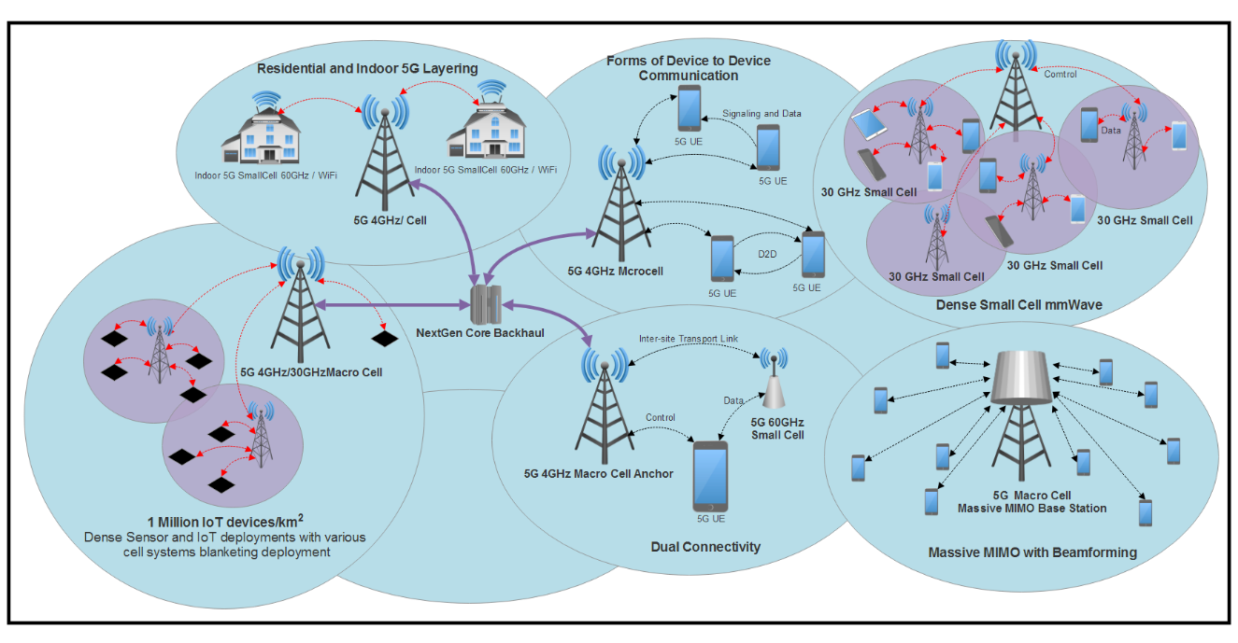
5G topology

Slide 16
LoRa and LoRaWAN
LoRa is a physical layer for a long-range and low-power IoT protocol while LoRaWAN represents the MAC layer.
The architecture was originally developed by Cycleo in France but then acquired by the Semtech Corporation.
One reason for the price difference, besides being in the unlicensed spectrum, is that a single LoRaWAN gateway has the potential to cover a significant amount of area. Belgium, with a land area of 30,500 km2, is completely covered by seven ≈167 LoRaWAN gateways

Slide 17
LoRa physical layer
LoRa represents the physical layer of a LoRaWAN network. It manages the modulation, power, receiver and transmission radios, and signal conditioning.
The architecture is based on the following bands in ISM license-free space:
  915 MHz: In the USA with power limits but no duty cycle limit.
  868 MHz: In Europe with a 1% and 10% duty cycle.
  433 MHz: In Asia.
LoRa networks have a powerful feature called Adaptive Data Rate (ADR). Essentially this enables dynamically scalable capacity based on the density of nodes and infrastructure.
Nodes that are close to a base station can be set to a higher data rate

Slide 18
LoRa physical layer

Slide 19
LoRaWAN MAC layer
The LoRaWAN MAC is an open protocol while the PHY is closed.
There are three MAC protocols that are part of the data link layer.
  Class-A is the best for energy mitigation while having the highest latency. Class-B is between Class-A and Class-C. Class-C has minimum latency but the highest energy usage.
Class-A devices are battery based sensors and endpoints.
  Class-A optimizes power by setting various Receive Delays during transmission.
  An endpoint starts by sending a packet of data to the gateway. After the transmission, the device will enter a sleep state until the Receive Delay timer expires. When the timer expires, the endpoint wakes and opens a receive slot and awaits a transmission for a period of time and then re-enters the sleep state.
Class-B devices balance power and latency.
  This type of device relies on a beacon being sent by the gateway at regular intervals. The beacon synchronizes all endpoints in the network and is broadcast to the network. When a device receives a beacon, it creates a ping slot which is a short reception window. During these pin slot periods, messages can be sent and received. At all other times, the device is in a sleep state.
Class-C endpoints use the most power but have the shortest latency.

Slide 20
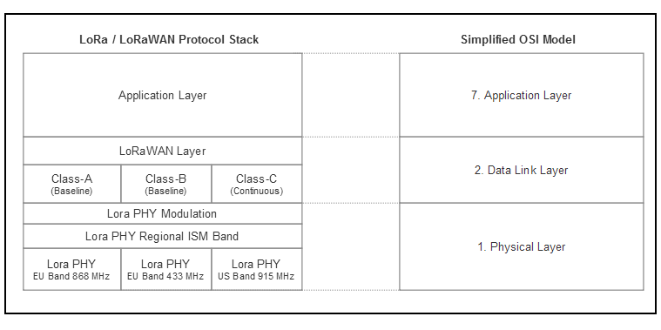
LoRa/LoRaWAN protocol stack
LoRaWAN is an asynchronous, ALOHA-based protocol.
In LoRaWAN, collisions only occur if transmissions use the same channels and spreading frequency.

Slide 21
LoRaWAN topology
LoRaWAN is based on a star network topology. For that matter, it can be said it supports star of stars topology.
The network service has the rules and logic to perform the necessary upper layers of the network stack.
If a node is mobile and moves from an antenna to antenna, the network services will capture multiple identical packets from different paths.
Responsibilities of the network services include:
  Duplicate packet identification and termination
  Security services
  Routing
  Acknowledgement messages
Additionally, LPWAN systems like LoRaWAN will have 5x to 10x fewer base stations for similar coverage to a 4G network.

Slide 22
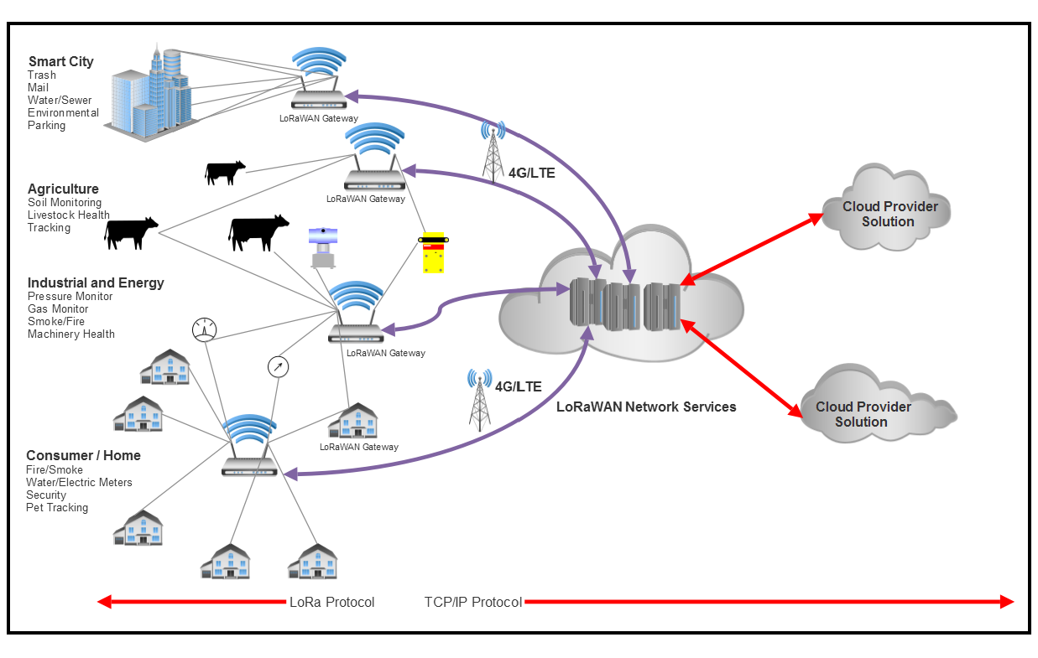
LoRaWAN network topology

Slide 23
LoRaWAN summary
LoRaWAN is not a complete network stack in the OSI model. It lacks the common features of a network layer, session layer, and transport layer: roaming, packetizations, retry mechanisms, QoS, and disconnects.
LoRaWAN is based on the ALOHA protocol. ALOHA complicates validation and acknowledgment as well as contributes to error rates over 50%.
LoRaWAN has high latency and no real-time ability.
Mobility and moving nodes are challenging to manage in LoRaWAN. A 40 to 60 byte message can take 1 to 1.5 s to transmit. This can be problematic for moving vehicles at highway speed. A base station also requires Linear Time Invariant(LTI) which means the radio waveform shouldn't change the time of flight.
Geo-location precision is about 100 m. Using RSSI signal strength measurements or time-of-flight measurements, a degree of accuracy can be obtained. The best solution is if three base stations triangulate a node. More base stations can improve the accuracy.

Slide 24
LPWAN protocols

