Slide 1
IP Based WPAN and WLAN
By: Mahmood Ahmadi

Slide 2
802.15 standards
WPAN networks have adopted protocols that are typically not TCP/IP
This chapter
  Internet protocol and transmission control protocol
  WPAN with IP – 6LoWPAN
  WPAN with IP – thread
  IEEE 802.11 protocols and WLAN

Slide 3
IP role in IoT
IP is the standard form of global communication for various reasons:
  Ubiquity: IP stacks are provided by nearly every operating system and every medium. IP communication protocols are capable of running on various WPAN systems, cellular, copper wire, fiber-optic, PCI Express, and satellite systems.
  Longevity: TCP was established in 1974, and the IPv4 standard still in use today was designed in 1978. It has withstood the test of time for 40 years. Longevity is paramount for many industrial and field IoT solutions that must support devices and systems for decades.
  Standards-based: TCP/IP is governed by the Internet Engineering Task Force (IETF).
  Scalability: IP has demonstrated scale and adoption. IP networks have demonstrated massive scaling to billions of users and many more devices.
  Reliability: IP at its heart is a reliable protocol for data transmission.
  Manageability: Various tools exist to manage IP networks and devices on an IP network. Modeling tools, network sniffers, diagnostic tools, and various appliances exist to assist in building, scaling, and maintaining networks.

Slide 4
WPAN with IP – 6LoWPAN
6LoWPAN is an acronym that stands for IPV6 over low power WPANs.
The principal advantage of 6LoWPAN is that the simplest of sensors can have IP addressability and act as a network citizen over 3G/4G/LTE/Wi-Fi/Ethernet routers.
A secondary effect is that IPV6 provides significant theoretical addressability of 2^128 or 3.4x10^38 unique addresses.
6LoWPAN networks are mesh networks residing on the periphery of larger networks.
6LoWPAN networks can be conjoined with multiple edge routers; this is called multi-homing.
An edge router (also known as border router) is necessary for a 6LoWPAN architecture as it has four functions:
  Handles the communication to the 6LoWPAN devices and relays data to the internet.
  Performs compression of IPv6 headers by reducing a 40-byte IPv6 header and 8- byte UDP headers for efficiency in a sensor network. A typical 40-byte IPv6 header can compress to two to 20-bytes depending on usage.
  Initiates the 6LoWPAN network.
  Exchanges data between devices on the 6LoWPAN network.

Slide 5
6-LOWPAN
There are three types of nodes within the 6LoWPAN mesh:
  Router nodes: These nodes marshal data from one 6LoWPAN mesh node to another. Routers can also communicate outward to the WAN and internet.
  Host nodes: Hosts in the mesh network cannot route data in the mesh and are simply endpoints consuming or producing data. Hosts are allowed to be in sleep states, occasionally waking to produce data or receive data cached by their parent routers.
  Edge routers: As stated, these are the gateways and mesh controllers usually at a WAN edge. A 6LoWPAN mesh would be administered under the edge router.

Slide 6
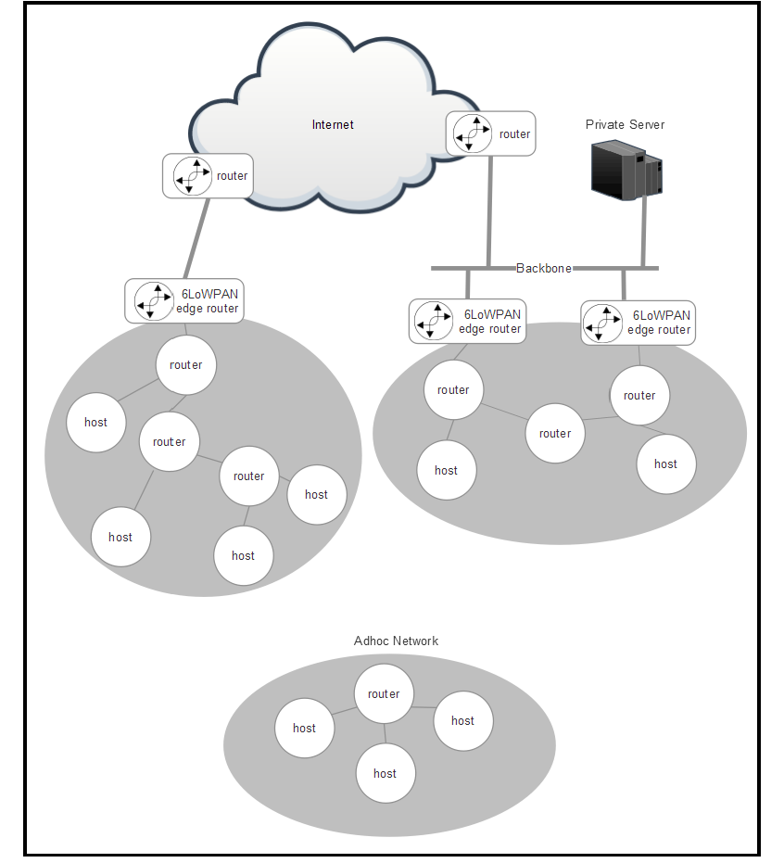
6LoWPAN topology
In an ad hoc mesh without an edge router, a 6LoWPAN router node could manage a 6LoWPAN mesh.
The router node would be configured to support two mandatory functions:
  Unique local unicast address generation
  Performing neighbor discovery ND registration

Slide 7
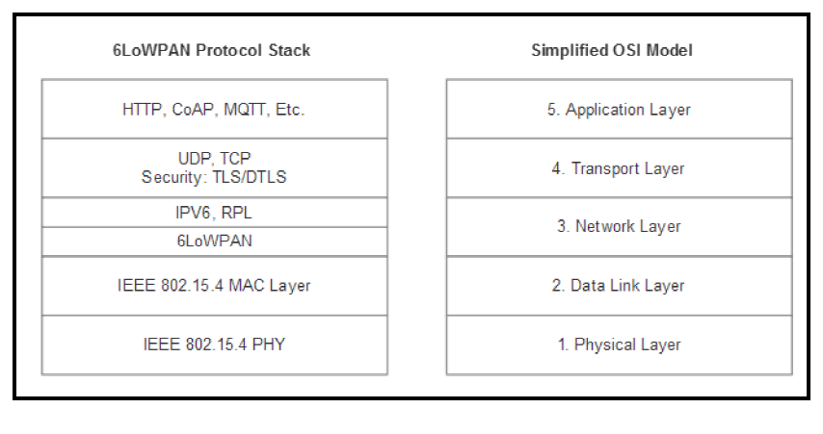
6LoWPAN protocol stack

Slide 8
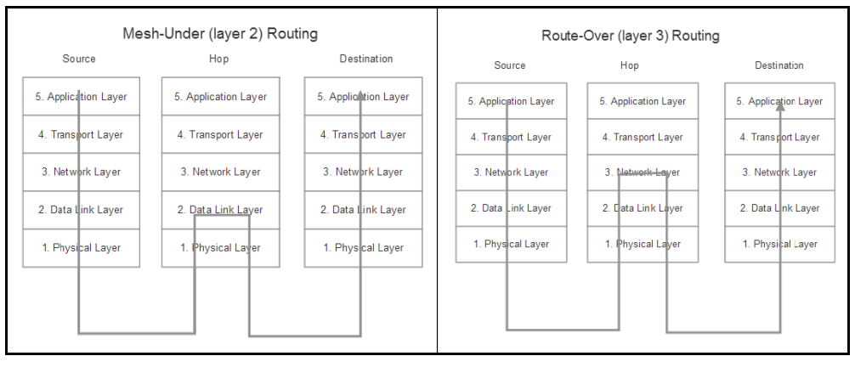
6LOWPAN-Mesh addressing and routing
Mesh-under network: In a mesh-under topology, routing is transparent and
assumes a single IP subnet representing the entirety of the mesh. A message is broadcast in a single domain and is sent to all devices in the mesh.
Route-over network: Route-over schemes manage routes at an IP level. Each hop represents one IP router.

Slide 9
6LoWPAN security
6LoWPAN provides for security at multiple levels.
At the 802.15.4 level two of the protocol, 6LoWPAN relies on AES-128 encryption of data.
802.15.4 provides a counter with CBCMAC mode (CCM) to provide encryption and an integrity check.
Most chipsets that provide an 802.15.4 network block also include a hardware encryption engine for performance improvement.
At layer three (the network layer) of the protocol, 6LoWPAN has the option to use Ipsec standard security.
In addition to link layer security, 6LoWPAN also utilizes Transport Layer Security (TLS) for TCP traffic and Datagram Transport Layer Security (DTLS) for UDP traffic.

Slide 10
WPAN with IP – Thread
Thread is a relatively new networking protocol for IoT and is based on IPV6 (6LoWPAN).
Its principal target is home connectivity and home automation.
Thread is also mesh-based, making it attractive for home lighting systems with up to 250 devices in a single mesh.
The philosophy with Thread is that by enabling IP addressability in the smallest of sensors and home automation systems, one can reduce power.
Thread uses the specification to define the Medium Access Controller (MAC) and physical (PHY) layers. It operates at 250 Kbps in the 2.4 GHz band.

Slide 11
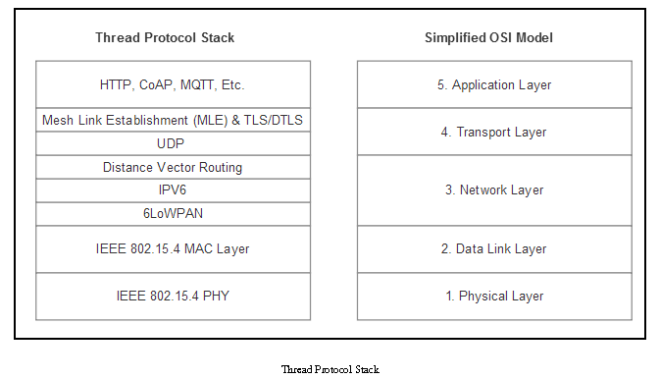
Thread protocol stack
Thread will make use of the full benefits of 6LoWPAN and enjoy the benefits of header compression, IPv6 addressing, and security.
It adds two additional stack components:
Distance vector routing
Mesh link establishment

Slide 12
IEEE 802.11 protocols and WLAN
The IEEE 802.11 is a suite of protocols with a rich history and different use cases.
802.11 is the specification defining the Media Access Controller (MAC) and physical layer (PHY) of a networking stack.
The original 802.11 goal was to provide a link layer protocol for wireless networking.
Specific 802.11 variants have been examined for use cases and segments such as low power/low bandwidth IoT interconnect (802.11ah), vehicle-to-vehicle communication (802.11p), reuse of television analog RF space (802.11af), extreme bandwidth near meter communication for audio/video (802.11ad), and of course the follow-on to the 802.11ac standard (802.11ax).

Slide 13
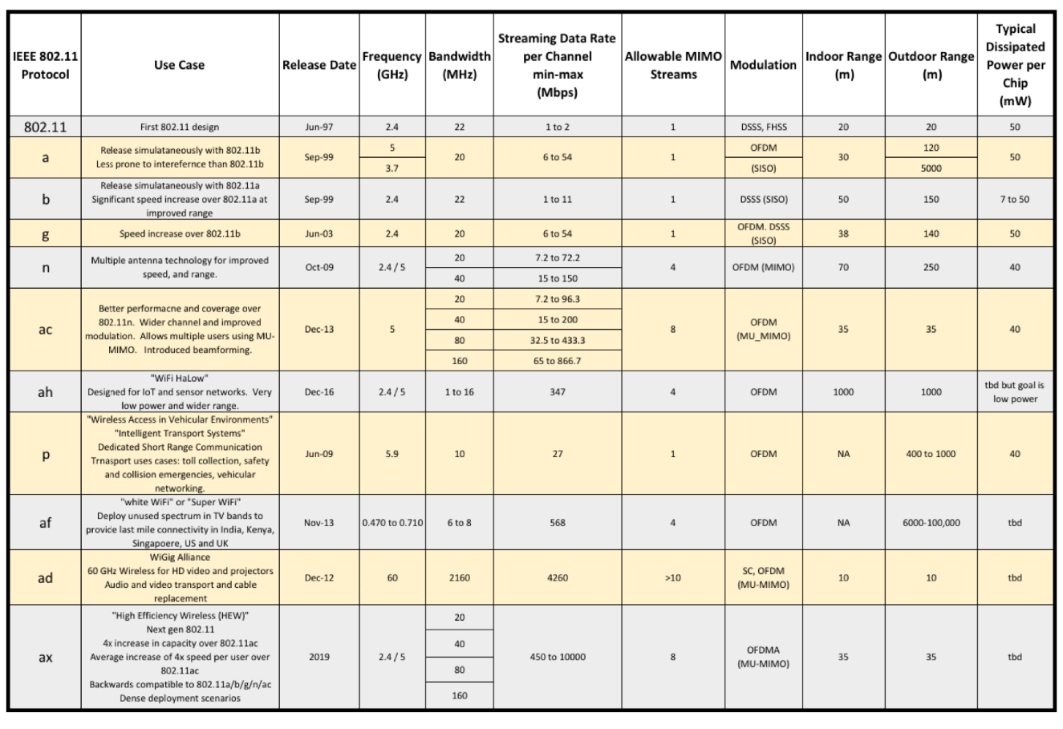
IEEE 802.11 suite of protocols and comparison

Slide 14
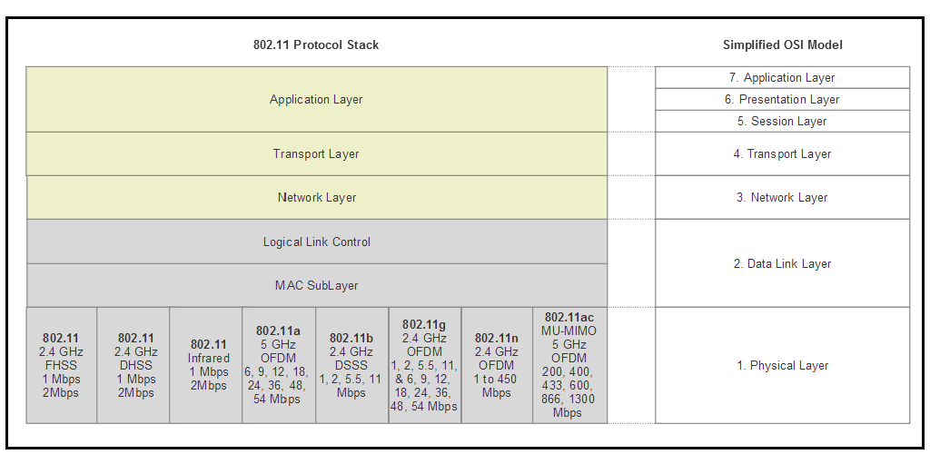
IEEE 802.11 architecture
The 802.11 protocol represents a family of wireless radio communications based on different modulation techniques in the 2.4 GHz and 5 GHz ISM bands of the unlicensed spectrum

Slide 15
IEEE 802.11 architecture
802.11 systems support three basic topologies:
  Infrastructure: In this form, a Station (STA) refers to an 802.11 endpoint device (like a Smartphone) that communicates with a central access point (AP). An AP can be a gateway to other networks (WAN), a router, or a true access point in a larger network. This is also known as Infrastructure Basic Set Service (BSS). This topology is a star topology.
  Ad hoc: 802.11 nodes can form what is called an Independent Basic Set Service (IBSS) where each station communicates and manages the interface to other stations. No access point or a star topology is used in this configuration. This is a peer-to-peer type of topology.
  Distribution system (DS): The DS combines two or more independent BSS networks through access point interconnects.
Note: IEEE802.11ah and IEEE802.11s support forms of a mesh topology.

Slide 16
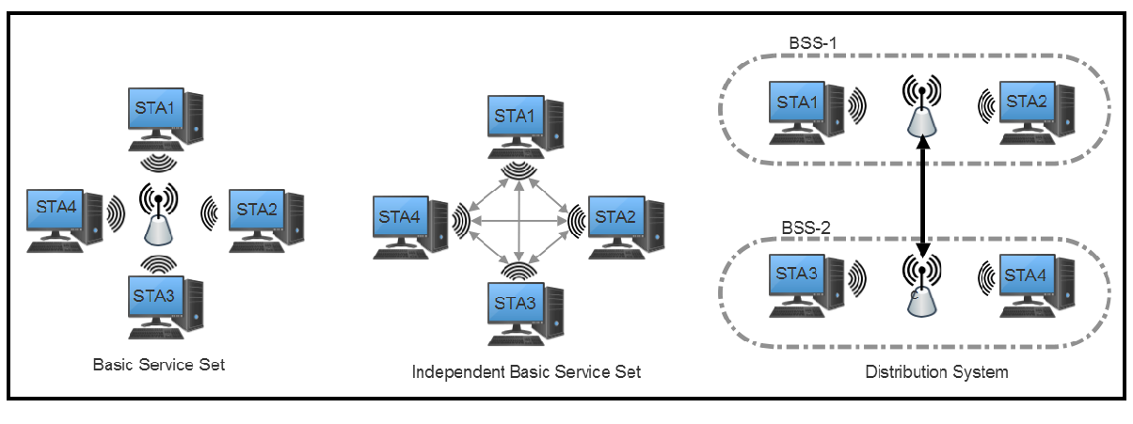
Three basic topologies of an IEEE 802.11 architecture
In total, the 802.11 protocol allows for up to 2007 STAs to be associated with a single access point. This is relevant when we use the IEEE 802.11ah for IoT

Slide 17
IEEE 802.11 spectrum allocation
The first 802.11 protocol used a spectrum in the 2 GHz and 5 GHz ISM region and evenly spaced channels roughly 20 MHz apart from each other.
The channel bandwidth was 20 MHz, but later amendments from IEEE allowed 5 MHz and 10 MHz to operate as well.
In the United States, 802.11b and g allow for eleven channels (other countries may support up to fourteen). Three of the channels are non-overlapping (1,6,11):

Slide 18
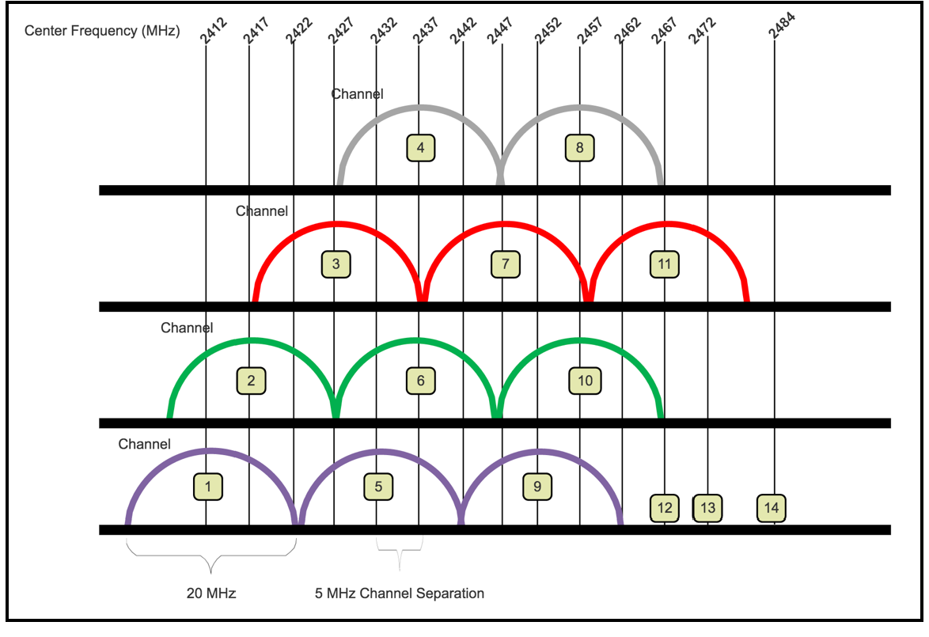
IEEE 802.11 spectrum allocation

Slide 19
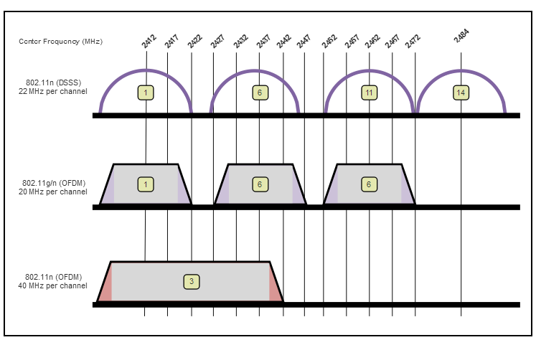
Differences between 802.11b,g, and n

Slide 20
IEEE 802.11 modulation and encoding techniques
The three basic forms include:
  Amplitude Shift Keying (ASK): This is a form of amplitude modulation. Binary 0 is represented by one form of modulation amplitude and 1 a different amplitude.
Frequency Shift Keying (FSK): This modulation technique modulates a carrier frequency to represent 0 or 1. The simplest form shown in the following figure is Binary Frequency Shift Keying (BPSK), which is the form used in 802.11 and other protocols.
Phase Shift Keying (PSK): Modulates the phase of a reference signal (carrier signal). Used primarily in 802.11b, Bluetooth, and RFID tags.

Slide 21
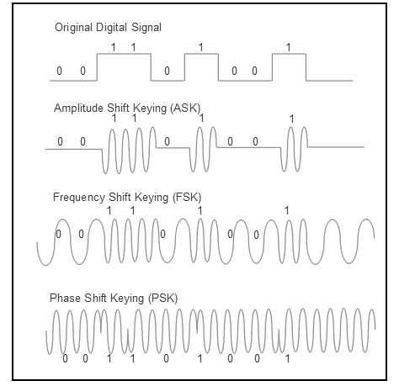
IEEE 802.11 modulation and encoding techniques

Slide 22
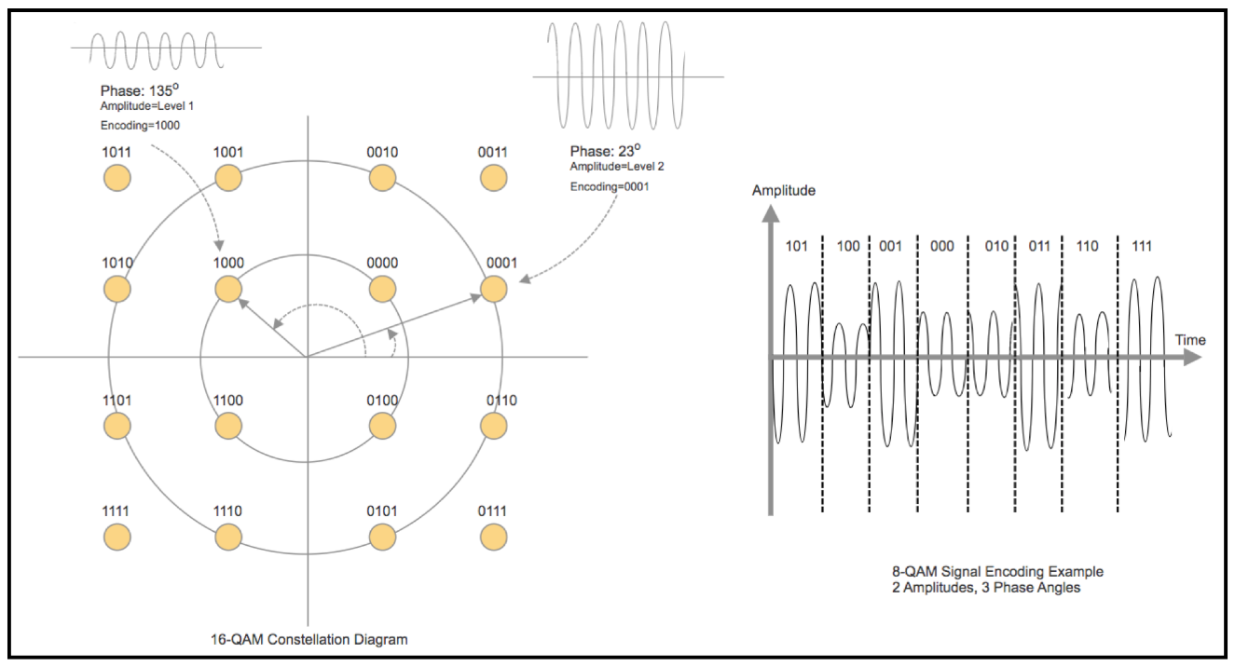
Quadrature Amplitude Modulation (QAM)
The 16-QAM has three amplitude levels and 12 total phases angles.
This allows for 16 bits to be encoded. 802.11a and 802.11g can use 16-QAM and even higher density 64-QAM.

Slide 23
IEEE 802.11 security
Various types of authentication used on Wi-Fi WLANs:
  WEP: Wired equivalent privacy. This mode sends a key in plain text from the client. The key is then encrypted and sent back to the client. WEP uses different size keys but they are typically 128 bit or 256 bit. WEP uses a shared key, which means that the same key is available to all clients.
  WPA: Wi-Fi protected access (or WPA-Enterprise) was developed as the IEEE 802.11i security standard. One significant difference is WPA uses a Temporal Key Integrity Protocol (TKIP), which performs per-packet key mixing and rekeying. This means that each packet will use a different key to encrypt itself, unlike in the case of WEP.
  WPA-PSK: WPA pre-shared key or WPA-Personal. This mode exists where there is no 802.11 authentication infrastructure. Here, one uses a passphrase as a preshared key. Each STA can have their own pre-shared key associated with its MAC address.
  WPA2: This replaces the original WPA design. WPA2 uses AES for encryption, which is much stronger than TKIP in WPA

Slide 24
IEEE 802.11p vehicle-to-vehicle
Vehicular networks (sometimes called vehicular ad hoc networks or VANET) are spontaneous and unstructured, operating as a car moves around a city while interacting with other vehicles and infrastructure.
The goal of this network is to provide a standard and secure V2V and V2I system used for vehicular safety, toll collection, traffic status/warnings, roadside assistance, and e-commerce within a vehicle.
There are two types of nodes in the network.
  First is the road-side unit (RSU), which is a fixed location device much like an access point. It services to bridge vehicles and moving devices to the internet for application service usage and access to trust authorities.
  The other node type is the on-board unit (OBU), which resides in the vehicle. It is capable of communicating to other OBUs and the fixed RSUs when needed.

Slide 25
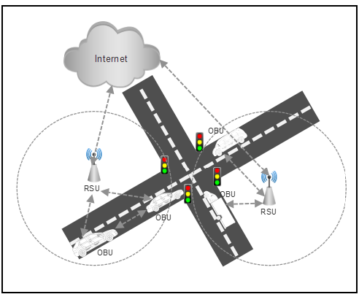
IEEE 802.11p vehicle-to-vehicle
The fundamental usage model of 802.11p is to create and associate to ad hoc networks
rapidly.

Slide 26
IEEE 802.11p Features and Differences
The features of IEEE 802.11p and differences with the IEEE 802.11a standards:
  Channel width is 10 MHz instead of 20 MHz used in 802.11a.
  IEEE 802.11p operates in the 75 MHz bandwidth of the 5.9 GHz space. This implies there are a total of seven channels available (one control channel, two critical, and four services channels).
  It supports half of the bit rates as compared to 802.11a; that is, 3/4.5/6/9/12/18/24/27 Mbps.
  It has the same modulation schemes such as BPSK/QPSK/16QAM/64QAM and 52 subcarriers.
  The symbol duration has become double compared to 802.11a: IEEE 802.11p supports 8 μs while 11a supports 4μs.

Slide 27
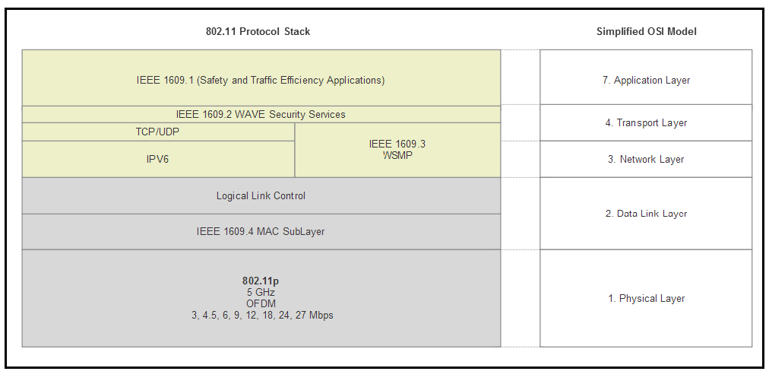
IEEE 802.11p protocol stack
1609.1: Wave resource manager. Allocates and provisions resources as needed.
1609.2: Defines security services for application and management messages. This layer also provides two modes of encryption. A public-key algorithm using the signing algorithm ECDSA can be used. Alternatively, a symmetric algorithm
based on AES-128 in CCM mode is available.
1609.3: Assists with connection setup and management of WAVE compliant
devices.
1609.4: Provides multi-channel operation above the 802.11p MAC layer.

Slide 28
IEEE 802.11ah
Based on 802.11ac architecture and PHY, 802.11ah is a variant of the wireless protocols targeted for the IoT. The design attempts to optimize for constrained sensor devices that require long battery life and can optimize range and bandwidth.
IEEE 802.11ah, specifications
  Operates in 900 MHz spectrum. This allows for good propagation and penetration of materials and atmospheric conditions.
  Fast association for networks of thousands of STAs using two different authentication methods to limit contention.
  Provides connectivity to thousands of devices under a single access point.
  Allows for advanced power management on each 802.11ah node.
  Allows for non-star topology communication through the use of Restricted Access Windows.
  Allows for sectorization, which enables antennas to be grouped to cover different regions of a BSS (called sectors).

Slide 29
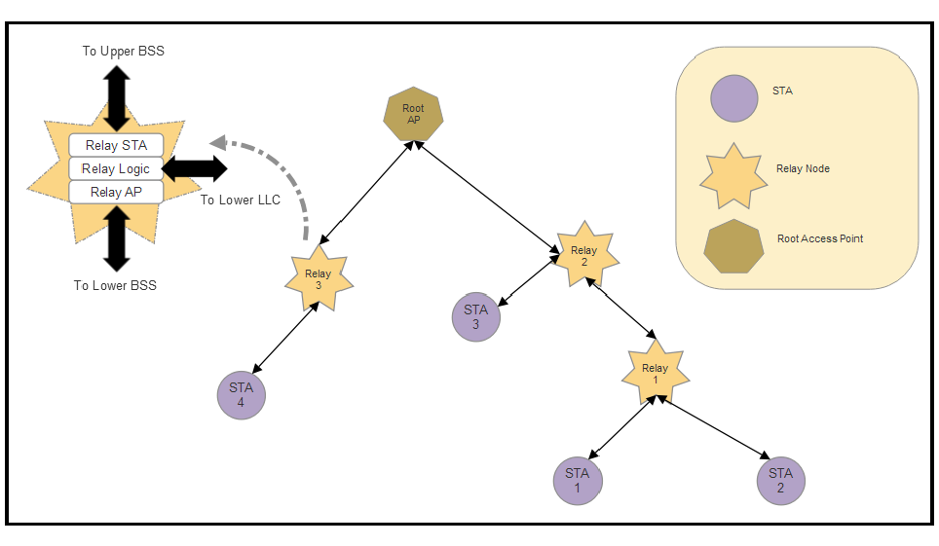
IEEE 802.11ah topology
There are three types of stations in an 802.11ah network:
  Root access point: The principle root. Typically, serves as a gateway to other networks (WAN).
  STA: The typical 802.11 station or end point client.
  Relay node: A special node that combines an AP interface to STAs residing to a lower BSS and an STA interface to other relay nodes or a root AP on the upper BSS.

Slide 30
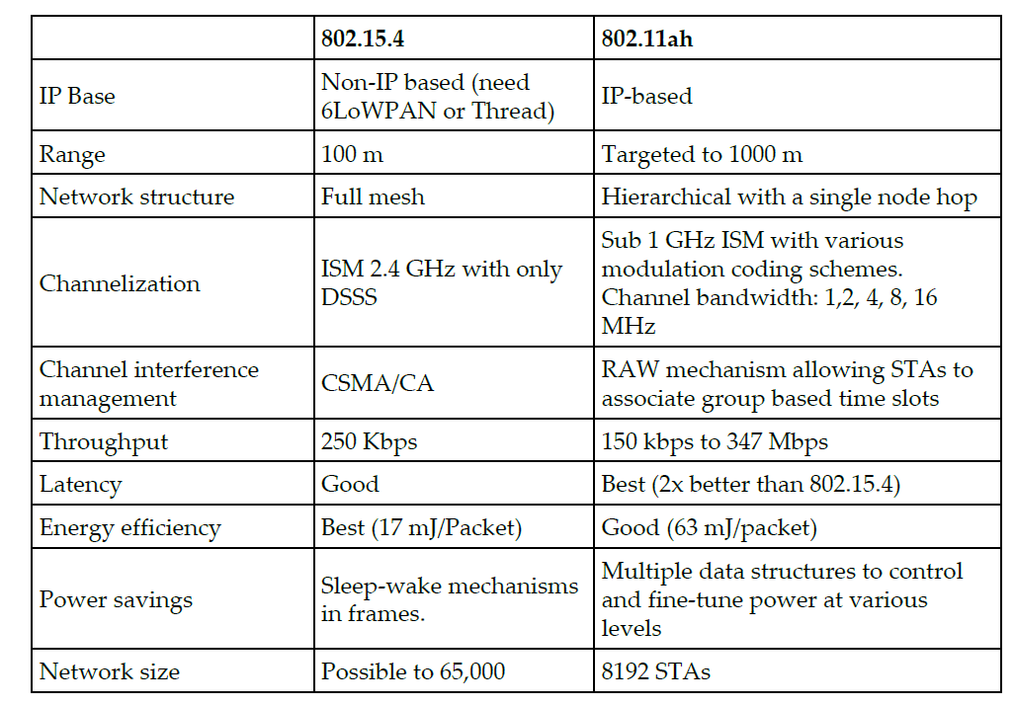
802.11ah vs 802.15.4

