Slide 1
Non-IP Based WPAN
By: Mahmood Ahmadi

Slide 2
802.15 standards
802.15 standards
  802.15: Wireless personal area network definitions
  802.15.1: Original foundation of the Bluetooth PAN
  802.15.2: Coexistence specifications for WPAN and WLAN for Bluetooth
  802.15.3: High data rate (55 Mbps+) on WPAN for multimedia
    802.15.3a, 802.15.3b, 802.15.3c
  802.15.4: Low data rate, simple, simple design, multi-year battery life specifications (Zigbee)
    802.15.4-2011, 802.15.4-2015, 802.15.4r, 802.15.4s, 802.15.4t
802.15.5: Mesh networking
802.15.6: Body area networking for medical and entertainment
802.15.7: Visible light communications using structured lighting

Slide 3
802.15 standards
802.15.8: Peer Aware Communications (PAC) infrastructure-less peer to peer at 10 Kbps to 55 Mbps
802.15.9: Key Management Protocol (KMP), management standard for key security
802.15.10: Layer 2 mesh routing, recommend mesh routing for 802.15.4, multi PAN
802.15.12: Upper layer interface, attempts to make 802.15.4 easier to use 802.11 or 802.3

Slide 4
Bluetooth
Bluetooth is a low-power wireless connectivity technology used pervasively in technology from cell phones sensors, and keyboards to video game systems.
Bluetooth technology was first conceived at Ericsson in 1994 with the intent to replace the litany of cables and cords connecting computer peripherals with an RF medium.
Bluetooth has been used extensively in IoT deployments for some time, being the principal device when used in low energy mode (LE) for beacons, wireless sensors, asset tracking systems, remote controls, health monitors, and alarm systems.
Bluetooth and all the optional components have been under GPL license and are essentially open source.

Slide 5
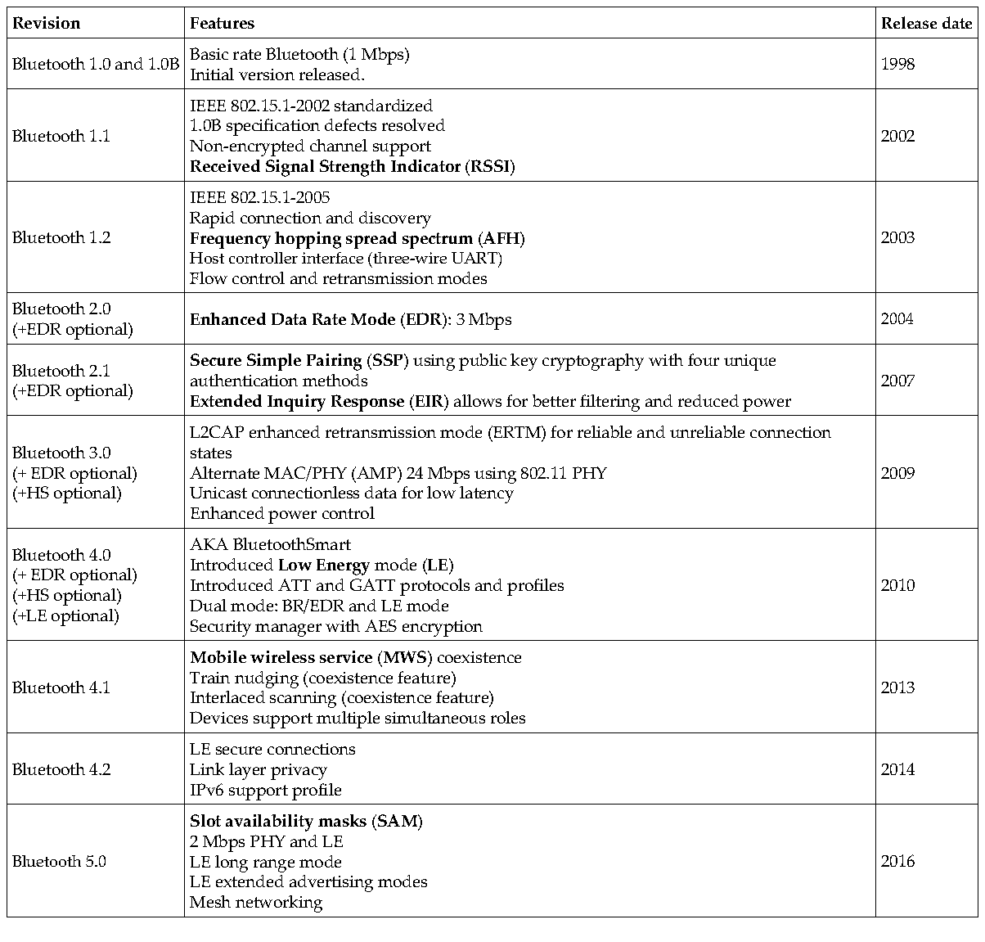
Bluetooth
The Bluetooth SIG released the Bluetooth Core Specification version 6.0 on 27 August 2024,and 6.1 in May 2025.

Slide 6
Bluetooth 5 communication process and topologies
Bluetooth wireless is comprised of two wireless technology systems: Basic Rate (BR) and Low Energy (LE or BLE).
Nodes can either be advertisers or scanners by this definition:
  Advertiser: Devices transmitting advertiser packets
  Scanner: Devices receiving advertiser packets without the intention to connect
  Initiator: Devices attempting to form a connection
There are several Bluetooth events that transpire in a Bluetooth WPAN:
  Advertising: Initiated by a device to broadcast to scanning devices to alert them of the presence of a device
  Connecting: This event is the process of pairing a device and a host.
  Periodic advertising: (for Bluetooth 5) allows an advertising device to periodically advertise over the 37 non-primary channels.
  Extended advertising: (for Bluetooth 5) allows for extended PDUs to support advertisement chaining and large PDU payloads,

Slide 7
Bluetooth 5 communication process and topologies
If a connection is formed, the advertising event ends and the initiator is now called the master and the advertiser is called the slave. This connection is termed a piconet in Bluetooth
Piconets form in two different fashions depending on BR/EDR (Bluetooth Basic Rate/ Enhanced Data Rate) mode or BLE mode.
In BR/EDR, the piconet uses three-bit addressing and can only reference seven slaves on one piconet. Multiple piconets can form a union and then be called a scatternet.
The slave/master node takes on the responsibility of bridging two piconets together.
In BR/EDR mode, the network uses the same frequency hopping schedule and all the nodes will be guaranteed to be on the same channel at a given time.

Slide 8
Bluetooth 5 communication process and topologies
In BLE mode, that system uses 24-bit addressing so the number of slaves associated with a master is in the millions.
Each master-slave relationship is itself a piconet and can be on a unique channel. In a piconet, nodes may be a master (M), slaves (S), standby (SB), or parked (P). Standby mode is the default state for a device. In this state, it has the option to be in a low-power mode. Up to 255 other devices can be in an SB or P mode on a single piconet.

Slide 9
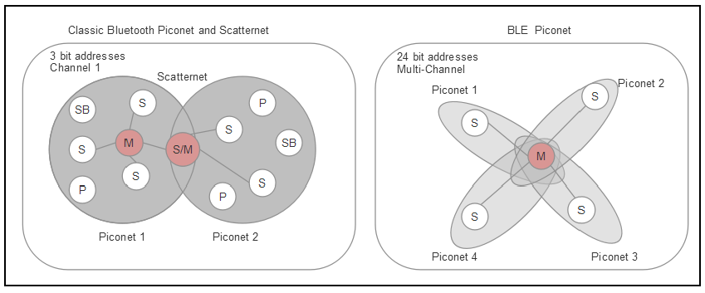
Piconet topologies
In BR/EDR mode up to seven slaves can be associated on a single piconet due to 3-bit addressing.

Slide 10
Bluethooth stack
Bluetooth has three basic components: a hardware controller, host software, and application profiles.
Bluetooth devices come in single and dual-mode versions (classic mode and BLE simultaneously).
The stack consists of layers, or protocols and profiles:
  Protocols: Horizontal tiers and layers representing functional blocks.
  Profiles: Represent vertical functions that use protocols.
There are essentially three Bluetooth modes of operation.
  Low Energy (LE) mode: This uses the 2.4 GHz. The PHY differs from BR/EDR and AMP radios by modulation, coding, and data rates. Bluetooth 5 allows for multiple configurable data rates of 125 Kbps, 500 Kbps, 1 Mbps, and 2 Mbps.
  Basic Rate/Enhanced Data Rate mode (BR/EDR): This uses a different radio than LE and AMP but operates in the ISM 2.4 GHz band. Basic radio operation is rated at 1 Msym/s and supports a bit rate of 1 Mbps. EDR sustains a data rate of 2 or 3 Mbps.
  Alternative MAC/PHY (AMP): This is an optional feature that uses 802.11 for high-speed transport up to 24 Mbps. This mode requires both the master and slave device to support AMP. This is a secondary physical controller, yet requires the system to have a BR/EDR controller to establish initial connection and negotiation.

Slide 11
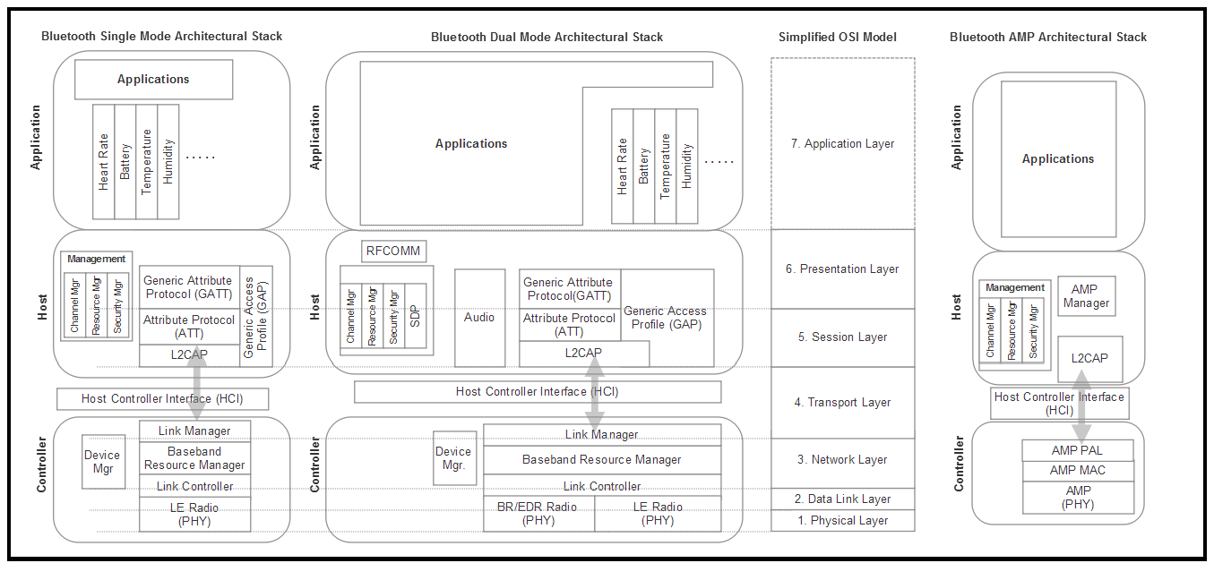
Bluethooth stack

Slide 12
Bluethooth stack architeture
Controller level:
  BR/EDR PHY (controller block): Responsible for transmitting and receiving packets through a physical channel on 79 channels.
  LE PHY: Low energy physical interface responsible for managing 40 channels and frequency hopping.
  Link controller: Encodes and decodes Bluetooth packets from the data payload.
  Baseband resource manager: Responsible for all access to the radio from any source.
  Link manager: Creates, modifies, and releases logical links and updates parameters related to physical links between devices.
  Device manager: Responsible for all operations not related to data transmission, including making devices discoverable or connectable, connecting to devices, and scanning for devices.
  Host Controller Interface (HCI): This is a separation between the host and the silicon controller in layer four of the network stack.

Slide 13
Bluethooth stack architeture
Host level:
  L2CAP: This is the logical link control and adaptation protocol.
  Channel manager: Responsible for creating, managing, and closing L2CAP channels. A master will use the L2CAP protocol to communicate to a slave channel manager.
  Resource manager: Responsible for managing the ordering of submission of fragments to the baseband level. Helps ensure the quality of service conformance.
  Security Manager Protocol (SMP): This block is responsible for generating keys, qualifying keys, and storing keys.
  Service Discovery Protocol (SDP): Discovers services offered on other devices by UUID.
  Audio: An optional efficient streaming audio playback profile.
  RFCOMM: This block is responsible for RS-232 emulation and interfacing and is used for supporting telephony functionality.

Slide 14
Bluethooth stack architeture
Host level:
  Attribute protocol (ATT): A wire application protocol used mainly in BLE (but can apply to BR/EDR). Optimized to run on BLE low power battery-based hardware.
  Generic Attribute Profile (GATT): This block represents the functionality of the attribute server and, optionally, the attribute client.
  Generic Access Profile (GAP): Controls connections and advertising states. Allows a device to be visible to the outside world and forms the basis of all other profiles.

Slide 15
Bluethooth stack architeture
AMP-specific stack:
  AMP (PHY): Physical layer responsible for transmission and reception of data packets up to 24 Mbps.
  AMP MAC: This is the media access control layer as defined in the IEEE 802 reference layer model. It provides address methods for the device.
  AMP PAL: Layer interfacing the AMP MAC with the host system (L2CAP and AMP manager). This block translates commands from the host into specific MAC primitives and vice versa.
  AMP manager: Uses L2CAP to communicate with a peer AMP manager on a remote device. Discovers remote AMP devices and determines their availability.

Slide 16
Bluetooth 5 PHY and interference
Bluetooth devices operate in the 2.4000 to 2.4835 GHz industrial, scientific, and medical(ISM) unlicensed frequency band.
To alleviate interference, Bluetooth supports frequency-hopping spread spectrum (FHSS).
BR/EDR mode has 79 channels and BLE has 40 channels. With 79 channels, BR/EDR mode has less than a 1.5 percent chance of interfering with another channel.
In BR/EDR mode, the physical channel is divided into slots. Data is positioned for transmission in precise slots and consecutive slots can be used if needed. By using this technique, Bluetooth achieves the effect of full-duplex communication through Time Division Duplexing (TDD). BR uses Gaussian Frequency-Shift Keying (GFSK) modulation to achieve its 1 Mbps rate, while EDR uses Differential Quaternary Phase Shift Keying (DQPSK) modulation to 2 Mbps and 8-phase differential phase-shift keying(8DPSK) at 3 Mbps.

Slide 17
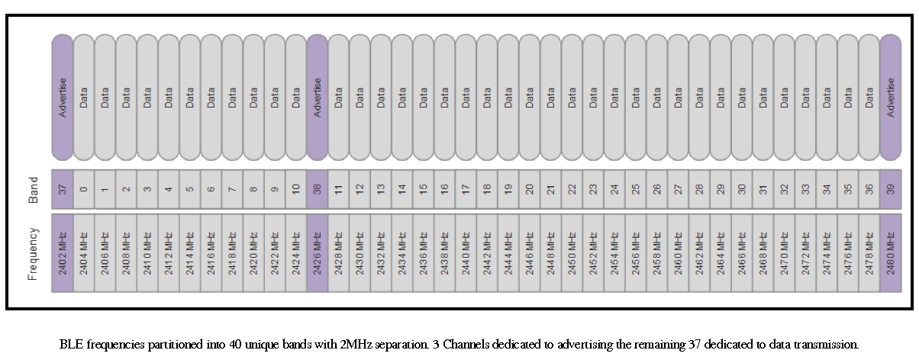
Bluetooth 5 PHY and interference

Slide 18
Bluetooth packet structure
Every Bluetooth device has a unique 48-bit address called the BD_ADDR.
The upper 24 bits of the BD_ADDR refer to the manufacturer specific address and are purchased through the IEEE Registration Authority. This address includes the Organization Unique Identifier (OUI), also known as the company ID, and is assigned by the IEEE.
The 24 least significant bits are free for the company to modify.

Slide 19
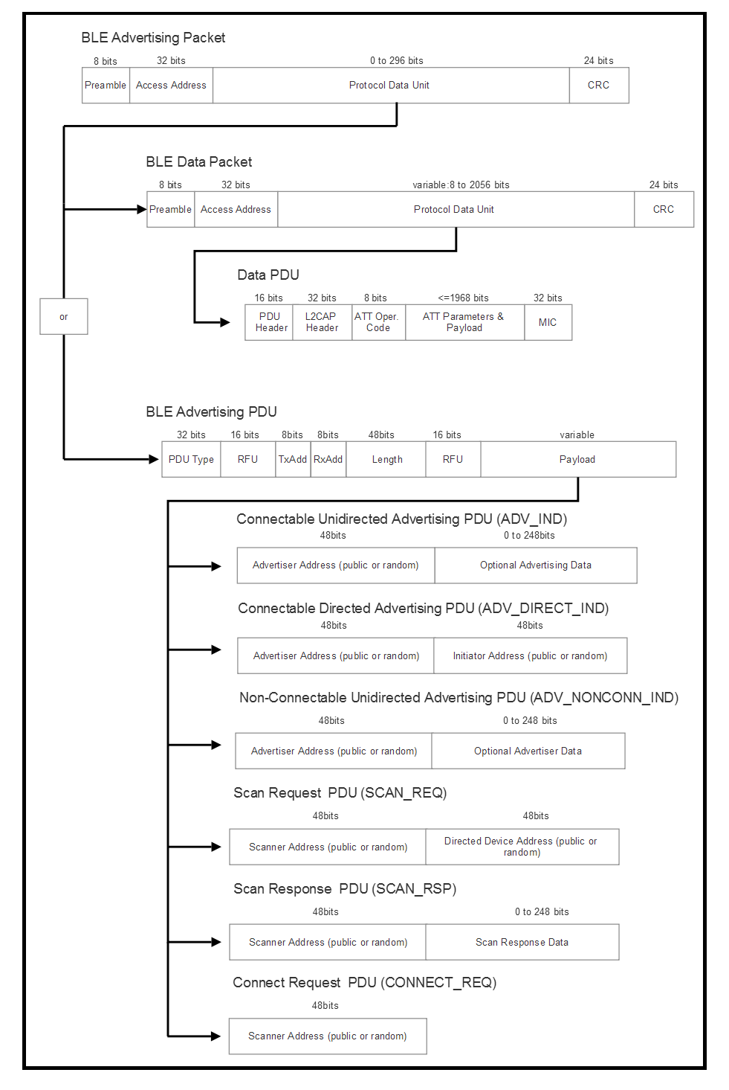
Bluetooth packet

Slide 20
BR/EDR operation
Classic Bluetooth (BR/EDR) mode is connection-orientated.
If a device is connected, the link is maintained even if no data is in being communicated.
The connection process proceeds in three steps:
  Inquiry: In this phase, two Bluetooth devices have never associated or bonded; they know nothing of each other. The devices must discover each other through an inquiry request.
  Paging: Paging or connecting forms a connection between the two devices. Each device knows the BD_ADDR of each other at this point.
  Connected: This is the normal state when two devices are actively communicating:
    Active mode: This is the normal mode of operation for transmission and receiving of Bluetooth data
    Sniff mode: This is a power saving mode. The device is essentially asleep but will listen for transmissions during specific slots that can be changed programmatically (for example, 50 ms).
    Hold mode: This is a temporary low power mode initiated by the master or slave. It will not listen for transmissions like sniff mode, and the slave temporarily ignores ACL packets.
    Park mode: As stated earlier, this mode is deprecated in Bluetooth 5.

Slide 21
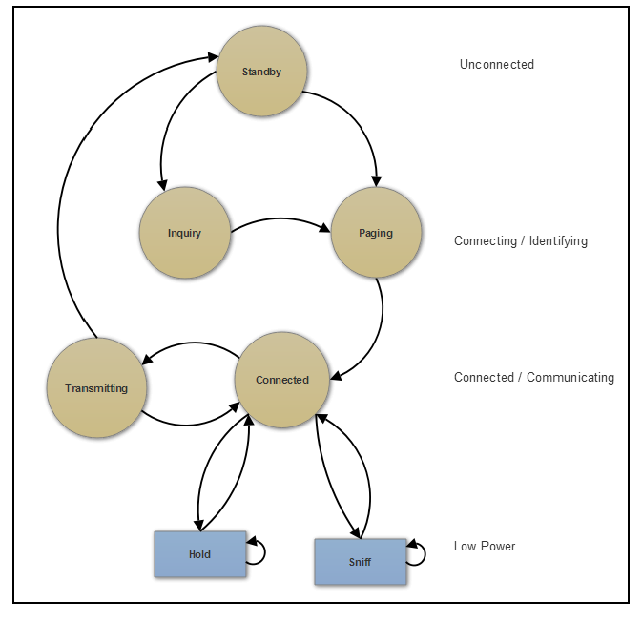
Connection process for Bluetooth (BR/EDR)
If this process completes successfully, the two devices can be forced to automatically connect when they are in range

Slide 22
BLE operation
In Bluetooth Low Energy mode, there are five link states:
  Advertising: Devices that transmit the advertising packets on the advertising channels.
  Scanning: Devices that receive advertising on the advertising channels without intention to connect.
    Active scanning: Link layer listens for advertising PDUs.
    Passive scanning: Link layer will only receive packets, transmission disabled.
  Initiating: Devices that need to form a connection to another device listen for connectable advertising packets and initiate by sending a connect packet.
  Connected: There is a relationship between master and slave in the connected state. The master is the initiator and the slave is the advertiser:
    Central: An initiator transforms the role and title to the central device.
    Peripheral: Advertising device becomes the peripheral device.
  Standby: Device in the unconnected state.

Slide 23
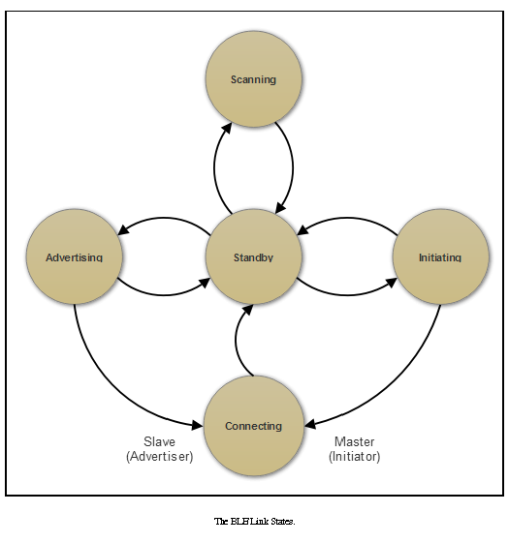
BLE state diagram
Advertisements can be general
advertisements where a device broadcasts a general invitation to some other device on the network. A directed advertisement is unique and designed to invite a specific peer to connect as fast as possible.

Slide 24
BR/EDR security
Bluetooth security has existed as part of the protocol since 1.0 in some form.
Pairing requires the generation of a secret symmetric key. In BR/EDR mode, this is called the link key, while in BLE mode it's termed the long-term key.
Older Bluetooth devices used a Personal Identification Number (PIN) pairing mode to initiate link keys. Newer devices (4.1+) use secure simple pairing.
Secure Simple Pairing (SSP) provides a pairing process with a number of different association models for various use cases. SSP also uses public key cryptography to protect from eavesdropping and Man-in-the-Middle attacks (MITM).
The models supported by SSP include:
  Numeric comparison: For use cases where both Bluetooth devices can display a six-digit numeric value allowing a user to enter a yes/no response on each device if the numbers match.
  Passkey entry: Used in situations where one device has a numeric display and the other only has a numeric keyboard.
  Just WorksTM : For situations where one device is headless and has no keyboard or display.
  Out-of-band (OOB): This is used when the device has a secondary form of communication such as NFC or Wi-Fi.

Slide 25
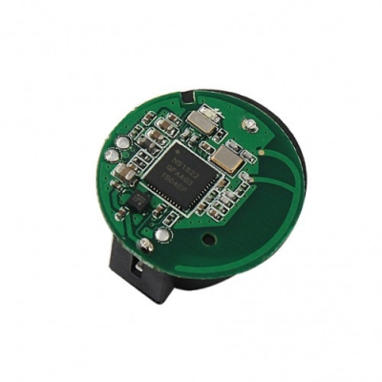
Beaconing
Bluetooth beaconing is a secondary effect of BLE;
Beaconing is simply using Bluetooth devices in LE mode to advertise on some periodic basis.
Beacons never connect or pair with a host.
Beacons applications:
  Static point of Interest (POI)
  Broadcasting telemetry data
  Indoor positioning and geolocation services
  healthcare, asset tracking, logistics
The signal strength of beacons is calibrated by manufacturers typically at a one-meter length.
There are two fundamental beaconing protocols used: Eddystone by Google and iBeacon by Apple.

Slide 26
Beaconing
Indoor navigation can be performed in three different ways:
  Multiple beacons per room: This is a simple triangulation method to determine a user's location-based on the advertised RSSI signal strength collected from numerous beacons in a room.
  One beacon per room: In this scheme, one beacon is placed in each room, allowing a user to navigate between rooms and halls with the fidelity of the location being a room. This is useful in museums, airports, concert venues, and so on.
  Few beacons per building
The beacon advertises every 150ms on the dedicated channels 37,38,39.

Slide 27
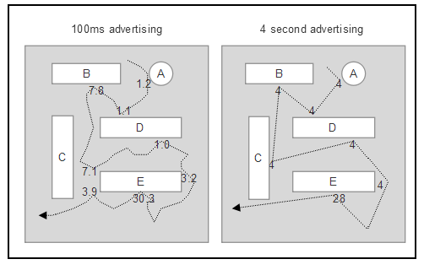
Beaconing
There are two fundamental challenges with architecting a beacon system. The first is the effect of advertising intervals versus the fidelity of location tracking. The second is the effect of advertising intervals versus the longevity of the battery powering the beacon.

Slide 28
Beaconing
Assume an iBeacon is advertised every 500 ms and the packet length is 31 bytes (it may be longer). Additionally, the device uses a CR2032 coin cell battery rated at 220mAh at 3.7V. The beacon electronics consume 49uA at 3V. We can now predict the life of the beacon and the efficiency of the transmission:

Slide 29
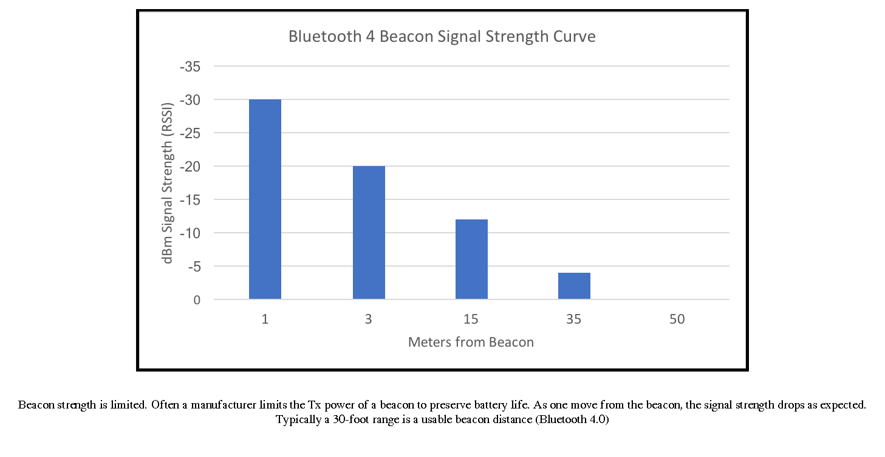
Beaconing

Slide 30
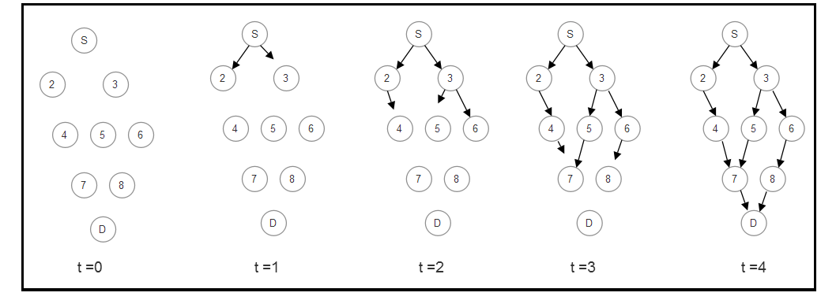
Bluetooth mesh
The Bluetooth SIG published the mesh profile, device, and model specification 1.0 on July 13, 2017.
As of the 1.0 specification, there can be up to 32,767 nodes in a Bluetooth mesh and 16,384 physical groups. The maximum time-to-live, which is indicative of the depth of the mesh, is 127.

Slide 31
IEEE 802.15.4
IEEE 802.15.4 forms the basis of many other protocols including Thread Zigbee WirelessHART, and others.
802.15.4 only defines the bottom portion (PHY and data link layer) of the stack and not the upper layers.
The goal of 802.15.4 and the protocols that sit on it are low-cost WPAN with low power consumption.
The IEEE 802.15.4 protocol operates in the unlicensed spectrum in three different radio frequency bands: 868 MHz, 915 MHz, and 2400 MHz.

Slide 32
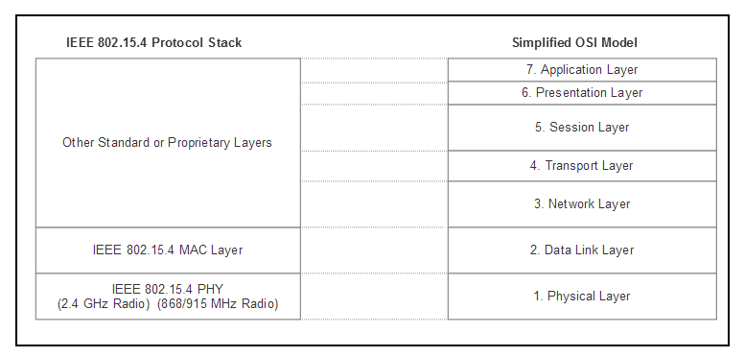
IEEE 802.15.4 architecture

Slide 33
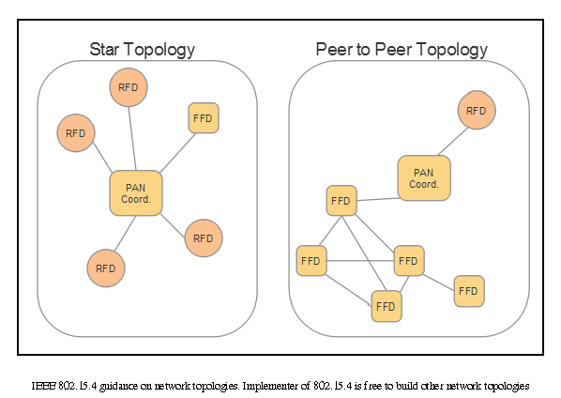
IEEE 802.15.4 topology
There are two fundamental device types in IEEE 802.15.4:
  Full function device (FFD): Supports any network topology, can be a network (PAN) coordinator and can communicate to any device PAN coordinator
  Reduced function device (RFD): Limited to only a star topology, cannot perform as a network coordinator, can only communicate with a network coordinator
The PAN coordinator has a unique role that is to set up and manage the PAN.

Slide 34
Zigbee
Zigbee is a WPAN protocol based on the IEEE 802.15.4 foundation targeted for commercial and residential IoT networking that is constrained by cost, power, and space.
Zigbee got its name from the concept of a bee flying.
Zigbee is based on 802.15.4 but layers on network services similar to TCP/IP. It can form networks, discover devices, provide security, and manage the network.
Zigbee prides itself on simplicity and claims a 50% reduction in software support by using a lightweight protocol stack.
There are three principal components in a Zigbee network:
  Zigbee controller (ZC): Highly capable device on a Zigbee network that is used to form and initiate network functions. Each Zigbee network will have a single ZC that fulfills the role of an 802.15.4 2003 PAN coordinator (FFD). After the network is formed, the ZC can behave as a ZR (Zigbee router).

Slide 35
Zigbee
  Zigbee router (ZR): This component is optional but handles some of a load of mesh network hopping and routing coordination.
  Zigbee end device (ZED): This is usually a simple endpoint device such as a light switch or thermostat. It contains enough functionality to communicate with the coordinator. It has no routing logic; therefore, any messages arriving at a ZED that are not targeted to that end device are simply relayed.
Zigbee supports three basic topologies:
  Star network: A single ZC with one or more ZEDs. Only extends two hops and is therefore limited in node distance.
  Cluster tree: A multi-hop network that employs beaconing and extends the network coverage and range over a star network. ZC and ZR nodes can have children, but ZEDs remain true endpoints.
  Mesh network: Dynamic path formation and morphing. Routing can occur from any source device to any destination device. Uses tree and table-driven routing algorithms. ZC and ZR radios must be powered at all times to perform routing duties, consuming battery life.

Slide 36
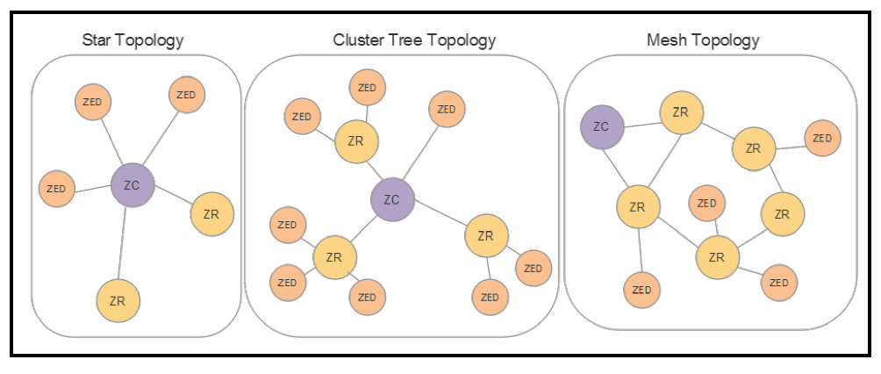
Zigbee Topologies
Zigbee, in theory, can deploy up to 65,536 Zigbee End Devices (ZED).

Slide 37
Zigbee PHY and MAC
Zigbee, like Bluetooth, operates primarily in the 2.4 GHz ISM band. Unlike Bluetooth, it also operates at 868 MHz in Europe and 915 MHz in the USA and Australia.
Zigbee does make use of the CSMA/CA collision avoidance scheme.

Slide 38
Zigbee protocol stack
The Zigbee protocol stack includes a network layer (NWK) and an application layer (APS).
The NWK is responsible for transferring network packets and routing of messages. During the process of joining nodes to a Zigbee mesh, the NWK provides the logical network address for the ZC and secures a connection.
The APS provides an interface between the network layer and application layer. It manages the binding table database, which is used to find the correct device depending on the service that is needed versus a service that is offered.
Applications are modeled by what are termed application objects. Application objects communicate with each other through a map of object attributes called clusters. Communication between objects is created in a compressed XML file to allow for ubiquity. All devices must support a basic set of methods; however, a total of 240 endpoints can exist per Zigbee device.
The APS interfaces the Zigbee device to a user. The majority of components in the Zigbee protocol reside here, including the Zigbee device object (ZDO).

Slide 39
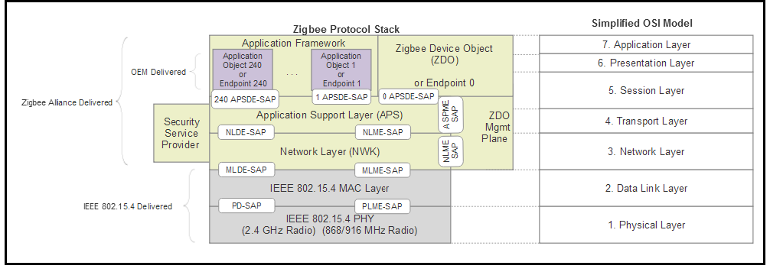
Zigbee protocol stack
The bindings are connections between two endpoints with each binding supporting a
particular application profile. Therefore, when we combine the source and a destination endpoint, the cluster ID, and profile ID, we can create a unique message between two endpoints and two devices. Bindings can be one-to-one, one-to-many, or many-to-one.

Slide 40
Zigbee addressing
Zigbee uses two unique addresses per node:
  Long address (64 bit): Assigned by the manufacturer of the device and is immutable. Uniquely identifies the Zigbee device from all other Zigbee devices. This is the same as the 802.15.4 64-bit address. The top 24 bits refer to the organizational unique identifier (OUI) and the bottom 40 bits are managed by the OEM. The addresses are managed in blocks and can be purchased through IEEE.
  Short address (16 bit): This too is the same as the PAN ID of the 802.15.4 specification and is also optional.
Zigbee mesh routing: table routing uses Ad Hoc On-Demand Distance Vector Routing (AODV) and the Cluster Tree Algorithm.
Zigbee has the ability to route packets in multiple manners:
  Broadcasting: Transmit packet to all other nodes in the fabric.
  Mesh routing (table routing):Zigbee will allow a mesh and table to route up to 30 hops away.
  Tree routing: Unicast messaging from one node to another.
  Source routing: Used primarily when a data concentrator is present.

Slide 41
Z-Wave
Z-Wave's design center is home and consumer lighting/automation.
There are three data rates that Z-Wave is capable
  100 Kbps: 916.0 MHz with a 400 KHz spread
  40 Kbps: 916.0 MHz with a 300 KHz spread
  9.6 Kbps: 908.4 MHz with a 300 KHz spread
Z-Wave limits the routing hops to a maximum of four.
Z-Wave addressing
  Home ID: This is a 32-bit unique identifier that is preprogrammed in controller devices.
  Node ID: This is an 8-bit value that is assigned to each slave by the controller

