Slide 1
IoT Hardware Platforms
By: Mahmood Ahmadi

Slide 2
Rererences
A chapter of book:
  Chapter 7, Internet of Things Architectures, Protocols and Standards, Simone Cirani, Gianluigi Ferrari, Marco Picone, Luca Veltri, Wiley, 2019

Slide 3
Hardware for the IoT
high-level view of the main hardware components in a smart object
  Communication module: It is typically either a radio transceiver with an antenna or a wired connection.
  Microcontroller: It is a small microprocessor that runs the software of the smart object.
  Sensors or actuators: These give the smart object a way to sense and interact with the physical world.
  Power source: This is needed because the smart object contains electrical circuits. The most common power source is a battery.

Slide 4
Hardware Platforms: TelosB
TelosB is a mote from Memsic Technology.
The TelosB was developed by the University of California, Berkeley.
It is comprises the MSP430 (the MSP430F1611) microcontroller and a CC2420 radio chip.
The micro-controller of this mote operates at 415 MHz and has 10 kB internal RAM and a 48kB programmable ﬂash memory.
IEEE 802.15.4 compliant
Integrated onboard antenna

Slide 5
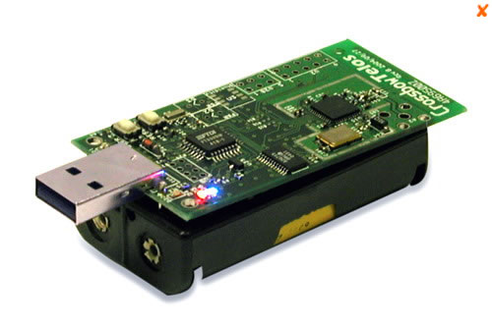
TelosB

Slide 6
Zolertia Z1
The Zolertia Z12 is a general purpose development board targeting wireless sensor networks and heterogeneous IoT applications.
It is equipped with two on-board digital sensors (an accelerometer and a temperature sensor), and uses Phidget Sensors connectors to easily extend connected devices such as sensors and actuators.
Applications
  Smart cities: Smart traffic lights, smart garbage bins or connected parkings are helping the grow of cities by improving efficiency of services and the management of city’s assets.
  Smart building: Power consumption, space utilization, and worker production.

Slide 7
Zoltria Z1

Slide 8
Arduino
The Arduino project started in Italy in 2005 as a program for students at the Ivrea Interaction Design Institute.
One of the ﬁrst Arduino boards built for the IoT ecosystem was the Arduino Yun.
This is a microcontroller board based on the ATmega32u4 and the Atheros AR9331.
The Atheros processor runs a Linux distribution, based on OpenWrt,5 called Linino OS.
The board has built-in Ethernet and Wi-Fi communication interfaces, a USB-A port, a micro-SD card slot, 20 digital input/output pins a 16 MHz crystal oscillator, a micro USB connection, an ICSP header, and three reset buttons.
Arduino boards are able to read inputs - light on a sensor, a finger on a button, or a Twitter message - and turn it into an output - activating a motor, turning on an LED, publishing something online.

Slide 9
Why Arduino?
Inexpensive - Arduino boards are relatively inexpensive compared to other microcontroller platforms. The least expensive version of the Arduino module can be assembled by hand, and even the pre-assembled Arduino modules cost less than $50.
Cross-platform - The Arduino Software (IDE) runs on Windows, Macintosh OSX, and Linux operating systems. Most microcontroller systems are limited to Windows.
Simple, clear programming environment - The Arduino Software (IDE) is easy-to-use for beginners, yet flexible enough for advanced users to take advantage of as well.
Open source and extensible software - The Arduino software is published as open source tools, available for extension by experienced programmers. The language can be expanded through C++ libraries.
Open source and extensible hardware - The plans of the Arduino boards are published under a Creative Commons license, so experienced circuit designers can make their own version of the module, extending it and improving it.

Slide 10
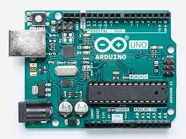
Arduino

Slide 11
Arduino

Slide 12
OpenMote
OpenMote3 hardware is composed of three boards: OpenMote-CC2538, OpenBase and OpenBattery.
OpenMote-CC2538 is the mote itself and includes the microcontroller and the radio transceiver.
The OpenBase is the board allowing programming and debugging through a UART or USB interface with a computer or via an Ethernet port with the Internet.
The OpenBattery is the board that lets OpenMote-CC2538 run autonomously by providing energy to all its subsystems, as well allowing it to interface it with various sensors.

Slide 13
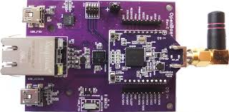

Slide 14
Raspberry Pi
The Raspberry Pi is a series of single-board computers created in the United Kingdom by the Raspberry Pi Foundation.
The original aim of the founders was to encourage the teaching of basic computer science in schools and developing countries.
Raspberry Pi is a small, cheap ARM-based PC for education
Runs Debian GNU/Linux from an SD card
Now the Raspberry Pi is being considered as a popular platform for embedded systems
The Raspberry Pi is an open hardware platform, which means the schematics for the board is publicly published
The Raspberry Pi comes in different models and configurations

Slide 15
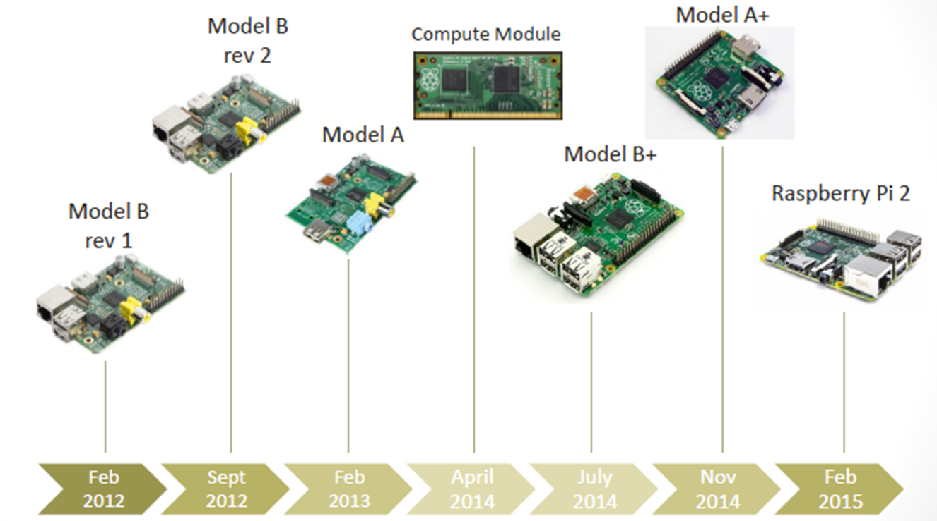
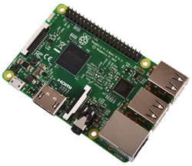

Raspberry Pi Roadmap

Slide 16
Raspberry Pi Board Configurations
Initially it was decided to have two main models,
  Model A: A low cost model (around $25) with less capabilities
  Model B: A higher cost model (around $35)
Model B was first released in Feb 2012, while Model A was first released in Feb 2013
Model A did not get much attention
The Model B went through two revisions, with minor changes
  Model B rev 1
  Model B rev 2 (Released in Sept 2012)
Aiming for using the Raspberry Pi in commercial and industrial products, the Raspberry Pi Compute module was announced in April 2014, this is a new form factor (200 Pin SO-DIMM Form factor), and much more signals available for developer than the other form
In July 2014, a new model (Model B+) was released, with few upgrades in the power supply, USB ports, GPIOs and other changes
In Nov. 2014, a new model (Model A+) was released with several upgrades from the original Model A

Slide 17
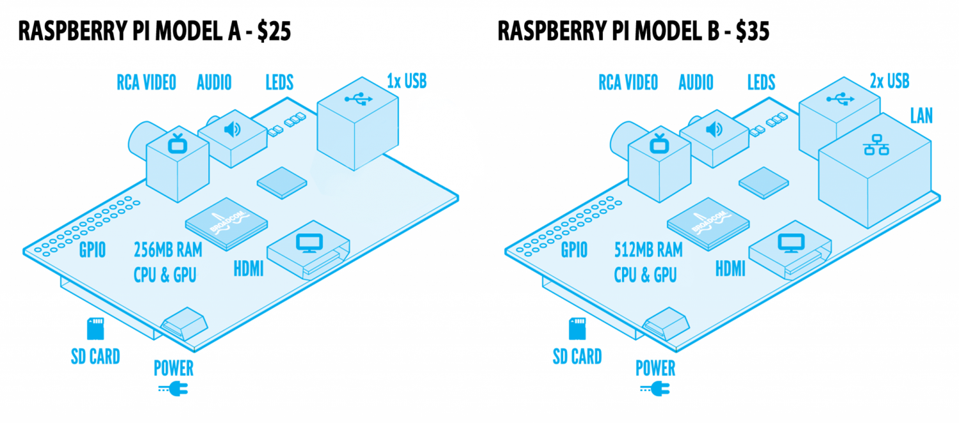
Raspberry Pi Board Configurations

Slide 18
Raspberry Pi 1
LAN9512 (Model B) providing:
  10/100Mb Ethernet (Auto-MDIX),
  2x USB 2.0
S1: Micro USB power jack (5v - Power Only)
S2: DSI (Display Serial Interface) interface. 15-pin surface mounted flat flex connector, providing two data lanes, one clock lane, 3.3V and GND.
S3: HDMI connector providing type A HDMI 1.3a out; S4: Composite Video connector: RCA; S5: MIPI CSI (Camera Serial Interface)-2 interface. 15-pin surface mounted flat flex connector.
S6: Audio connector: 3.5mm stereo jack (output only); S8: SD/MMC/SDIO memory card slot (underside); S7: Either 1x USB 2.0 (Model A) 2x USB 2.0 (Model B)

Slide 19
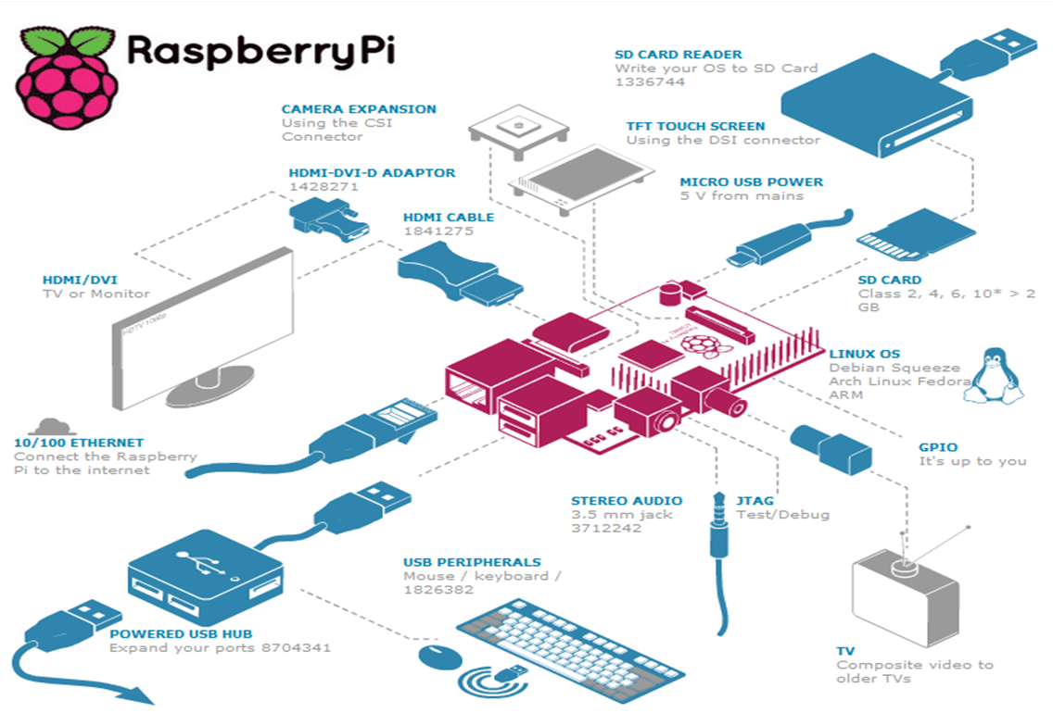
Raspberry Pi 1

Slide 20
Raspberry Pi 2
Uses a different Broadcom chip (BCM2836)
A big upgrade from the older platforms
Quad core ARM Cortex A7 (900 MHz)
1 GB SDRAM
The new ARM Core supports the ARMv7 Instruction set
This enables it to run Ubuntu and Windows 10 OSs
Fully backward compatible with the older models
Like the (Pi 1) Model B+, it also has:
4 USB ports
40 GPIO pins
Full HDMI port
Ethernet port
Combined 3.5mm audio jack and composite video
Camera interface (CSI)
Display interface (DSI)
Micro SD card slot
VideoCore IV 3D graphics core

Slide 21
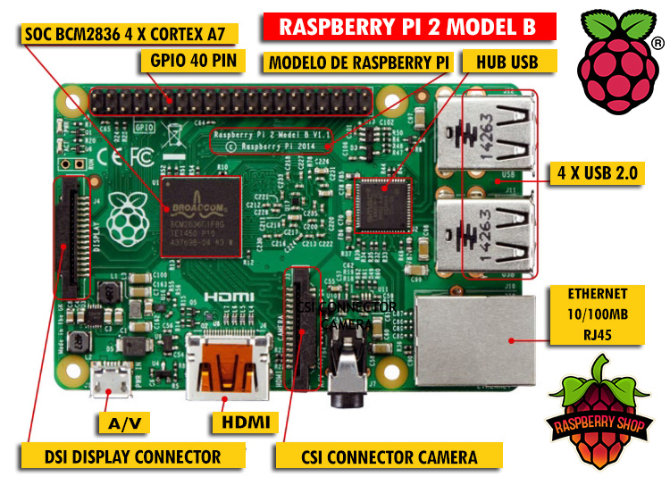
Raspberry Pi 2

Slide 22
Raspberry Pi 3
SoC: Broadcom BCM2837
CPU: 4× ARM Cortex-A53, 1.2GHz
GPU: Broadcom VideoCore IV
RAM: 1GB LPDDR2 (900 MHz)
Networking: 10/100 Ethernet, 2.4GHz 802.11n wireless
Bluetooth: Bluetooth 4.1 Classic, Bluetooth Low Energy
Storage: microSD
GPIO: 40-pin header, populated
Ports: HDMI, 3.5mm analogue audio-video jack, 4× USB 2.0, Ethernet, Camera Serial Interface (CSI), Display Serial Interface (DSI)

Slide 23
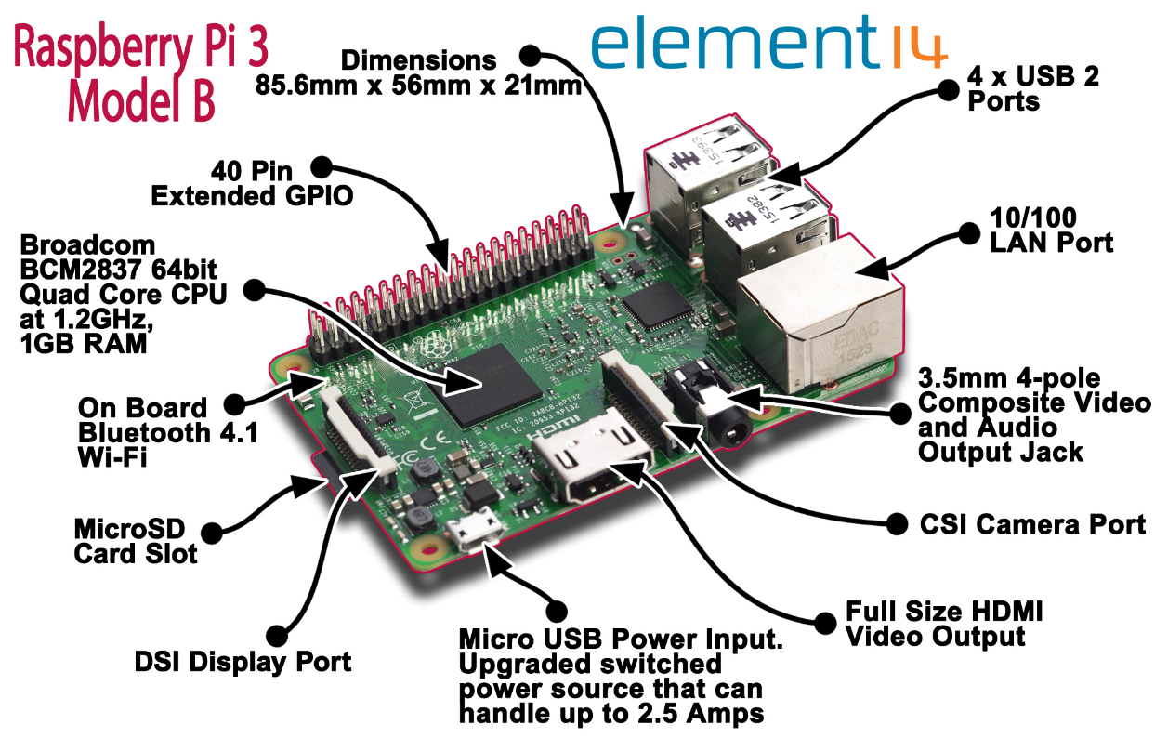
Raspberry Pi 3

Slide 24
Operating systems
The Foundation provides Raspbian, a Debianbased Linux distribution for download, as well as third party Ubuntu, Windows 10 IOT Core, RISC OS, and specialised media center distributions.
It promotes Python and Scratch as the main programming language, with support for many other languages.

Slide 25
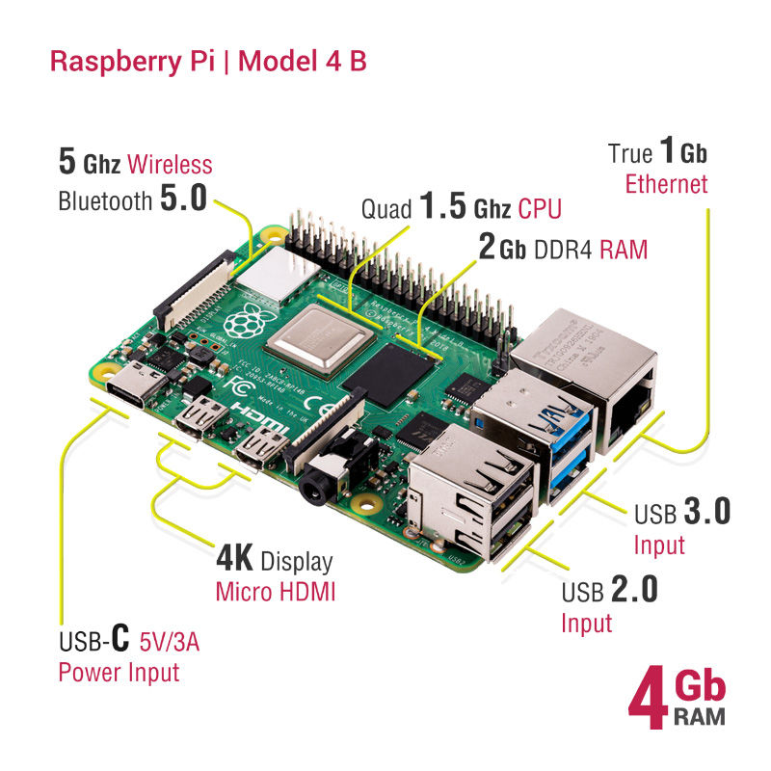
Raspberry Pi 4
Raspberry Pi 4 Model B was released in June 2019
Raspberry Pi 400 was released in November 2020.
Hardware
  Quad core 64-bit ARM-Cortex A72 running at 1.5GHz
  1, 2 and 4 Gigabyte LPDDR4 RAM options
  H.265 (HEVC) hardware decode (up to 4Kp60)
  H.264 hardware decode (up to 1080p60)
  VideoCore VI 3D Graphics
  Supports dual HDMI display output up to 4Kp60
Interfaces
  802.11 b/g/n/ac Wireless LAN
  Bluetooth 5.0 with BLE
  1x SD Card
  2x micro-HDMI ports supporting dual displays up to 4Kp60 resolution
  2x USB2 ports
  2x USB3 ports
  1x Gigabit Ethernet port (supports PoE with add-on PoE HAT)
  1x Raspberry Pi camera port (2-lane MIPI CSI)
  1x Raspberry Pi display port (2-lane MIPI DSI)
  28x user GPIO supporting various interface options

Slide 26
Raspberry Pi 4
Software
  ARMv8 Instruction Set
  Mature Linux software stack
  Actively developed and maintained
  Recent Linux kernel support
  Many drivers upstreamed
  Stable and well supported userland
  Availability of GPU functions using standard APIs

Slide 27
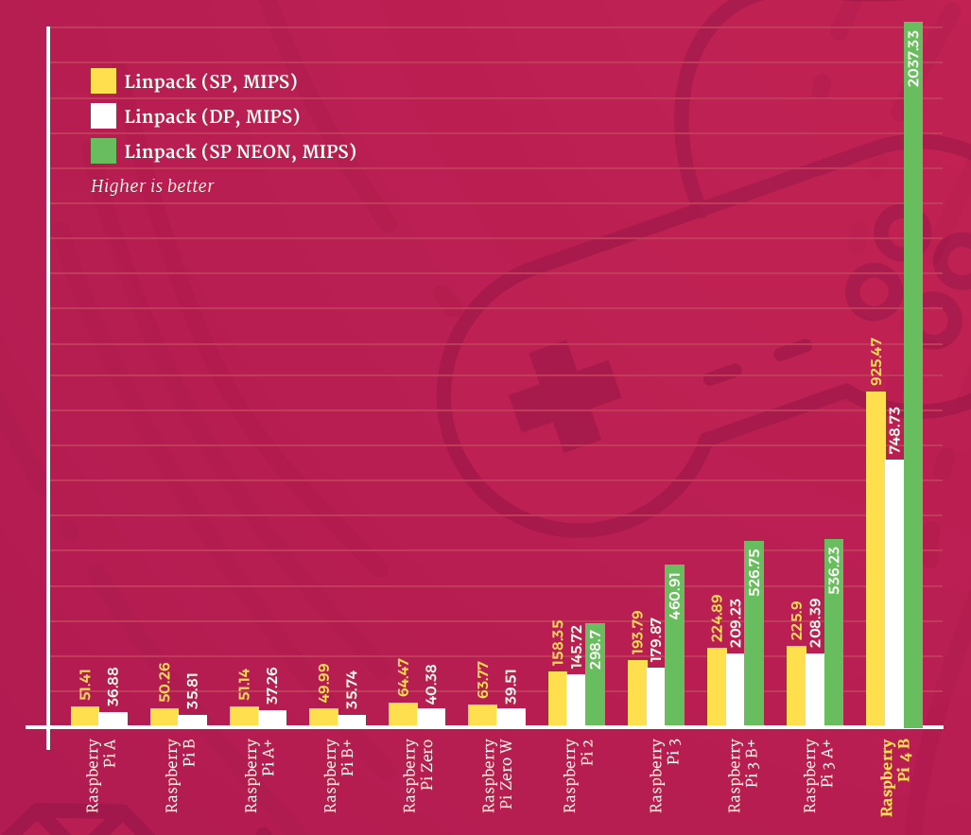
Raspberry Pi 4 Benchmarks
Linpack (CPU speed test)
A synthetic benchmark originally developed for supercomputers, Linpack offers a glimpse at just how far the Raspberry Pi family has come.

Slide 28
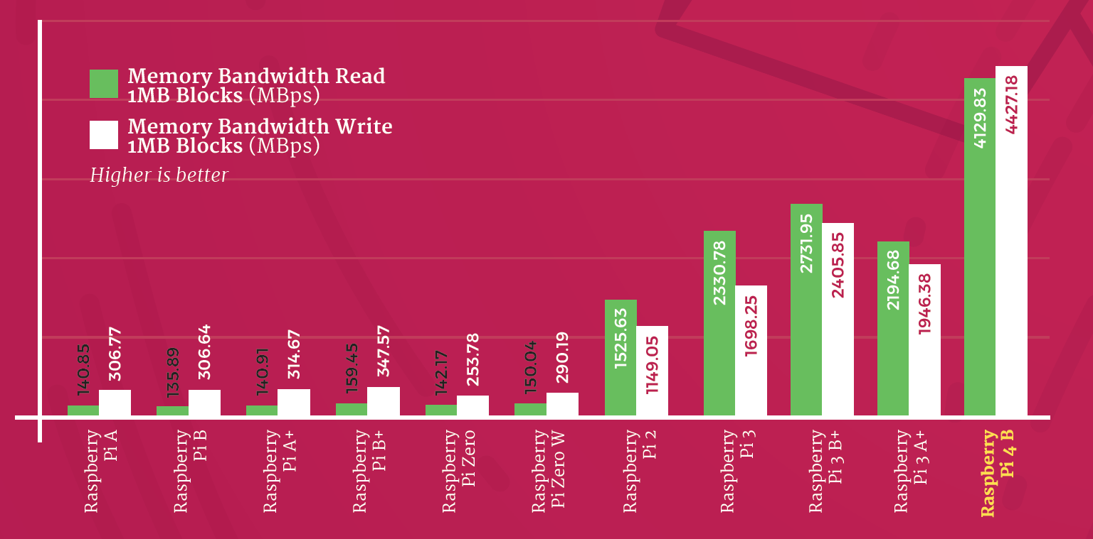
Raspberry Pi 4 Benchmarks

Slide 29
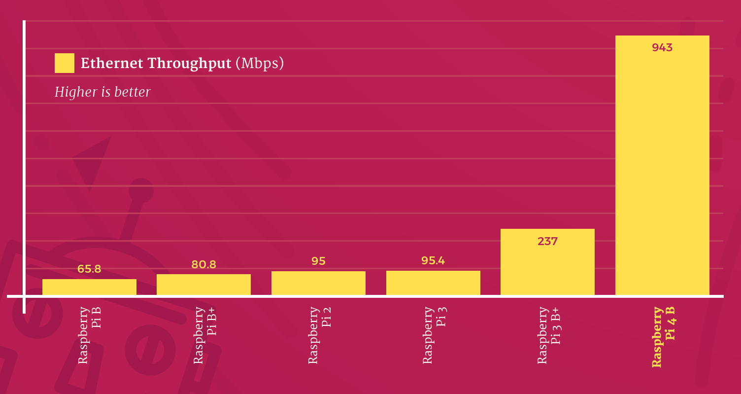
Raspberry Pi 4 Benchmarks
The throughput of all Raspberry Pi models with a built-in Ethernet port is measured using the iperf3 tool

Slide 30
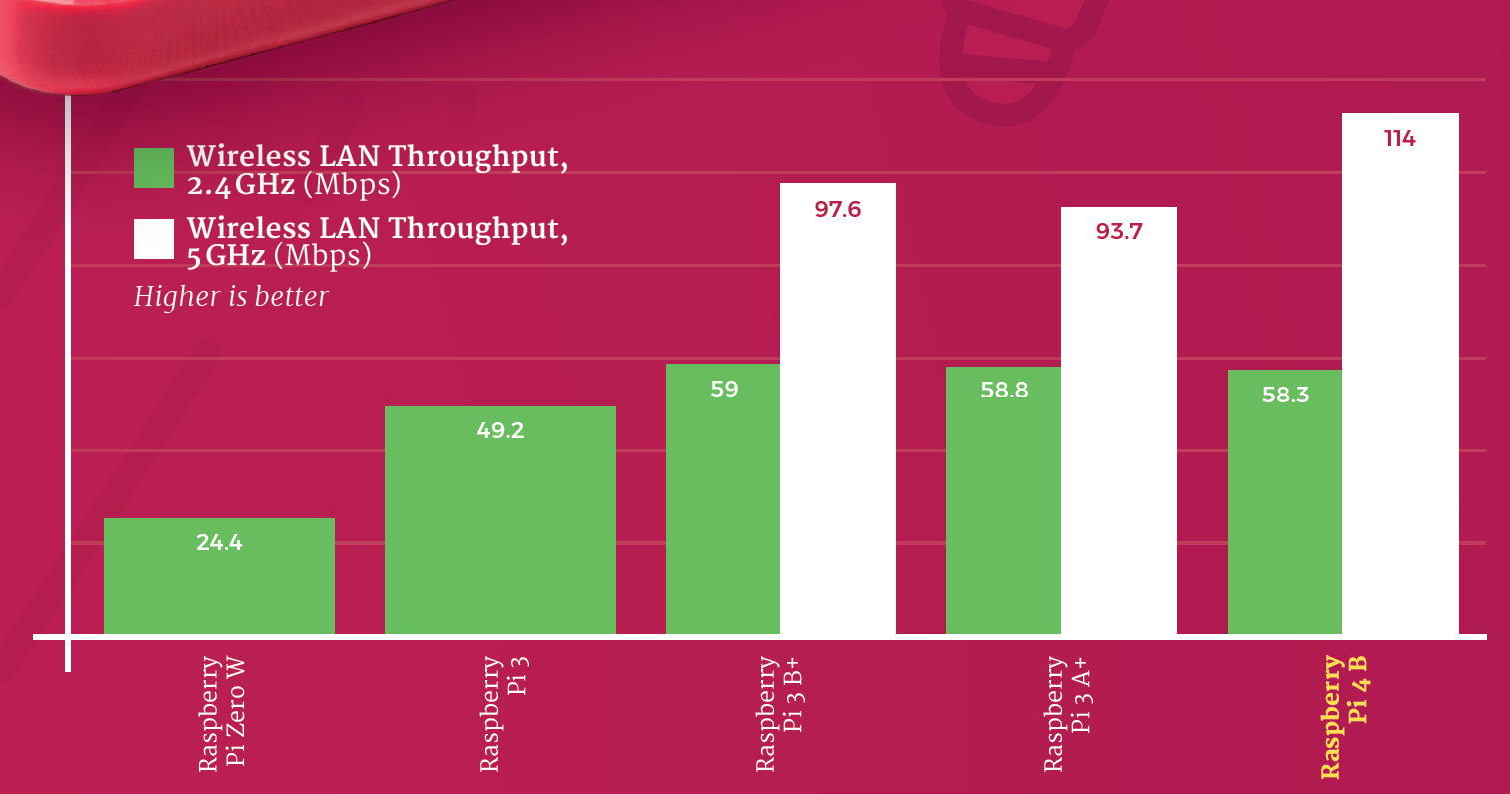
Raspberry Pi 4 Benchmarks
Raspberry Pi is placed in line-of-sight of an 802.11ac router, and a wired laptop uses iperf3 to measure the average throughput over several runs.

Slide 31
Raspberry Pi 5
Raspberry Pi 5 Specifications (Expected)
  Quad-core Cortex-A76 (ARM v8.2) 64-bit SoC @ 2GHz
  4GB, 8GB or 16GB LPDDR5 SDRAM
  2.4 GHz and 5.0 GHz IEEE 802.11ac wireless, Bluetooth 5.2
  2 × traditional HDMI ports
  Micro-SD card slot for loading OS and data
  5V DC via USB-C connector
  5V DC via GPIO header
The Pi 4B (4GB) comes with a price tag of $80. So we can expect the raspberry pi 5 price to be around $90.

Slide 32
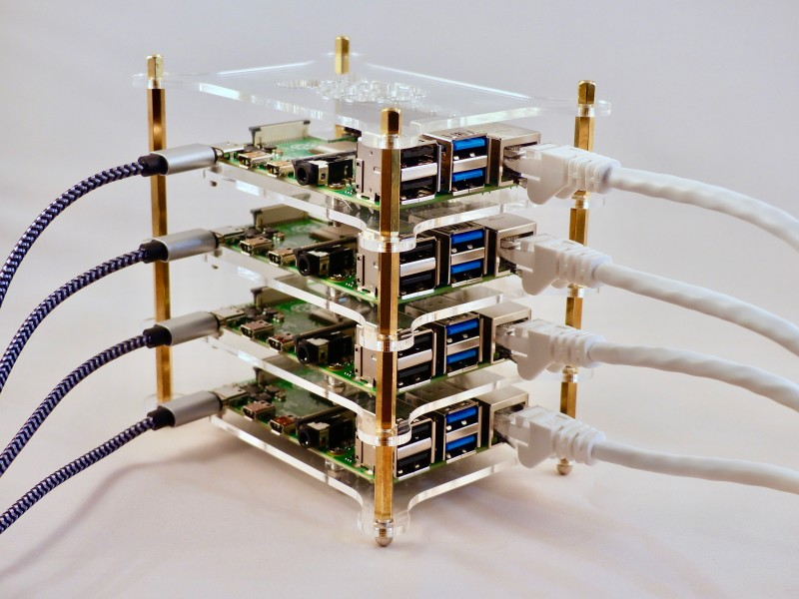
Build a Raspberry Pi cluster computer
Four Raspberry Pi 4 computers
A cluster case
Ethernet switch
Multi-port USB PSU
Four USB C cables
Four Ethernet cables

Slide 33
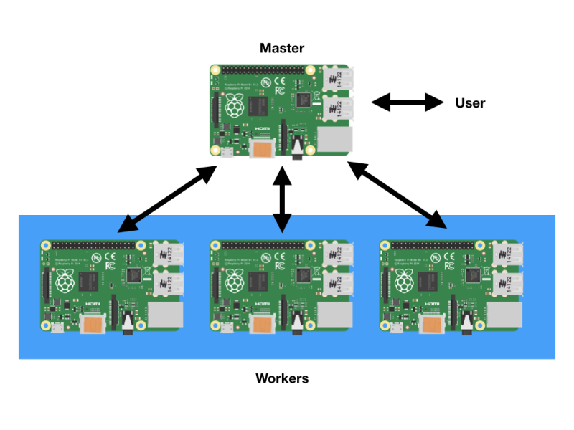
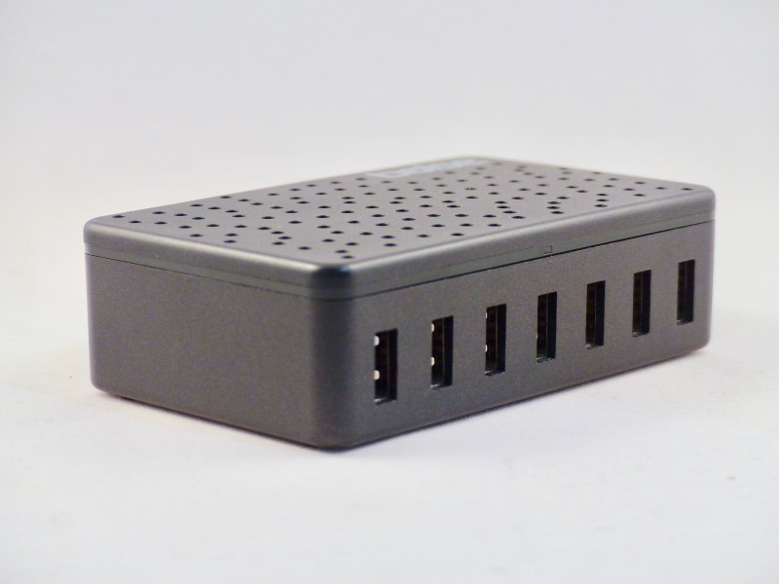
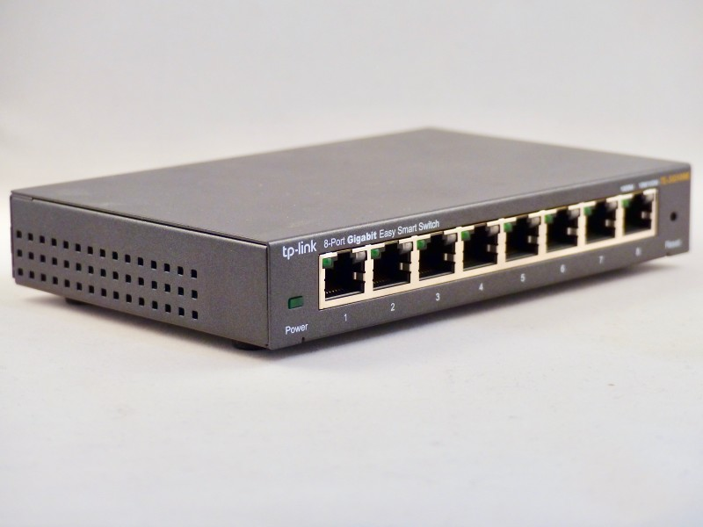
Build a Raspberry Pi cluster computer
A cluster works by communication. A ‘master’ node is in charge of the cluster and the ‘workers’ are told what to do and to report back the results on demand.
The wired Ethernet link is known as the cluster’s ‘backbone’.
The magic that makes our cluster work is MPI (Message Passing Interface). This protocol allows multiple computers to delegate tasks amongst themselves and respond with results.

Slide 34
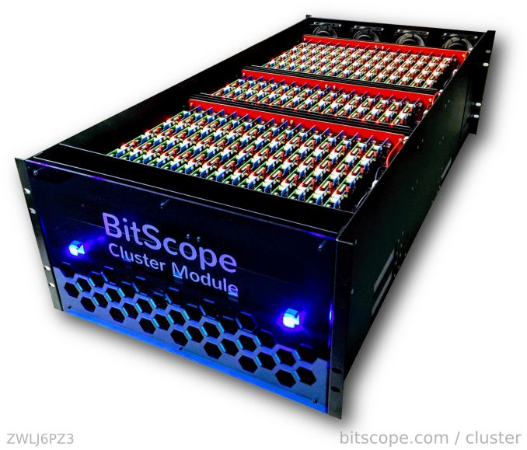
750-node Raspberry Pi clusters
Five rack-mount Bitscope Cluster Modules, each with 150 Raspberry Pi boards
With each of the 750 chips packing four cores, it offers a 3000-core highly parallelizable platform
The full 750-node cluster, running 2-3 W per processor, runs at 1000W idle, 3000W at typical and 4000W at peak.
a 150-node Cluster Module will fall in around $18k-$20k each.

Slide 35
ESP Modules
ESP8266 | DESCRIPTION
 | Core | 1
 | Arcuitecture | 32 bits
 | Clock | Xtensa LX106 80-160MHz
 | WiFi | IEEE802.11 b/g/n support for WPA and WPA2
 | Bluetooth | No
 | RAM | 160KB - 64KB Instruction - 96KB Data
 | Flash | Extern QSPI - 512KB A 4MB
 | GPIO | 16
 | DAC | 0
 | ADC | 1
 | Interfaces | SPI-I2C-UART-I2S
The ESP8266 is a system on a chip (SOC) Wi-Fi microchip for Internet of Things (IoT) applications produced by Espressif Systems.
The ESP8266 module enables microcontrollers to connect to 2.4 GHz Wi-Fi, using IEEE 802.11 bgn.
The module has a full TCP/IP stack and provides the ability for data processing, reads and controls of GPIOs.
ESP8266 Functions
  Networking: The module’s Wi-Fi antenna enables embedded devices to connect to routers and transmit data
  Data Processing: Includes processing basic inputs from analog and digital sensors for far more complex calculations with an RTOS or Non-OS SDK
  P2P Connectivity: Create direct communication between ESPs and other devices using IoT P2P connectivity
  Web Server: Access pages written in HTML or development languages.

Slide 36
ESP Modules
ESP8266 Applications
  The ESP8266 modules are commonly found in the following IoT devices:
    Smart security devices, including surveillance cameras and smart locks
    Smart energy devices, including HVACs and thermostats
    Smart industrial devices, including Programmable Logic Controllers (PLCs)
    Smart medical devices, including wearable health monitors
Chip versus Modules versus Development Boards
  ESP8266 Chip: This is the basic chip manufactured by Espressif, which comes unshielded and needs to be soldered onto a module.
  ESP8266 Modules: These are the surface-mountable modules that contain the chip, which are ready to be mounted onto an MCU, produced by Espressif.
  ESP8266 Development Boards: These are the complete IoT MCU development boards that have the modules preinstalled.
ESP8266 IoT development board options include:
  GPIO pins, ADC pins, Wi-Fi antennas, LEDs, Shielding, Flash Memory

Slide 37
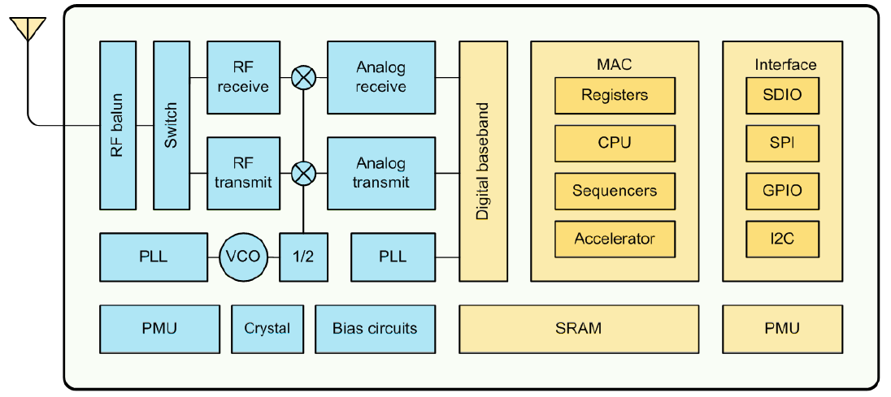
ESP8266

Slide 38
Manufacturers of Modules and Boards
Manufacturers of Modules and Boards Some of the largest manufacturers of ESP8266 modules and development boards are:
  Espressif
  Ai-Thinker
  WeMos
  Adafruit
  Olimex

Slide 39
Espressif Systems
The Espressif Systems esp8266 is available in the following modules:
Model | Antennae | Dimensions | GPIO & ADC Pins | Flash | LEDs | Shielded
ESP-WROOM-02 | PCB trace | 18 × 20 | 18 | 2 MiB | No | Yes
ESP-WROOM-02D | PCB trace | 18 × 20 | 18 | 2 MiB | No | Yes
ESP-WROOM-02U | U.FL socket | 18 × 20 | 18 | 2 MiB | No | Yes
ESP-WROOM-S2 | PCB trace | 16 × 23 | 20 | 2 MiB | No | Yes

Slide 40
Ai-Thinker
Current Ai-Thinker esp8266 modules are the following:
Model | Antennae | Dimensions | GPIO & ADC Pins | Flash | LEDs | Shielded
ESP-01S | PCB trace | 14.4 × 24.7 | 6 | 1 MiB | Yes | No
ESP-01M | PCB trace | 18 × 18 | 16 | 1 MiB | No | Yes
ESP-07S | U.FL socket | 17 × 16 | 14 | 4 MiB | No | Yes
ESP-08S | None | 17 × 16 | 10 | 4 MiB | No | Yes
ESP-12F | PCB trace | 24 × 16 | 20﻿ | 4 MiB | Yes | Yes
ESP-12S | PCB trace | 24 × 16 | 14 | 4 MiB | Yes | Yes

Slide 41
WeMos
Current WeMos boards are the following:
Model | Antennae | Firmware | GPIO & ADC Pins | USB | Flash
D1 R2 | PCB trace | Compatible with MicroPython, Arduino, nodemcu | 12﻿ | Micro-USB socket | 1 MiB
D1 mini | PCB trace | Compatible with MicroPython, Arduino, nodemcu | 12﻿ | Micro-USB socket | 4 MiB
D1 mini Lite | PCB trace | Compatible with MicroPython, Arduino, nodemcu | 12﻿ | Micro-USB socket | 1 MiB
D1 mini Pro | Ceramic and U.FL socket | Compatible with MicroPython, Arduino, nodemcu | 12﻿ | Micro-USB socket | 16 MiB

Slide 42
Adafruit and Olimex
The current Adafruit 8266 board is the following:
The current Olimex 8266 boards are the following:
Model | Antennae | Firmware | GPIO & ADC Pins | USB | Flash
Huzzah ESP8266 Breakout | PCB trace | NodeMCU’s Lua interpreter or Arduino IDE | 14﻿ | USB to serial interface | 1 MiB
Model | Antennae | GPIO & ADC Pins | USB | Flash
MOD-WIFI-ESP8266 | PCB trace | 2 | USB to serial interface | 2 MiB
MOD-WIFI-ESP8266-DEV | PCB trace | 20 | USB to serial interface | 2 MiB

Slide 43
ESP8266 Opensource Community
Model | Antennae | Firmware | GPIO & ADC Pins | USB | Flash
NodeMCU | PCB trace | Espressif Non-OS SDK, using Lua scripting language | 14﻿ | USB to serial interface﻿ | 1 MiB
NodeMCU is an open source Lua based firmware for the ESP8266 WiFi SOC from Espressif and uses an on-module flash-based SPIFFS file system. NodeMCU is implemented in C and is layered on the Espressif NON-OS SDK.
The NodeMCU programming model is similar to that of Node.js, only in Lua.

Slide 44
ESP32 Series SoCs
32-bit MCU & 2.4 GHz Wi-Fi & Bluetooth/Bluetooth LE
Two or one CPU core(s) with adjustable clock frequency, ranging from 80 MHz to 240 MHz
+19.5 dBm output power ensures a good physical range
Classic Bluetooth for legacy connections, also supporting L2CAP, SDP, GAP, SMP, AVDTP, AVCTP, A2DP (SNK) and AVRCP (CT)
Support for Bluetooth Low Energy (Bluetooth LE) profiles including L2CAP, GAP, GATT, SMP, and GATT-based profiles like BluFi, SPP-like, etc
Bluetooth Low Energy (Bluetooth LE) connects to smart phones, broadcasting low-energy beacons for easy detection
Sleep current is less than 5 μA, making it suitable for battery-powered and wearable-electronics applications
Peripherals include capacitive touch sensors, Hall sensor, low-noise sense amplifiers, SD card interface, Ethernet, high-speed SPI, UART, I2S and I2C

