Slide 1
Sensors, Endpoints, and Power
Systems
By: Mahmood Ahmadi

Slide 2
Sensing devices: Thermocouples and temperature sensing
The Internet of Things (IoT) begins with sources of data or devices that perform an action. These we call endpoints, and they are the things associated with the internet.
Temperature sensors are the most prevalent form of sensor products. They exist just about everywhere. From smart thermostats to IoT cold storage logistics, from refrigerators to industrial machinery.
A thermocouple (or TC) is a form of temperature-sensing apparatus.
They produce very small signals (often microvolts in amplitude). Two wires of two different materials meet where a temperature measurement is to be sampled. Each metal develops a voltage differential independently of each other. This effect is known as the Seebeck electromotive effect, in which the difference between the voltage of the two metals has a nonlinear relationship to the temperature.

Slide 3
Sensing devices: Thermocouples and temperature sensing
The magnitude of the voltage depends on the metal material chosen.
In general, these sensors are good for long distance measurements with long leads, and are often used in industrial and high-temperature environments.
Thermocouples are good for wide temperature ranges, are color-coded for different metal combinations, and labeled by type (for example, E, M, PT-PD, to name a few).

Slide 4
Resistance Temperature Detectors
Resistance Temperature Detectors (RTDs) operate within a narrow range of temperatures, but have much better accuracy than thermocouples (below 600 degrees Celsius).
These are usually constructed with very fine platinum wire tightly wrapped around ceramic or glass.
This produces a resistance-to-temperature relationship. An excitation current is needed to operate an RTD (1 mA).
RTDs are rarely used above 600 degrees Celsius, which limits their application in industry.
A 200 PT100 RTD has a slope of 0.00200 Ohms/degrees Celsius from 0 to 100 degrees Celsius. Within that range (0 to 100 degrees Celsius), the slope will be linear.

Slide 5
Thermistors
The last temperature sensing device is the thermistor.
These are also resistance-based relationship sensors like RTDs, but produce a higher degree of change for a given temperature than an RTD.
RTD has a linear relationship with a change in temperature, thermistors have a highly nonlinear relationship, and are suitable where a high resolution is needed for a narrow temperature range.
There are two types of thermistors: NTC, where resistance decreases as temperatures rise; and PTC, where resistance increases with rising temperatures.
Thermistors are found in medical devices, scientific equipment, food handling equipment, incubators, and home appliances such are thermostats.

Slide 6
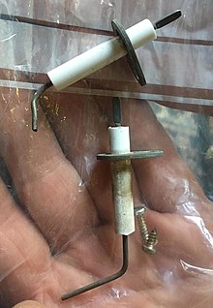
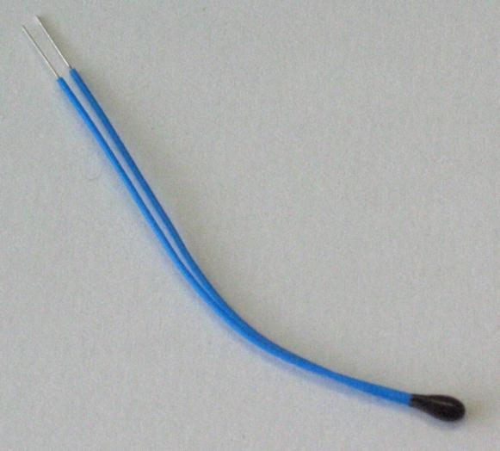
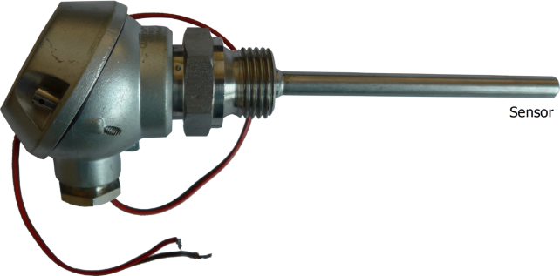
Temperature sensor summary

Slide 7
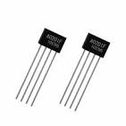
Hall effect sensors and current sensors
  A hall effect sensor consists of a strip of metal that a current runs across.
  If a conductor is placed in the magnetic field perpendicular to the electron flow, it will gather charge carriers and produce a voltage differential between the positive side of the metal strip and the negative side.

Slide 8
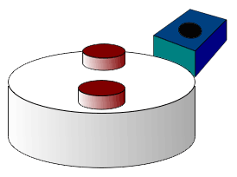
Hall effect sensors and current sensors
Typical uses of Hall sensors include position sensing, magnetometers, highly reliable switches, and water level detection.
They are used in industrial sensors to measure the rotational velocity of different machines and motors. Automotive fuel-level indicator, Electric treadmill,

Slide 9
Photoelectric sensors
The detection of light and light intensity is used in many IoT sensor devices, such as security systems, smart switches, and smart street lighting.
A photoresistor varies in resistance depending on light intensity, while photodiodes convert light into an electrical current.
Photoresistors are manufactured using a high-resistance semiconductor.
The resistance decreases as more light is absorbed. In the dark, a photoresistor can have quite a high resistance.
Photons absorbed by the semiconductor allow electrons to jump to the conduction band and conduct electricity.

Slide 10
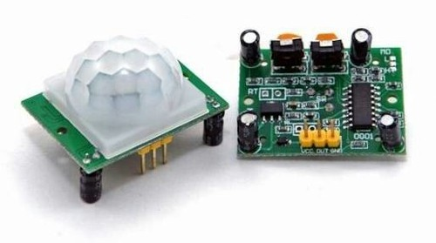
PIR sensors
Pyroelectric Infrared (PIR) sensors contain two slots filled with material that reacts to IR radiation and heat.
Typical use cases are security, or warm-body movement.
In its simplest form, a Fresnel lens sits on top of the PIR sensor, allowing both slots to form a widening arc outward. These two arcs create detection zones. When a warm body enters one of the arcs, or leaves one, it generates a signal that is sampled.
The PIR sensors use a crystalline material that generates current when subjected to IR radiation. A Field Effect Transistor (FET) detects the change in current, and sends the signal to an amplification unit. PIR sensors respond well in the 8 to 14 um range, which is typical of a human body.

Slide 11
LiDAR and active sensing systems
Passive sensors that simply respond to environmental changes.
Active sensing involves broadcasting a signal that is referenced to measure the environment either spatially or sensorily.
LiDAR stands for Light Detecting and Ranging. This type of sensor measures the distance to a target by measuring a laser pulse reflection on the target. Where a PIR sensor will detect movement within a range, LiDAR is capable of measuring a range.
They are used to analyze gases, atmospheres, cloud formations and compositions, particulates, the speed of moving objects, and so on.
LiDAR is an active sensor technology, and broadcasts laser energy. As a laser hits an object, some of the energy will be reflected back towards the LiDAR emitter.
To calculate the distance to an object, the equation is relatively simple:

Slide 12
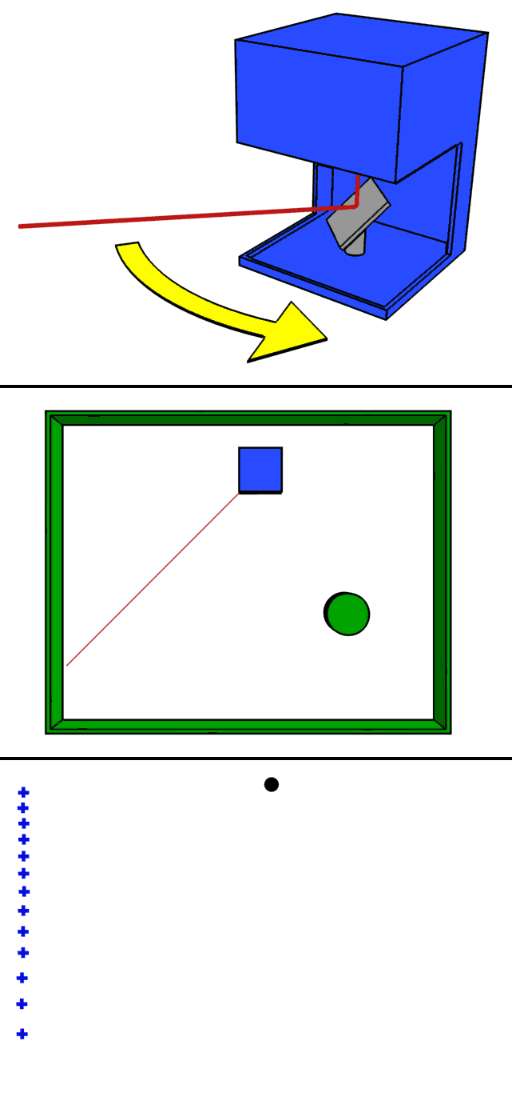
LiDAR and active sensing systems
Agriculture
  Agricultural robots
  Lidar is now used to monitor insects in the field.
  Lidar is useful in GPS-denied situations
Autonomous vehicles: Adaptive Cruise Control (ACC), and Emergency Brake Assist
Archaeology
Object detection for transportation systems
Mining
Military

Slide 13
MEMS sensors
Micro-electromechanical systems (MEMS) have been in the industry since they were first produced in the 1980s
Typically, these sensors are in the 1 to 100 um geometry range.
MEMS mechanical structures can spin, stretch, bend, move, or alter form, which in turn affects an electrical signal.
MEMS devices are manufactured in a typical silicon fabrication process using multiple masks, lithography, deposition, and etching processes.
MEMS silicon dies are then packaged with other components such as operational amplifiers, analog to digital converters, and support circuitry.

Slide 14
MEMS accelerometers
Accelerometers and gyroscopes are common in many mobile devices today, and are used in positioning and movement tracking, such as with pedometers and fitness trackers.
Gyroscopes detect rotational motion, and accelerometers respond to changes in linear motion.
Typically, a central mass that is fixed to a calibrated location via a spring will respond to changes in acceleration that are measured by varying capacitance in a MEMS circuit.
Engineering: vehicle acceleration, measure vibration on cars, machines, buildings, scientific research of earthquakes.
Industry: machinery health monitoring,
Human activities: walking, running, sport
Medical applications

Slide 15
MEMS accelerometers

Slide 16
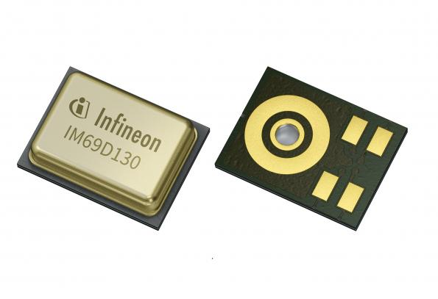
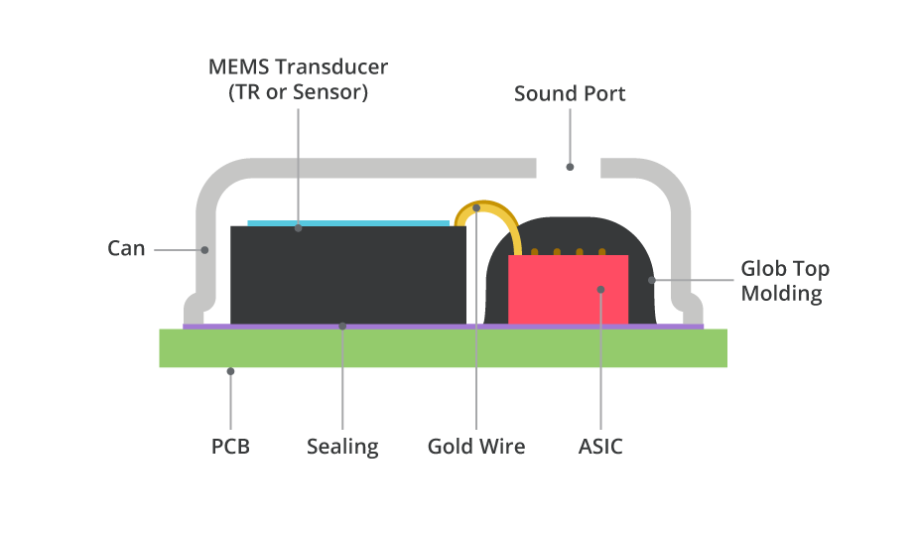
Mem-microphones
MEMS devices can also be used for sound and vibration detection.
These types of MEMS devices are related to the accelerometers.
For IoT deployments, sound and vibration measurements are common in the industrial IoT and predictive maintenance applications.
A MEMS sound or vibration unit will typically be used to monitor the health and safety of such equipment.
This type of sensor will require an analog-to-digital converter of sufficient sampling frequency.
A MEMS microphone can be analog or digital.

Slide 17
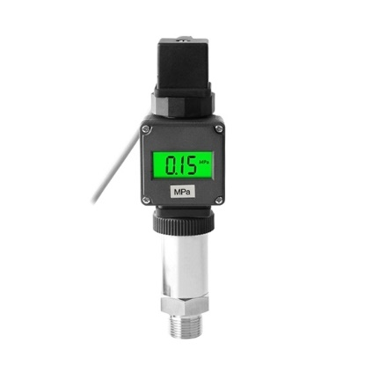
MEMS pressure sensors
Pressure and strain gauges are used in a variety of IoT deployments, from smart cities monitoring infrastructure to industrial manufacturing.
These are typically used to measure fluid and gas pressures. The heart of the sensor is a piezoelectric circuit.
A diaphragm will be placed above or below a cavity on the piezoelectric substrate. The substrate is flexible, and allows the piezo crystals to change shape. This change in shape results in a directly correlated resistance change in the material:

Slide 18
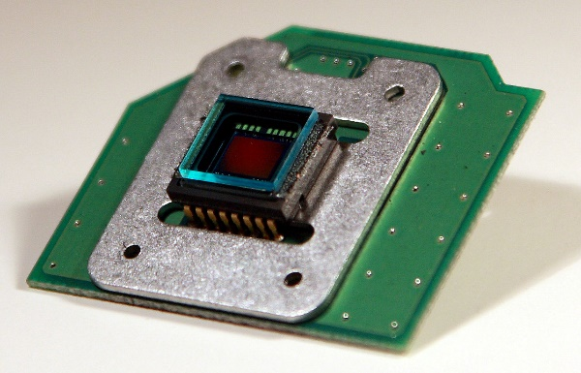
Smart IoT endpoints and Vision system
Smart sensors include devices such as video cameras and vision systems.
Smart sensors can include substantial amounts of processing in the form of high-end processors, digital signal processors, FPGAs, and custom ASICs.
Vision systems start with a lens that observes a scene.
In modern vision systems, one of two types of sensing elements is used: charge-coupled devices (CCD), or complementary metal-oxide (CMOS) devices.
CCD: Charge is transported from the sensor to the edge of the chip to be sampled sequentially via an analog-to-digital converter. CCDs create high-resolution and low-noise images. They consume considerable power (100x that of CMOS). They also require a unique manufacturing process.
CMOS: Individual pixels contain transistors to sample the charge and allow each pixel to be read individually. CMOS is more susceptible to noise, but uses little power.

Slide 19
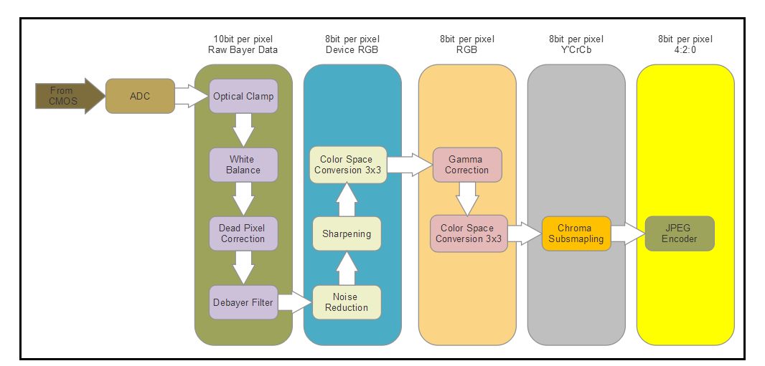
Vision system

Slide 20
Sensor fusion
Sensor fusion is the process of combining several different kinds of sensor data to reveal more about context than a single sensor can provide.
There are two modes of sensor fusion:
  Centralized: Where raw data is streamed and aggregated to a central service and fusion occurs there (cloud-based, for example)
  De-centralized: Where data is correlated at the sensor (or close to it)
The basis of correlating sensor data is usually expressed through the central limit theorem, where two sensor measurements, x1 and x2, are combined to reveal a correlated measurement, x3, based on the combined variances. This is simply adding two measures, and weighting the sum by the variances:
Other sensor fusion methods used are Kalman filters and Bayesian networks.

Slide 21
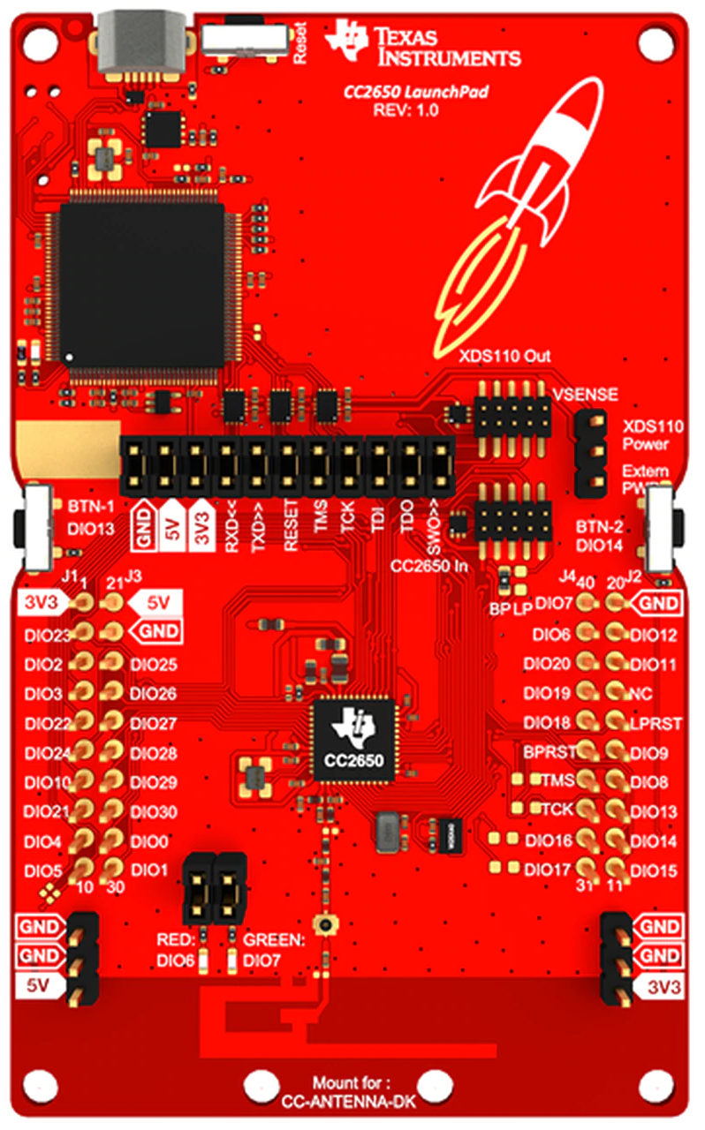
Functional example – TI SensorTag CC2650
Sensor input
  Ambient light sensor (TI Light Sensor OPT3001)
  Infrared temperature sensor (TI Thermopile infrared TMP007)
  Ambient temperature sensor (TI light sensor OPT3001)
  Accelerometer (Invensense MPU-9250)
  Gyroscope (Invensense MPU-9250)
  Magnetometer (Bosch SensorTec BMP280)
  Altimeter/Pressure sensor (Bosch SensorTec BMP280)
  Humidity sensor (TI HDC1000)
  MEMS microphone (Knowles SPH0641LU4H)
  Magnetic sensor (Bosch SensorTec BMP280)
  2 Push-button GPIOs
  Reed relay (Meder MK24)

Slide 22
Functional example – TI SensorTag CC2650
Output devices
  Buzzer/speaker
  2 LEDs
Communications
  Bluetooth Low Energy (Bluetooth Smart)
  Zigbee
  6LoWPAN

Slide 23
Power management
Managing power is a very broad topic, and spans software and hardware.
The architect must build a power budget for the edge device, which includes:
  Active sensor power
  Frequency of data collection
  Wireless radio communication strength and power
  Frequency of communication
  Microprocessor or microcontroller power as a function of core frequency
  Passive component power
  Energy loss from leakage or power supply inefficiency
  Power reserve for actuators and motors
The budget simply reflects the sum of these power contributors subtracted from the source of power (battery)
Batteries also do not have a linear power behavior over time.

Slide 24
Power management
The TI SensorTag C2650 has the following power characteristics:
Standby mode: 0.24 mA
Running with all sensors disabled: 0.33 mA
LEDs
All sensors on at 100 ms/sample data rate and broadcasting BLE: 5.5 mA:
  Temperature sensor: 0.84 mA
  Light sensor: 0.56 mA
  Accelerometer and gyros: 4.68 mA
  Barometric sensor: 0.5 mA
The TI SensorTag uses a standard CR2032 coin cell battery rated at 240 mAh. Therefore, the maximum life is expected to be about 44 hours.

Slide 25
Energy harvesting
Energy harvesting (also known as power harvesting or energy scavenging) is the process in which energy is captured from a system's environment and converted into usable electric power.
Systems must be efficient in capturing energy and storing power.

Slide 26
Solar harvesting
Energy from light, whether it is natural or artificial, can be captured and used as an energy source.
Solar harvesting is only as effective as how much the sun shines, which varies seasonally and geographically.
A 25 cm2 solar array could produce 300 mW at peak power.
One can expect an 8% to 20% efficiency, with 12% being typical.
Iran holds 1018% of the global oil reserves and 15 %17 natural gas.
It is the second largest producer and exporter of oil and gas in Organization of the Petroleum Exporting Countries (OPEC).
The consumption of energy in Iran is 4.4 times higher than the global average, placing it among the world's top ten greenhouse gas (GHG) emitters.
Iran has the remarkable potential for solar energy with the average annual rate of 4.5–5.5 kWh/m².

Slide 27

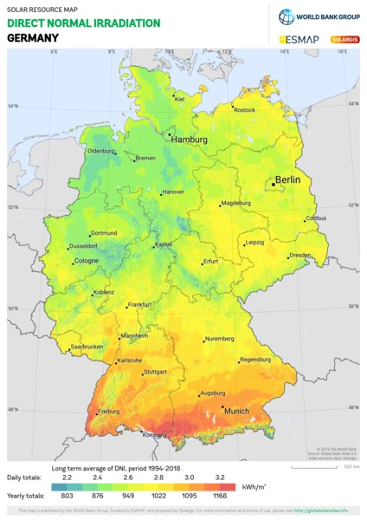
Solar harvesting

Slide 28
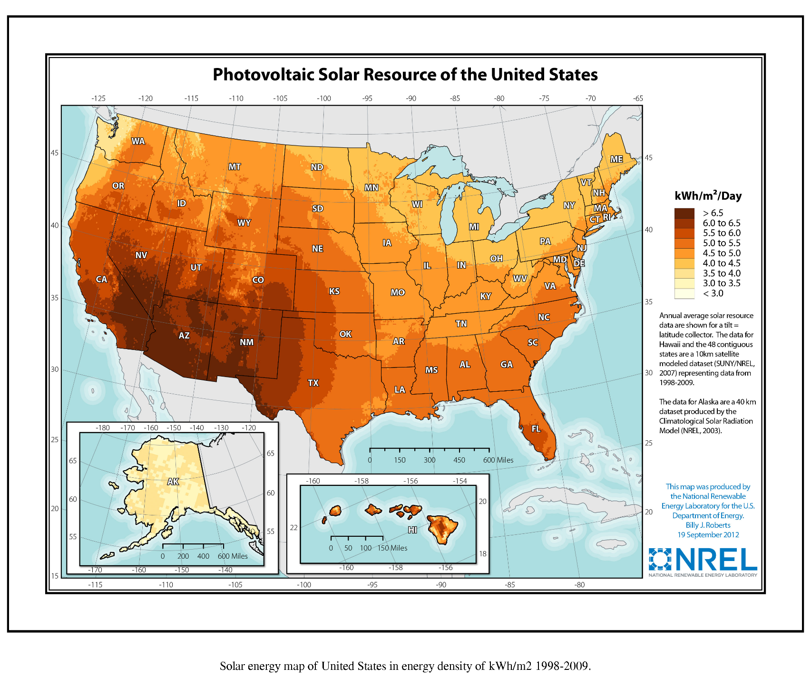
Solar harvesting

Slide 29
Thermal harvesting
Thermal energy can be converted into an electric current for any device exhibiting heat flow.
Thermal energy can be converted into electrical energy by two basic processes:
  Thermoelectric: Direct conversion of thermal energy into electrical energy through the Seebeck effect.
  Thermionic: Also known as thermotunneling. Electrons are ejected from an electrode that is heated, and into an electrode that is cool.
A thermocouple, or thermoelectric generator (TEG), could effectively produce voltage simply based on the temperature difference of a human, based on their core body temperature and outside temperature.

Slide 30
Energy storage
Typical storage for an IoT sensor will be a battery or supercapacitor.
When considering the architecture for sensor power, one must consider several aspects:
  The battery energy capacity.
  Accessibility. If the unit is embedded in concrete, limited forms of energy regeneration can be used, and the difficulty of replacing batteries can be costly.
  Weight. Is the unit intended to fly as a drone, or float on water?
  How often will the battery be recharged?
  Is the renewable form of energy constantly available, or intermittent, as in solar?
  The battery power characteristics. How the battery's energy will vary over time as it's discharged.
  Is the sensor in a thermally constrained environment that can affect battery life and reliability?
  Does the battery have a profile that guarantees minimum current availability?

Slide 31


Energy and power models
Battery capacity is measured in amp-hours.
A simplified equation to estimate the life of a battery power source is given as:
      t=$\frac{C}{I^{k}}$
Peukert's exponent usually lies between 1.1 and 1.3. As n increases.
C is Peukert's capacity, I represents the discharge current, and k is Peukert's exponent.
H is the rated discharge time (in hours),
if a battery rated for 100 ampere-hours at a 20-hour rate has a Peukert constant of 1.2 and is discharged at a rate of 10 amperes,It would therefore deliver only 87 ampere-hours rather than 100.

Slide 32
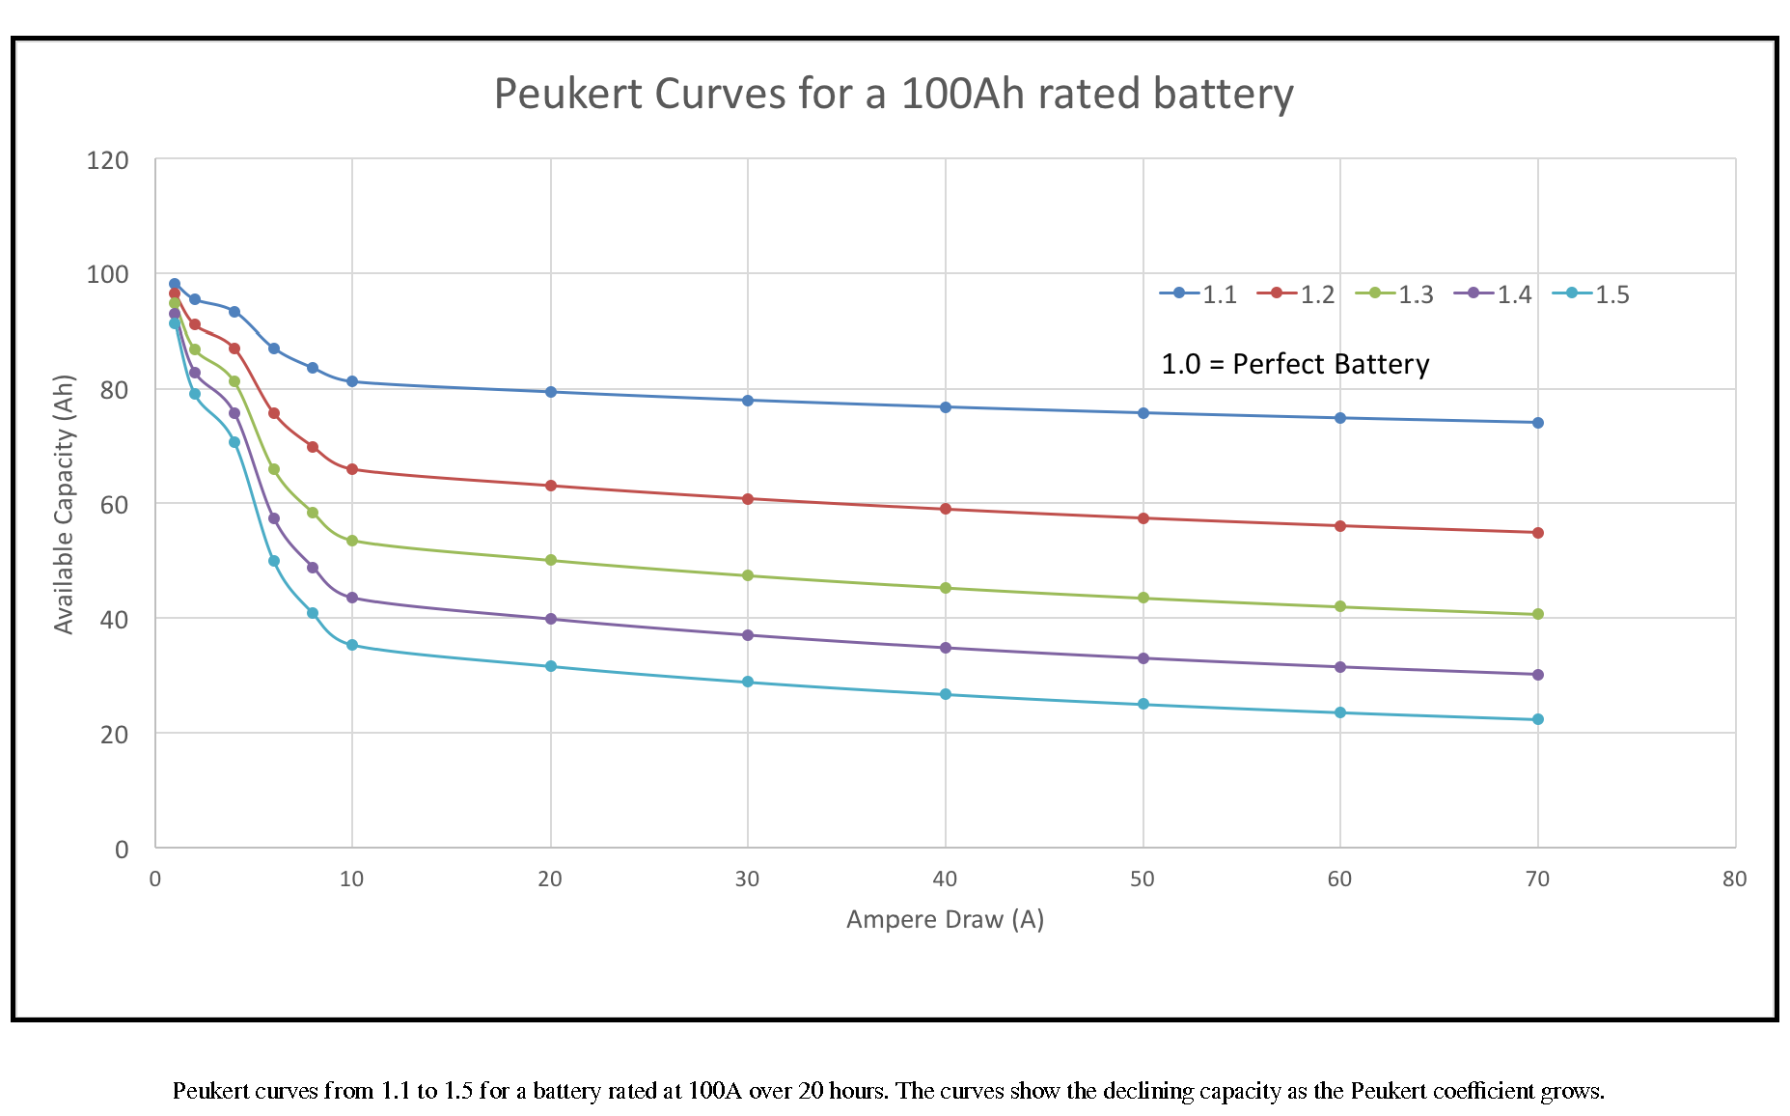
Energy and power models

Slide 33
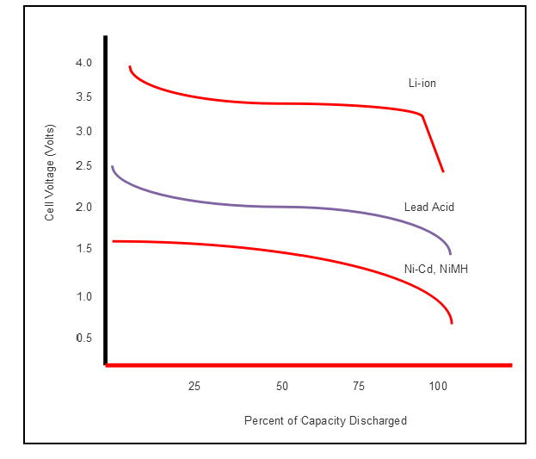
Energy and power models
One advantage of alkaline batteries is that the discharge rate is almost linear in a large portion of the graph.
Lithium-ion has a stair-step function in performance, thus making battery charge predictions more difficult. That said, Li-ion provides a near steady and continuous voltage level over the life of the charge.

Slide 34
Batteries
lithium-ion (Li-ion) battery is the standard form of power in mobile devices.
lithium-ions physically move from the negative electrode to the positive. During recharge, the ions move back to the negative region. This is known as an ionic movement.
This capacity loss is expressed as a measure of the initial capacity (for example, 30% loss after 1,000 cycles).
Another factor in battery life is self-discharge. When unwanted chemical reactions occur in a battery cell, energy will be lost.

