Slide 1
IoT Architecture and Core IoT Modules
By: Mahmood Ahmadi

Slide 2
IoT ecosystem
Sensors: Embedded systems, real-time operating systems, energy-harvesting sources
Sensor communication systems: Wireless personal area networks reach from 0 cm to 100 m. Often non-IP based.
Local area networks: Typically, IP-based communication systems such as 802.11. Often in peer-to-peer or star topologies.
Aggregators, routers, gateways: Embedded systems providers, cheapest vendors (processors, DRAM, and storage), module vendors, passive component manufacturers, thin client manufacturers, cellular and wireless radio manufacturers, middleware providers, fog framework providers, edge analytics packages, edge security providers, certificate management systems.
WAN: Cellular network providers, satellite network providers, Low-Power Wide-Area Network (LPWAN) providers.

Slide 3
IoT Ecosystem
Cloud: Infrastructure as a service provider, platform as a service provider, database manufacturers, streaming and batch processing manufacturers, data analytics packages, software as a service provider, data lake providers, Software- Defined Networking/Software-Defined Perimeter providers, and machine learning services.
Data analytics: As the information propagates to the cloud en-mass. Dealing with volumes data and extracting value is the job of complex event processing, data analytics, and machine learning techniques.
Security: Tying the entire architecture together is security. Security will touch every component from physical sensors to the CPU and digital hardware, to the radio communication systems, to the communication protocols themselves. Each level needs to ensure security, authenticity, and integrity.

Slide 4
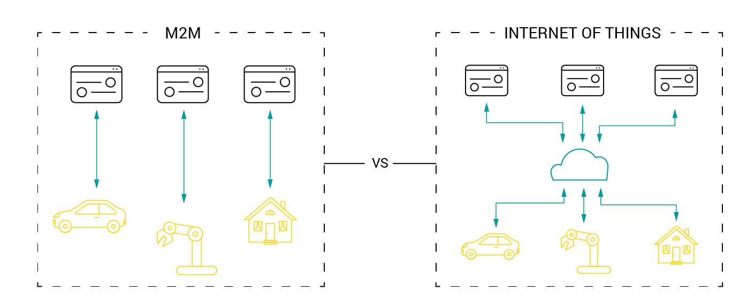
IoT versus machine to machine
M2M: It is a general concept involving an autonomous device communicating directly to another autonomous device.
M2M, or machine-to-machine communication, derives from telemetry technology and generally refers to data exchange between various devices (usually) through the Internet without human participation.
IoT: IoT systems may incorporate some M2M nodes (such as a Bluetooth mesh using non-IP communication), but aggregates data at an edge router or gateway.

Slide 5
The value of a network and Metcalfe's and
Beckstrom's law
  V≈N²
  V = Value of the network N = Number of nodes within the network
A recent example validating Metcalfe's law to the value of blockchains and cryptocurrency
trends

Slide 6
The value of a network and Metcalfe's and
Beckstrom's law
  Metcalfe's law does not account for service degradation in the event of service degradation as the number of users and/or data consumption grows, but the network bandwidth does not. Metcalfe's law also doesn't account for various levels of network service, unreliable infrastructure (such as 4G LTE in a moving vehicle), or bad actors affecting the network (for example, denial of service attacks).

Slide 7
IoT architecture

