Slide 1
IoT Security
By: Mahmood Ahmadi

Slide 2
Rererences
A chapter of book:
  Chapter 2, Introduction to IoT Security, Anca D. Jurcut , Pasika Ranaweera, and Lina Xu, Wiley, 2020.
Survey papers:
  Current research on Internet of Things (IoT) security: A survey, Mardiana binti Mohamad Noor, Wan Haslina Hassan , Computer Netowrks, vol.148, pp. 283-294, 2019.
  A Survey on IoT Security: Application Areas, Security Threats, and Solution Architecturesو, Vikas Hassija, Vinay Chamola, Vikas Saxena, Divyansh Jain, Pranav Goyal, Biplab Sikda, IEEE Access, Vol. 7, 2019

Slide 3
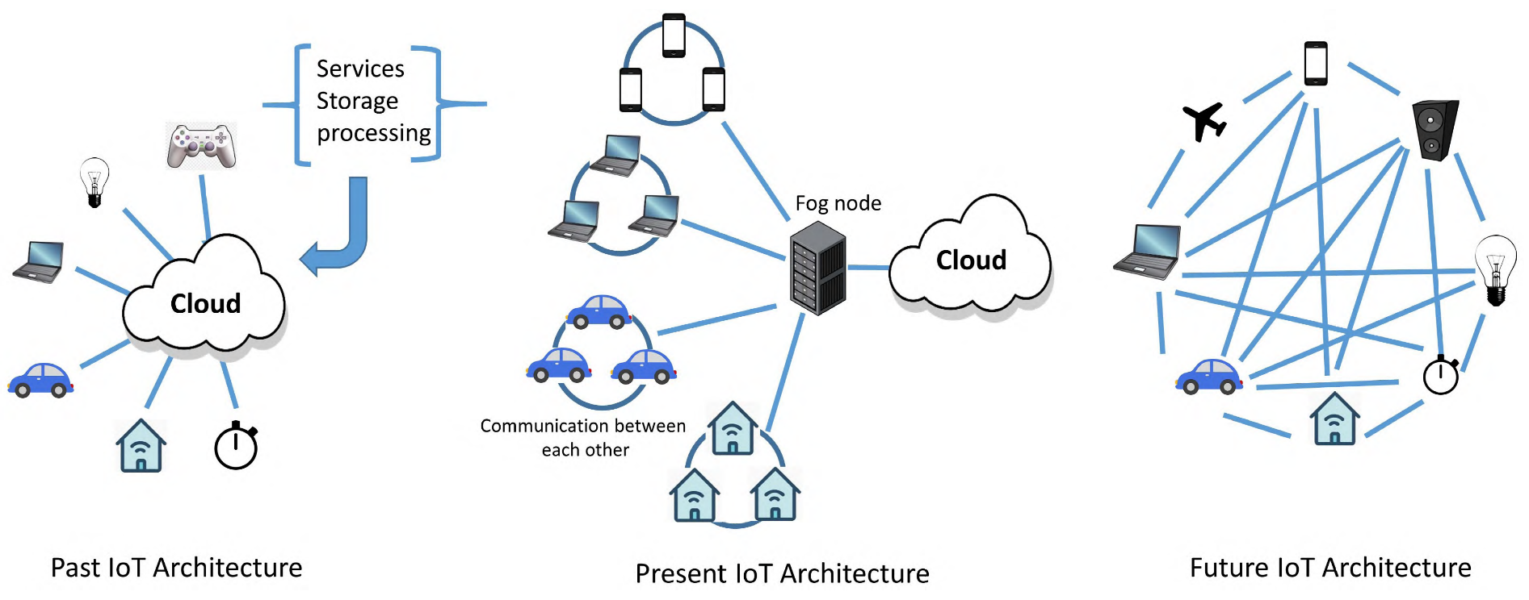
IoT Security
In future, the devices are not only expected to be connected to the Internet and other local devices but are also expected to communicate with other devices on the Internet directly.
The concept of social IoT (SIoT) is also emerging. SIoT will enable different social networking users to be connected to the devices and users can share the devices over the Internet

Slide 4
IoT Security
IT vs IoT security challanges
Mirai attack in the last quarter of 2016 was estimated to infect around 2.5 million devices connected to the Internet and launch distributed denial of service (DDoS) attack

Slide 5
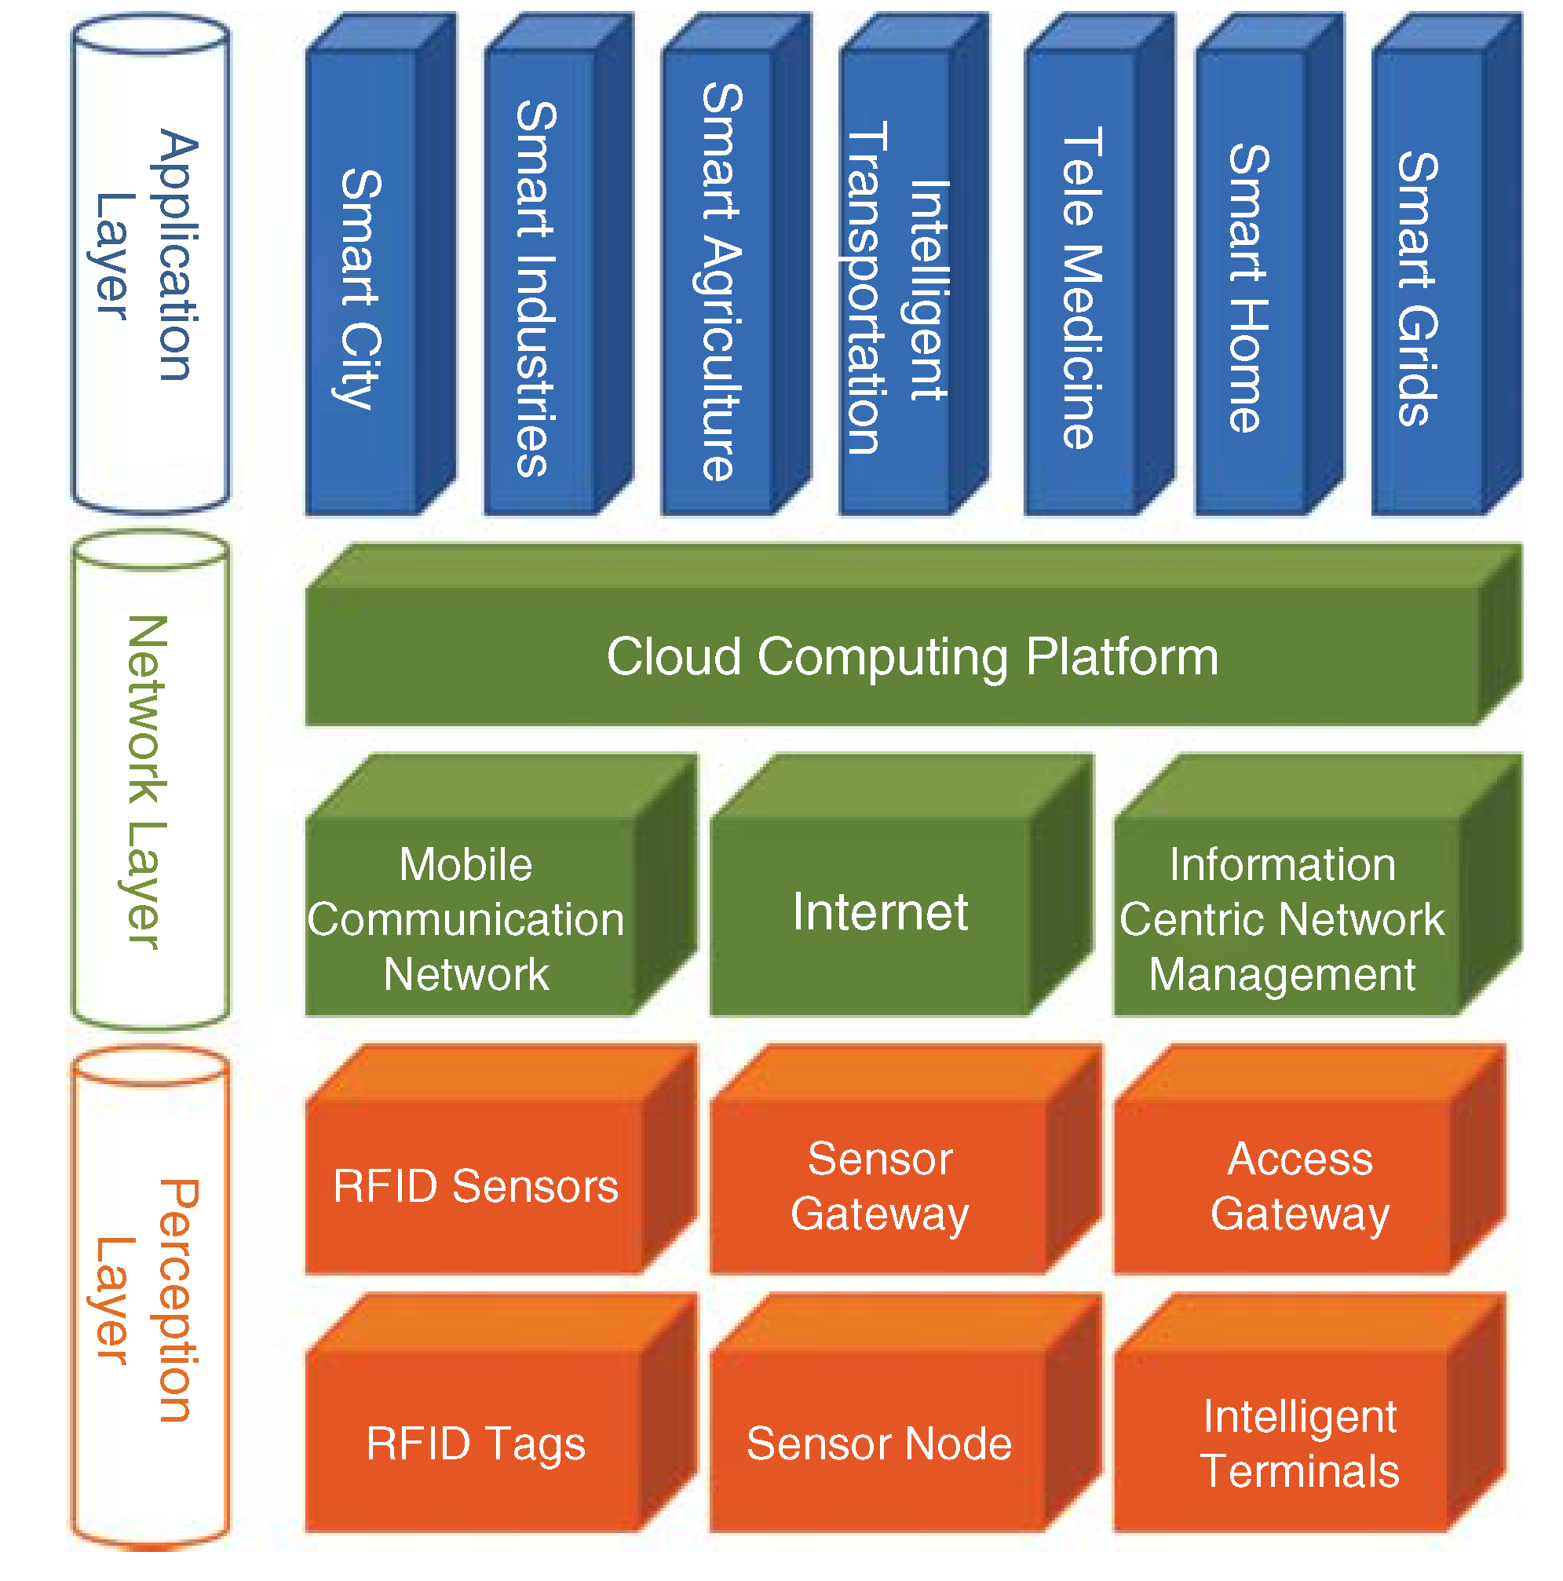
Iot Architeture
Smart Cities: Smart cities involve extensive use of emerging computation and communication resources for increasing the overall quality of life of the people. It includes smart homes, smart trafﬁc management, smart disaster management, smart utilities, etc.
Smart Environment: Smart environment includes various IoT applications such as ﬁre detection in forests, monitoring the level of snow in high altitude regions, preventing landslides, early detection of earth-quakes, pollution monitoring.
Smart Metering and Smart Grids:smart metering is smart grids, where the electricity consumption is measured and monitored. Smart metering may also be used to address the problem of electricity theft. Monitoring of water, oil and gas levels in storage tanks and cisterns.

Slide 6
Iot Architeture
Security and Emergencies: authorized people in restricted areas, detection of leakage of hazardous gases in industrial areas, Radiation levels can also be measured in the areas around nuclear power reactors or cellular base stations.
Smart retail: Various applications have been developed to monitor the storage conditions of the goods as they move along the supply chain.
Smart Agriculture and Animal Farming: Smart agriculture includes monitoring soil moisture, controlling micro-climate conditions, selective irrigation in dry zones, and controlling humidity and temperature.
Home Automation: Home automation is one of the most widely used and deployed IoT applications.

Slide 7
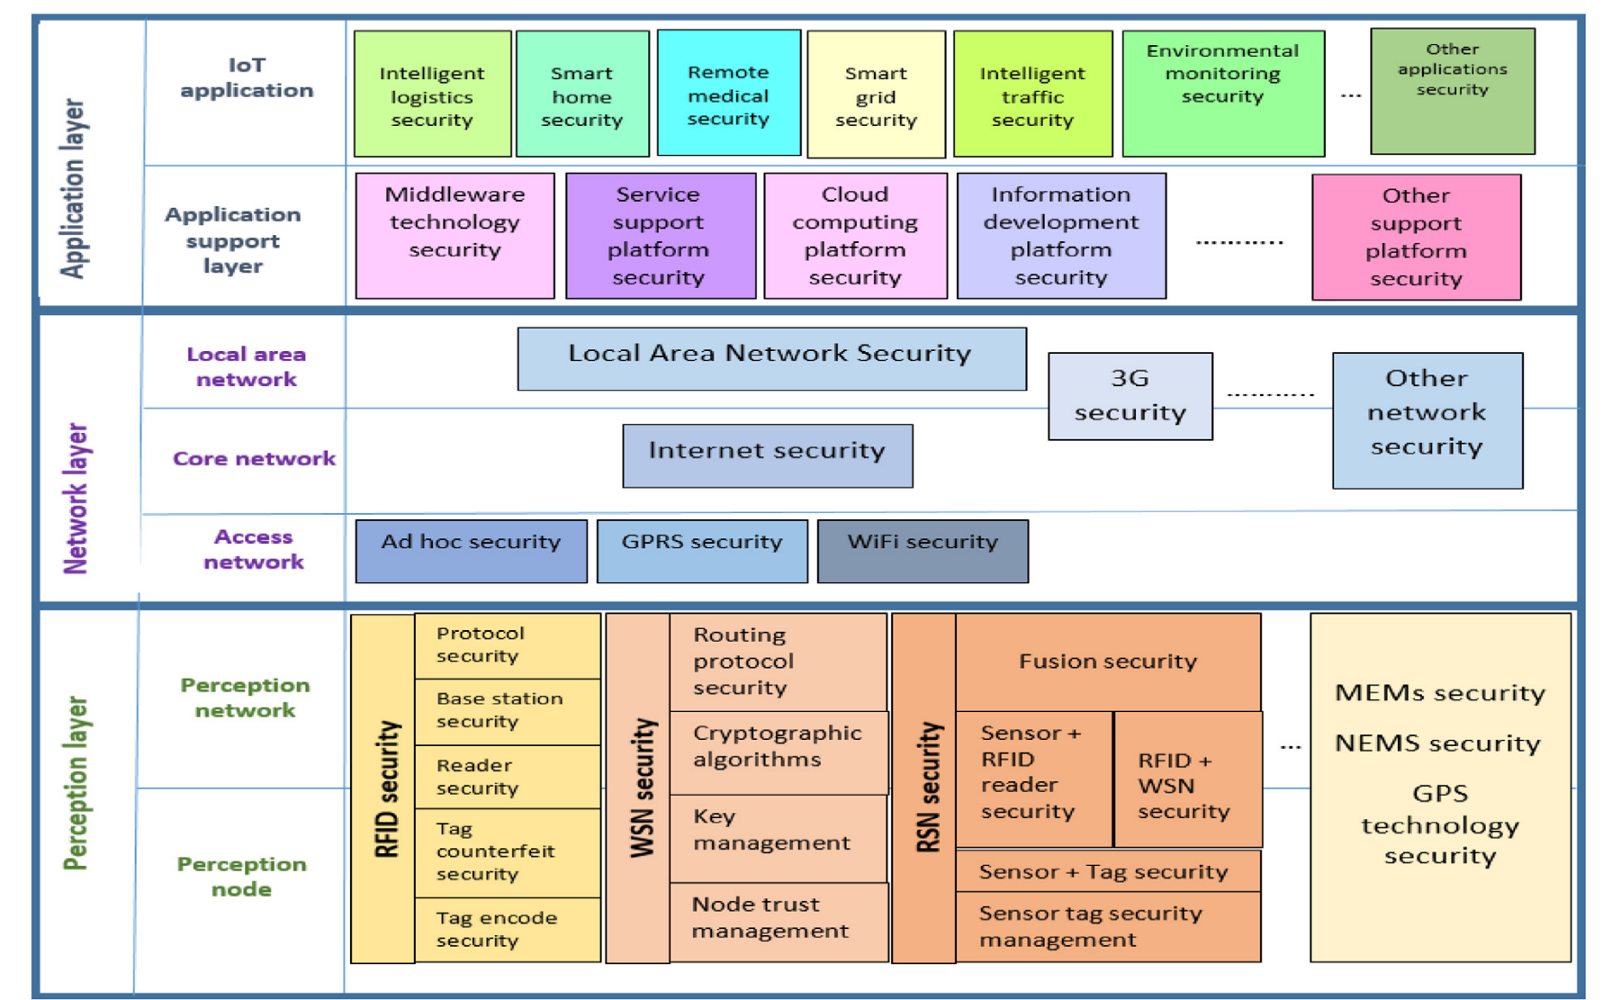
IoT Security Architeture
Due to the diversity of the devices and multitude of communication protocols in an IoT systems, and also various interfaces and services offered, it is not suitable to implement security mitigation based on the traditional IT network solutions.

Slide 8
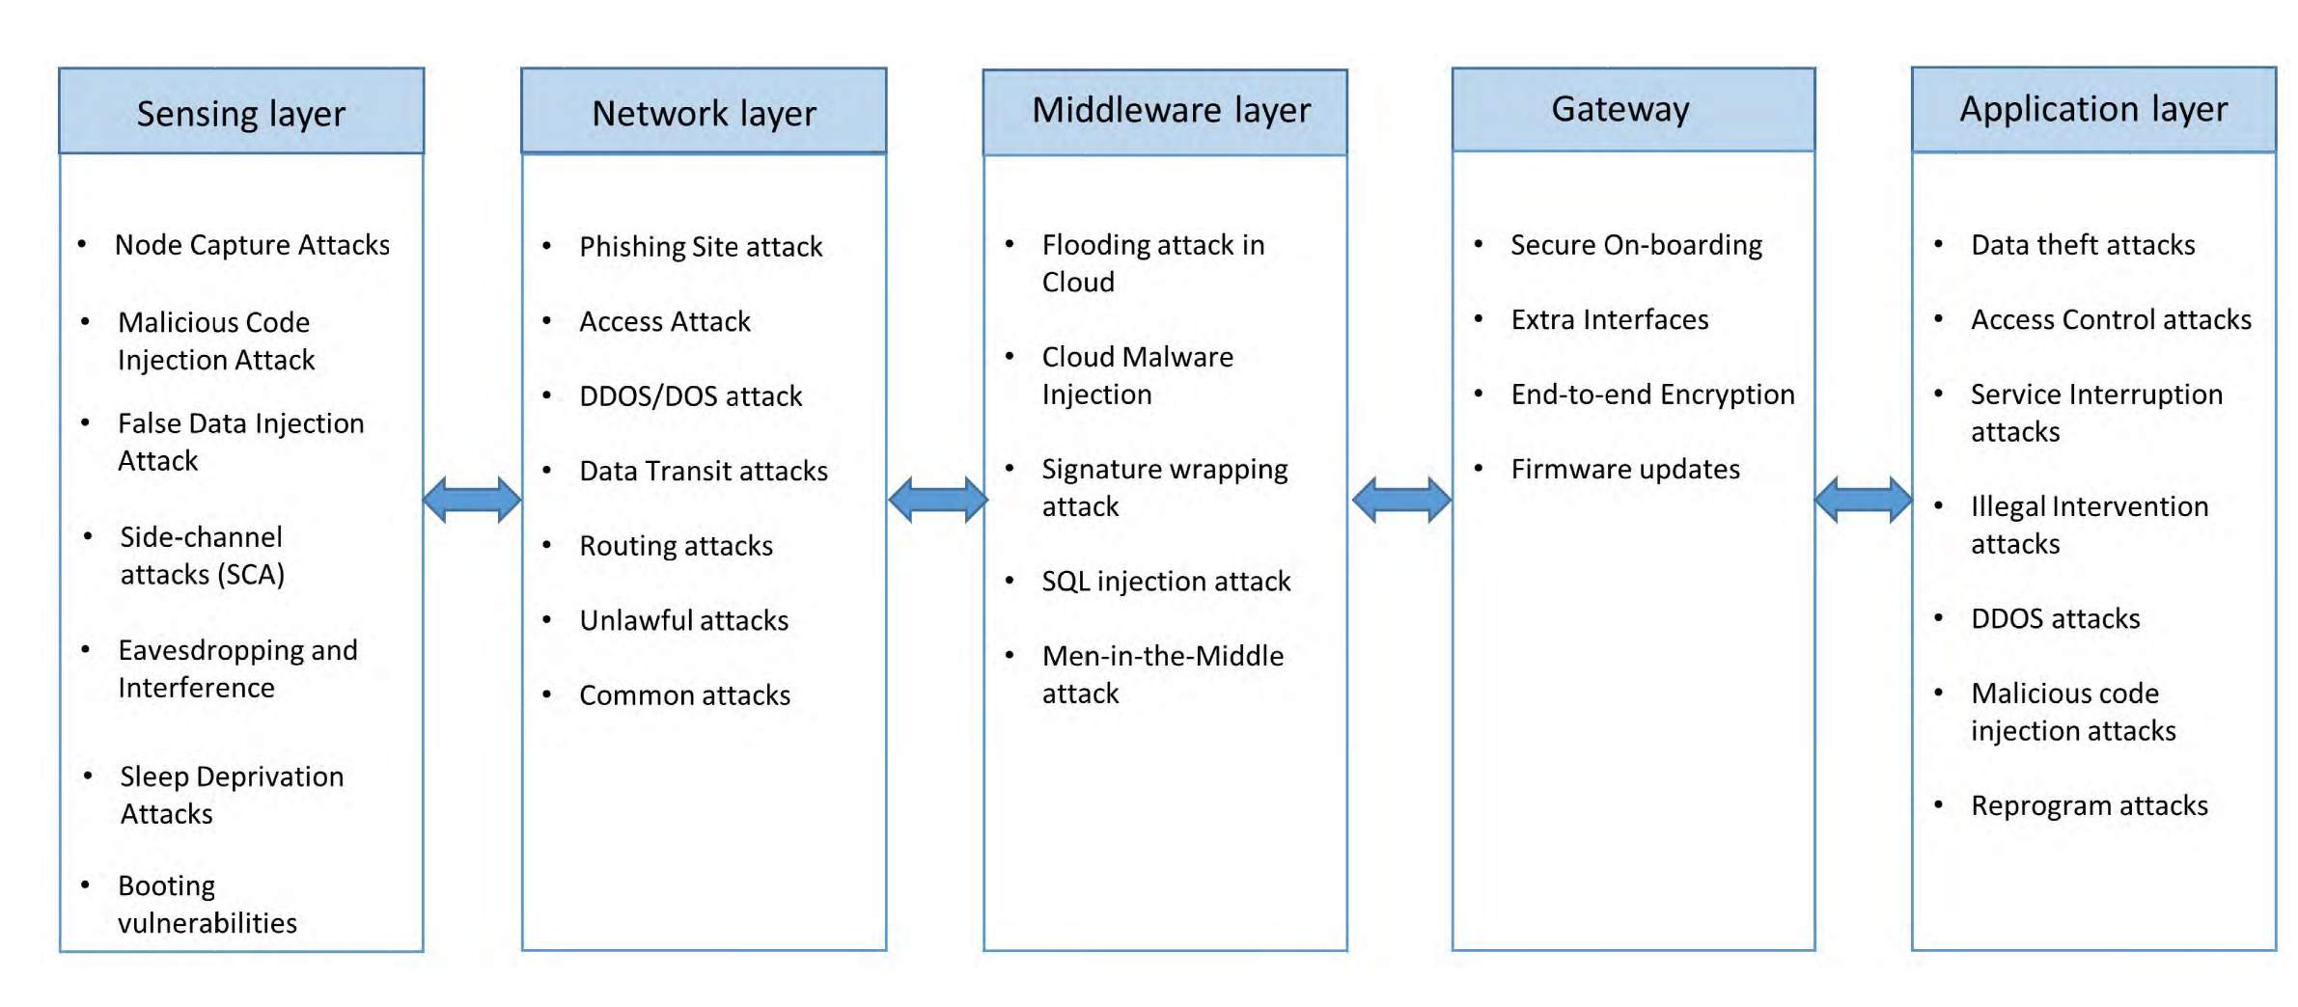
Types of attacks on IoT

Slide 9
Security Issues at Sensing Layer
There are various kinds of sensors for sensing different kinds of data, e.g., ultrasonic sensors, camera sensors, smoke detection sensors, temperature and humidity sensors, etc. There can be mechanical, electrical, electronic or chemical sensors used to sense the physical environment.
Node capturing: The attackers may try to capture or replace the node in the IoT system with a malicious node. The new node may appear to be the part of the system but is controlled by the attacker. This may lead to compromising the security of the complete IoT application.
Malicious Code Injection Attack: The attack involves the attacker injecting some malicious code in the memory of the node. Generally, the rmware or software of IoT nodes are upgraded on the air, and this gives a gateway to the attackers to inject malicious code. Using such malicious code, the attackers may force the nodes to perform some unintended functions or may even try to access the complete IoT system.

Slide 10
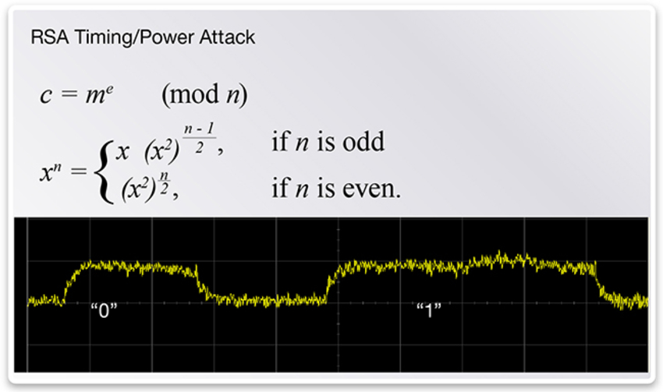
Security Issues at Sensing Layer
False Data Injection Attack: Once the node is captured, the attacker may use it to inject erroneous data onto the IoT system. This may lead to false results and may result in malfunctioning of the IoT application. The attacker may also use this method to cause a DDoS attack.
Side-channel Attack: In computer security, a side-channel attack is any attack based on information gained from the implementation of a computer system, rather than weaknesses in the implemented algorithm itself (e.g. cryptanalysis and software bugs). Timing information, power consumption, electromagnetic leaks or even sound can provide an extra source of information, which can be exploited.
Eavesdropping and Interference: IoT applications often consist of various nodes deployed in open environments . As a result, such IoT applications are exposed to eavesdroppers. The attackers may eavesdrop and capture the data during different phases like data transmission or authentication.

Slide 11
Security Issues at Sensing Layer
Sleep Deprivation Attacks: In such type of attacks the adversaries try to drain the battery of the low-powered IoT edge devices. This leads to a denial of service from the nodes in the IoT application due to a dead battery. This can be done by running infinite loops in the edge devices using malicious code or by artificially increasing the power consumption of the edge devices.
Booting Attacks: The edge devices are vulnerable to various attacks during the boot process. This is because the inbuilt security processes are not enabled at that point. The attackers may take advantage of this vulnerability and try to attack the node devices when they are being restarted. As edge devices are typically low powered and at times go through sleep-wake cycles, it is thus essential to secure the boot process in these devices.

Slide 12

Security Issues at Network Layer
Phishing Site Attack: Phishing is when attackers attempt to trick users into doing 'the wrong thing', such as clicking a bad link that will download malware, or direct them to a dodgy website. Once the user's account and password are compromised, the whole IoT environment being used by the user becomes vulnerable to cyber attacks. The network layer in IoT is highly vulnerable to phishing sites attacks.
Access attack: Access attack is also referred to as advanced persistent threat (APT). This is a type of attack in which an unauthorized person or an adversary gains access to the IoT network. The attacker can continue to stay in the network undetected for a long duration. The purpose or intention of this kind of attack is to steal valuable data or information, rather than to cause damage to the network. IoT applications continuously receive and transfer valuable data and are therefore highly vulnerable to such attacks.

Slide 13
Security Issues at Network Layer
DDoS/DoS Attack: In this kind of attacks, the attacker floods the target servers with a large number of unwanted requests. This incapacitates the target server, thereby disrupting services to genuine users. If there are multiple sources used by the attacker to flood the target server, then such an attack is termed as DDoS or distributed denial of service attack. Such attacks are not specific to IoT applications, but due to the heterogeneity and complexity of IoT networks, the network layer of the IoT is prone to such attacks. Many IoT devices in IoT applications are not strongly configured, and thus become easy gateways for attackers to launch DDoS attacks on the target servers.
Data Transit Attacks: IoT applications deal with a lot of data storage and exchange. Data is valuable, and therefore it is always the target of hackers and other adversaries. Data that is stored in the local servers or the cloud has a security risk, but the data that is in transit or is moving from one location to another is even more vulnerable to cyber attacks. In IoT applications, there is a lot of data movement between sensors, actuators, cloud, etc. Diffèrent connections technologies are used in such data movements, and therefore IoT applications are susceptible to data breaches.

Slide 14
Security Issues at Network Layer
Routing Attacks: In such attacks, malicious nodes in an IoT application may try to redirect the routing paths during data transit. Sinkhole attacks are a specific kind of routing attack in which an adversary advertises an artificial shortest routing path and attracts nodes to route traffic through it. A worm-hole attack is another attack which can become serious security threat if combined with other attacks such as sinkhole attacks. A warm-hole is an out of band connection between two nodes for fast packet transfer. An attacker can create a warm-hole between a compromised node and a device on the internet and try to bypass the basic security protocols in an IoT application.

Slide 15
Security Issues at Middleware Layer
Man-in-the-Middle Attack: The MQTT protocol uses publish-subscribe model of communication between clients and subscribers using the MQTT broker, which effectively acts as a proxy. This helps in decoupling the publishing and the subscribing clients from each other and messages can be sent without the knowledge of the destination. If the attacker can control the broker and become a man-in-the-middle, then he/she can get complete control of all communication without any knowledge of the clients.
SQL Injection Attack: MIddleware is also susceptible to SQL Injection (SQLi) attacks. In such attacks, attacker can embed malicious SQL statements in a program. Then, the attackers can obtain private data of any user and can even alter records in the database.

Slide 16
Security Issues at Middleware Layer
Signature Wrapping Attack: In the web services used in the middleware, XML signatures are used. In a signature wrapping attack, the attacker breaks the signature algorithm and can execute operations or modify eavesdropped message by exploiting vulnerabilities in SOAP (Simple Object Access Protocol).
Cloud Malware Injection: In cloud malware injection, the attacker can obtain control, inject malicious code or can inject a virtual machine into the cloud. The attacker pretends to be a valid service by trying to create a virtual machine instance or a malicious service module. In this way, the attacker can obtain access to service requests of the victim's service and can capture sensitive data which can be modified as per the instance.
Flooding Attack in Cloud: This attack works almost the same as DoS attack in the cloud and affects the quality of service (QoS). For depleting cloud resources, the attackers continuously send multiple requests to a service. These attacks can have a big impact on cloud systems by increasing the load on the cloud servers.

Slide 17
Security Issues at Gateway Layer
Secure On-boarding: When a new device or sensor is installed in an IoT system, it is imperative to protect encryption keys. Gateways act as an intermediary between the new devices and the managing services, and all the keys pass through the gateways. The gateways are susceptible to man-in-the-middle attacks and eavesdropping to capture the encryption keys, especially during the on-boarding process.
Extra Interfaces: Minimizing the attack surface is an important strategy that needs to be kept in mind while installing the IoT devices. Only the necessary interfaces and protocols should be implemented by an IoT gateway manufacturer. Some of the services and functionalities should be restricted for end-users to avoid backdoor authentication or information breach.

Slide 18
Security Issues at Gateway Layer
End-to-End Encryption: True end-to-end application layer security is required to ensure the confidentiality of the data. The application should not let anyone other than the unique recipient to decrypt the encrypted messages. Although Zigbee and Zwave protocols support encryption, this is not end-to-end encryption, because, in order to translate the information from one protocol to another, the gateways are required to decrypt and re-encrypt the messages. This decryption at the gateway level makes the data susceptible to data breaches.
Firmware updates: Most IoT devices are resource constrained, and therefore they do not have an user interface or the computation power to download and install the firmware updates. Generally, gateways are used to download and apply the firmware updates. The current and new version of the firmware should be recorded, and validity of the signatures should be checked for secure firmware updates.

Slide 19
Security Issues at Application Layer
Data Thefts: IoT applications deal with lot of critical and private data. The data in transit is even more vulnerable to attacks than data at rest, and in IoT applications, there is a lot of data movement. The users will be reluctant to register their private data on IoT applications if these applications are vulnerable to data theft attacks.
Access Control Attacks: Access control is authorization mechanism that allows only legitimate users or processes to access the data or account. Access control attack is a critical attack in IoT applications because once the access is compromised, then the complete IoT application becomes vulnerable to attacks.
Service Interruption Attacks: These attacks are also referred to as illegal interruption attacks or DDoS attacks in existing literature. There have been various instances of such attacks on IoT applications. Such attacks deprive legitimate users from using the services of IoT applications by artificially making the servers or network too busy to respond.

Slide 20
Security Issues at Application Layer
Malicious Code Injection Attacks: Attackers generally go for the easiest or simplest method they can use to break into a system or network. If the system is vulnerable to malicious scripts and misdirections due to insufficient code checks, then that would be the first entry point that an attacker would choose. Generally, attackers use XSS (cross-site scripting) to inject some malicious script into an otherwise trusted website. A successful XSS attack can result in the hijacking of an IoT account and can paralyze the IoT system.
Sniffing Attacks: The attackers may use sniffer applications to monitor the network traffic in IoT applications. This may allow the attacker to gain access to confidential user data if there are not enough security protocols implemented to prevent it.
Reprogram Attacks: If the programming process is not protected, then the attackers can try to reprogram the IoT objects remotely. This may lead to the hijacking of the IoT network

Slide 21
Significant Improvements and Enhancements
Rigorous penetration testing for IoT devices is necessary to quantify the level of risk involved in deploying these devices in different applications.
Encryption techniques are being used in IoT system at different layers and protocols. End to end encryption would be a promising solution to prevent different attacks.
Authenticate-always protocols need to be implemented. Whenever a device wants to interact with another device, an authentication process should be implemented.
Any IoT security framework being implemented should be tested and confirmed for scalability. The security protocols should not be working only for a limited set of users.

Slide 22
Significant Improvements and Enhancements
A mechanism based on encryption techniques like RSA, SHA256, or hash chains is required to secure the user and environment data from being captured.
A paradigm shift from a centralized approach to some decentralized approach might be needed, where devices can automatically and securely communicate with each other.
Since most of the IoT applications use cloud services for data storage and retrieval, the risks caused by the cloud should also be considered. Cloud is a public platform used by multiple users and there may be malicious users on the cloud who can be the cause of threat for IoT related data. The data should be stored as ciphertext in the cloud and the cloud should not be allowed to decrypt any ciphertext.

Slide 23
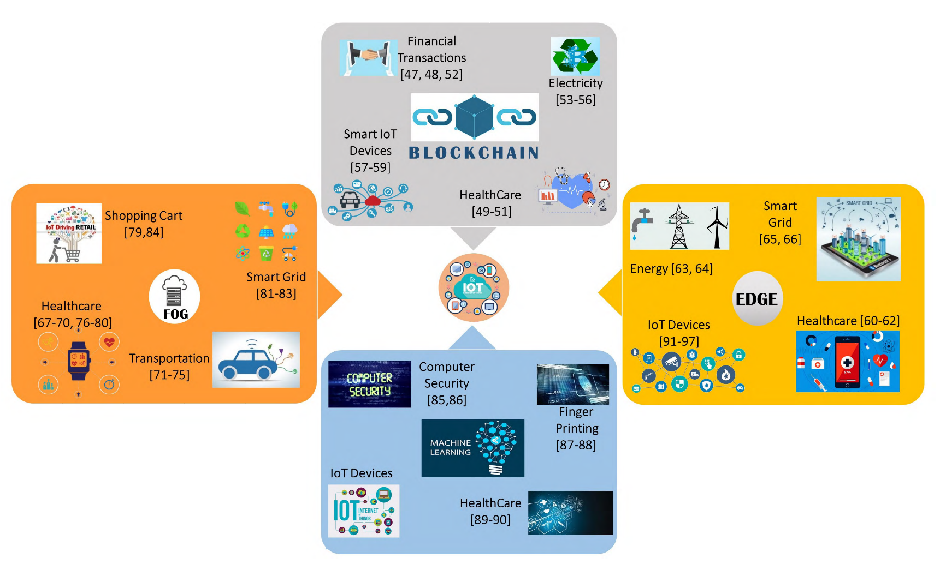
Various Techniques and Approaches for Securing IoT Environments
Blockchain based solutions;
Fog computing based
Machine learning based solutions
Edge computing based solutions

Slide 24
IoT SECURITY USING BLOCKCHAIN
The basic idea behind the blockchain is simple: it is a distributed ledger (also called replicated log les).
There are two types of blockchain architectures based on the type of data being added:
  In permission-less blockchain, there is no specic permission required for a user to become the part of the blockchain network or to become a miner. Anyone can join or leave this network of permission-less blockchain. The best example of permission-less blockchains is Bitcoin.
  The permissioned blockchains have a dened set of rules to participate in the blockchain network. The miners are also the authorized persons and the blocks are allowed to be added to the chain only after their validation. The blockchain of Ripple and Hyperledger are two prime examples of permissioned blockchain.

Slide 25
BENEFITS OF BLOCKCHAIN IN IoT
Data coming from IoT devices can be stored in Blockchain
Distributed nature of blockchain allowing secure data storage
Data encryption using the hash key and verfied by miners
Prevention from data loss and spoong attacks
Blockchain to prevent unauthorized access
Proxy-based architecture in blockchain for resource-constrained devices
Elimination of centralized cloud servers

Slide 26
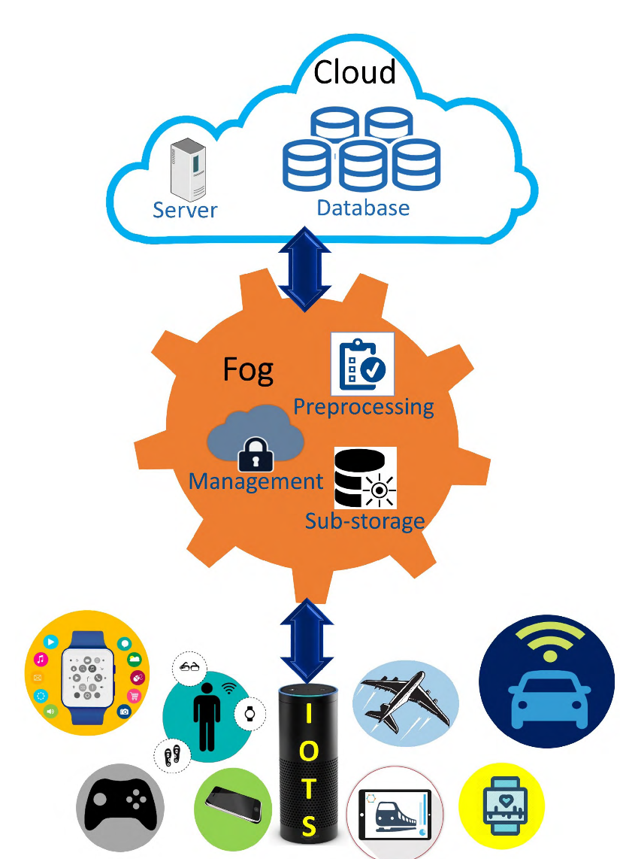
IoT SECURITY USING FOG COMPUTING
Fog computing reduces the data traffic between cloud and network edge by 90% and average response time for a user by 20% when compared with cloud-only model.

Slide 27
IoT SECURITY USING FOG COMPUTING
Man-in-the-middle attack: Fog acts as a security layer between end-user and cloud or IoT system. All threats or attacks on the IoT systems need to pass through the fog layer in between, and this layer can identify and mitigate unusual activities before they are passed to the system.
Data transit attacks: Data storage and management is much better if performed on the secure fog nodes, as compared to the IoT devices. Data will be better protected if it is stored on the fog nodes as compared to storing the data on the end-user devices. Fog nodes also help in making the user data more available.
Eavesdropping: Using fog nodes, the communication takes place between the end-user and the fog node only, rather than routing the information through the entire network. The chances of an adversary trying to eavesdrop reduces a lot because the traffic on the network is reduced.

Slide 28
IoT SECURITY USING FOG COMPUTING
Resource-constraint issues: Most of the IoT devices are resource constrained and the attackers take advantage of this fact. They try to damage the edge devices and use them as the weak links to enter the system. Fog nodes can support the edge devices and can prevent them from being affected by such attacks.
Incident response services: Fog nodes can be programmed to provide real-time incident response services. Fog nodes can generate a ag to the IoT system or the end users as soon as they encounter a suspicious data or request. Fog computing allows for malware detection and problem resolution in transit. In many critical applications, it might not be possible to stop the entire system to resolve malware incidences. Fog nodes can help in such resolutions while the system is up and running.

Slide 29
SOLUTIONS PROVIDED BY ML TO OVERCOME
SECURITY THREATS
DoS Attack: DoS attacks on IoT devices or originating from IoT devices are a serious concern. One approach to prevent such attacks is to use a Multi-Layer Perceptron (MLP) based protocol that secures networks against DoS attacks.
Eavesdropping: Attackers may eavesdrop on messages during data transmission. To provide protection from such attacks, ML techniques such as Q-learning based offloading strategy or non-parametric Bayesian techniques can be used. Schemes such as Q-learning and Dyna-Q are ML techniques that may also be used to protect devices from eavesdropping.
Spoofing: Attacks from spooffers can be avoided by using Q-learning, Dyna-Q, Support Vector Machines (SVM), Deep Neural Network (DNN) model, incremental aggregated gradient (IAG), and distributed FrankWolfe (dFW) techniques.

Slide 30
SOLUTIONS PROVIDED BY ML TO OVERCOME
SECURITY THREATS
Digital Fingerprinting: Digital fingerprinting is one of the upcoming and promising solutions to secure IoT systems and to help the end users gain sufficient trust in the applications. Fingerprints are being widely used to unlock smartphones, approve payments, unlock the car and home doors, etc. Due to its low cost, reliability, acceptability and high-security level, digital fingerprinting is emerging as a dominant bio-metric identification method

Slide 31
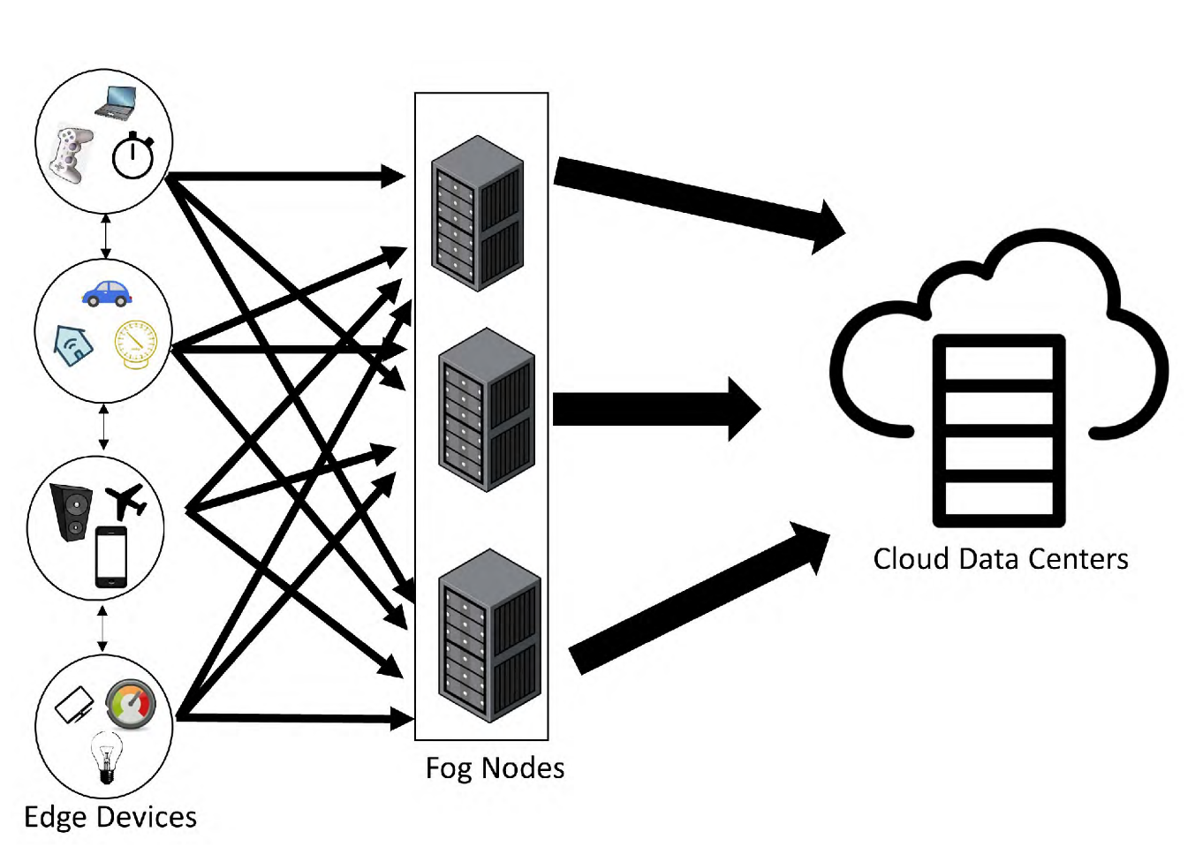
IoT SECURITY USING EDGE COMPUTING
Data Breaches: In edge computing, all the data is stored and processed within the device or local network. There is no movement of the data from the data originator to the processor. This prevents the data from being in transit and thereby prevents the risk of data thefts and data breaches.

Slide 32
IoT SECURITY USING EDGE COMPUTING
Data Compliance Issues: Many countries have strict regulatory acts to prevent data movement outside their boundaries, e.g., European Union's GDPR (General Data Protection Regulation). Using edge computing, organizations can keep the data within their borders and ensure compliance with data sovereignity laws
Safety Issues: With the increase in the deployment of cyber-physical systems, security and safety are considered as integral issues. If there is even a little delay in responses, then that may lead to physical safety issues. For example, if the sensors in a car predict that a crash is about to happen, then the airbags have to be deployed immediately.
Bandwidth Issues: IoT application generate a lot of data at very high rate. Most of this data is raw and of relatively low-value. Sending all the data to the cloud involves a lot of bandwidth cost as well, along with the security challenges of data movement. If edge computing is used, then a lot of data cleaning and aggregation can be done at the edge nodes and only the summarized data, if required, needs to be sent to the cloud

