Slide 1
IoT Platforms
By: Mahmood Ahmadi

Slide 2
Rererences
Papers:
  Guth J. et al. (2018) A Detailed Analysis of IoT Platform Architectures: Concepts, Similarities, and Differences. In: Di Martino B., Li KC., Yang L., Esposito A. (eds) Internet of Everything. Internet of Things (Technology, Communications and Computing). Springer, Singapore. https://doi.org/10.1007/978-981-10-5861-5_4
  Ray PP, A Survey of IoT Cloud Platforms, Future Computing and Informatics Journal (2017), https:/doi.org/ 10.1016/j.fcij.2017.02.001.
  Agarwal P., Alam M. (2020) Investigating IoT Middleware Platforms for Smart Application Development. In: Ahmed S., Abbas S., Zia H. (eds) Smart Cities—Opportunities and Challenges. Lecture Notes in Civil Engineering, vol 58. Springer, Singapore. https://doi.org/10.1007/978-981-15-2545-2_21
A chapter of book:
  Chapter 5, The Enablement Platforms for IoT Applications and Analytics, The Internet of Things Enabling Technologies, Platforms, and Use Cases, Pethuru Raj, Anupama C. Raman, Taylor an Francis, CRC press, 2017

Slide 3
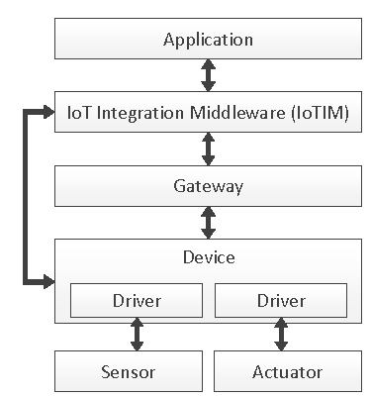
IoT reference architecture
An Actuator is a hardware component which manipulates the physical environment. Actuators receive commands from their connected Device and translate these electrical signals into some kind of physical action. For instance, an Actuator turning on or off a ventilation within a room acts on the physical environment by influencing the humidity of the room.
Devices have a processor and storage capacity to run software and to establish a connection to the IoT Integration Middleware.
A Gateway provides required technologies and mechanisms to translate between different protocols, communication technologies, and payload formats.

Slide 4
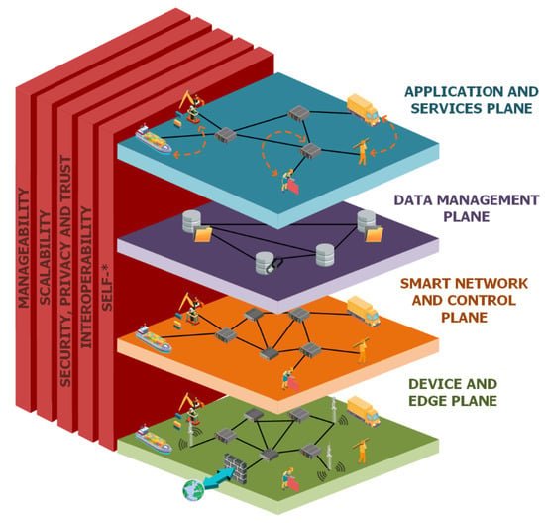
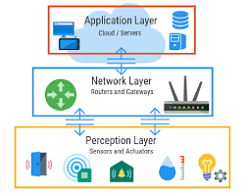
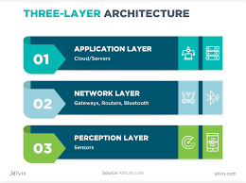
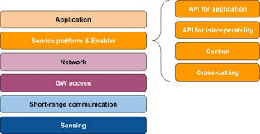
IoT reference architecture

Slide 5
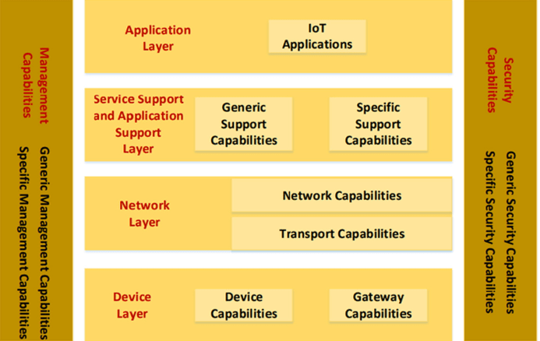
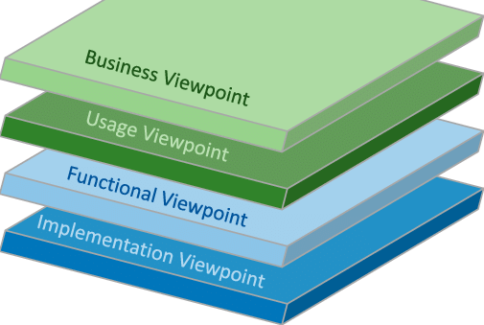
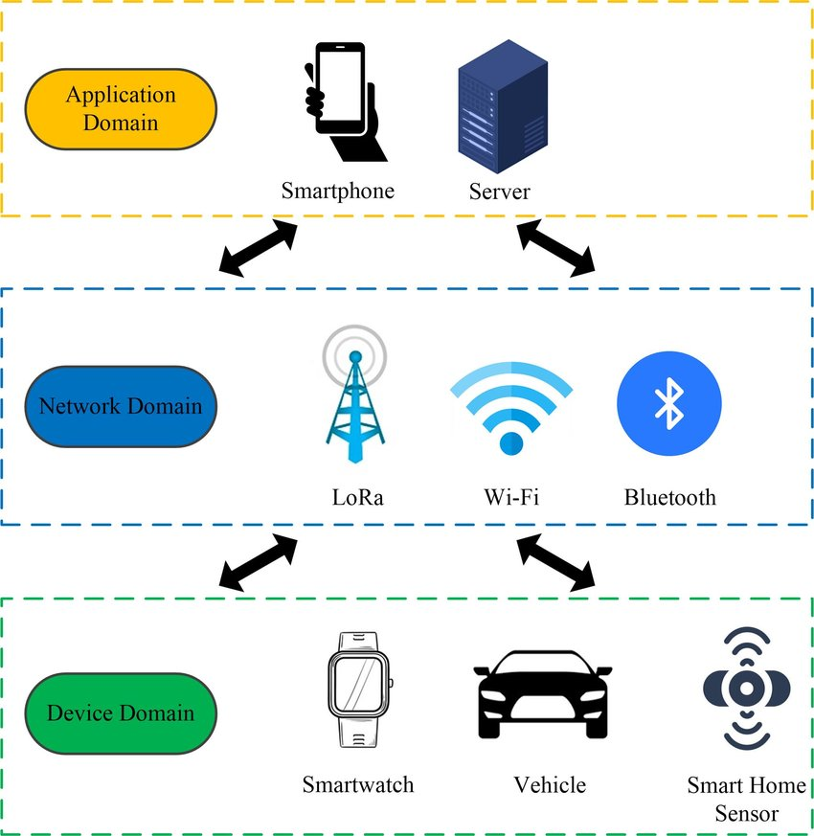
IoT reference architecture

Slide 6
IoT Integration Middleware
The IoT Integration Middleware (IoTIM) serves as an integration layer for different kinds of Sensors, Actuators, Devices, and Applications.
It is responsible for
  Receiving data from the connected Devices,
  Processing the received data,
  Providing the received data to connected Applications, and controlling Devices.
A Device can communicate directly with the IoT Integration Middleware if it supports an appropriate communication technology, such as IP over Ethernet or WiFi, a corresponding transport protocol, such as HTTP or MQTT

Slide 7
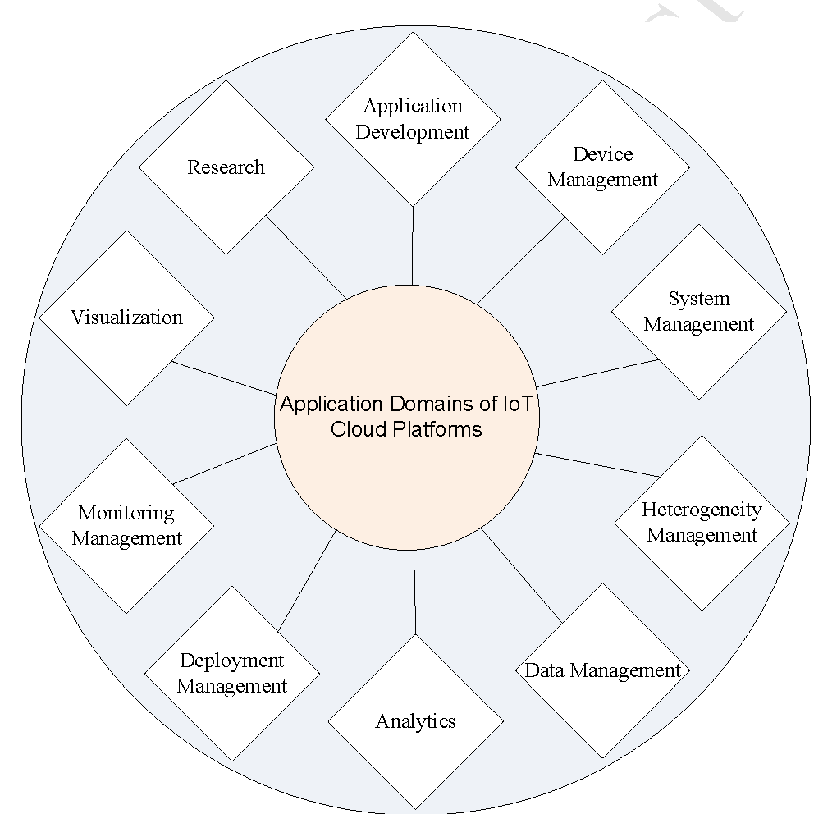
Application domains of IoT cloud platforms

Slide 8
Criteria for Selection of the Right IoT Middleware Platform
Availability: Availability and stability are important parameters for application requirement. Smart healthcare application requires patient medical data to be monitored continuously (24*7).
Deployment type: According to the resource requirement, developer can choose among different cloud deployment models- Infrastructure as a Service (IaaS), Platform as a Service (PaaS), and Software as a Service (SaaS).
Pricing Model: Some support pay as you execute, some pay per storage, pay according to number of connected devices, some are subscription based. Microsoft Azure charges based on number of devices and messages. Kaa and ThingSpeak are open sources and free, good for personalized applications.
Support for required Hardware: Number of IoT boards like Arduino Yun, Photon, Raspberry Pi, etc. are available in market. AWS IoT have highest number of compatible hardware devices.
Security Requirement: Microsoft Azure IoT and Kaa platform provides flexibility to users to implement their own security policies.

Slide 9
Criteria for Selection of the Right IoT Middleware Platform
Type of communication protocol support: CoAP is similar to HTTP but is lightweight, therefore more suitable for mobile applications. MQTT is also lightweight and supports broker concept, making it good for limited bandwidth applications.
Storage Technologies used: Mainly vendors use cloud as their storage. AWS IoT supports largest number of storage technologies.
Type of Analytics Supported: IoT applications usually require either Real time/Streaming data or historic data for application development. ThingSpeak and Kaa supports M2M applications. AWS IoT, Microsoft Azure IoT, Google IoT, Oracle IoT, ThingSpeak support real time analytics on streaming data. AWS IoT also supports artificial Intelligence.

Slide 10
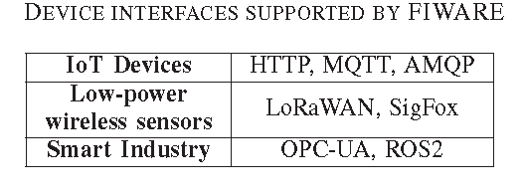
FIWARE
FIWARE is funded by the European Union and the European Commission.
It provides an enhanced OpenStack-based cloud.
Devices can communicate directly with the IoT Back-End or via a Gateway.
The IoT Edge represents the Gateway
The IoT Back-End and the Data Context Broker provide the main functionality of FIWARE, and therefore they are encapsulated by our IoT Integration Middleware.

Slide 11
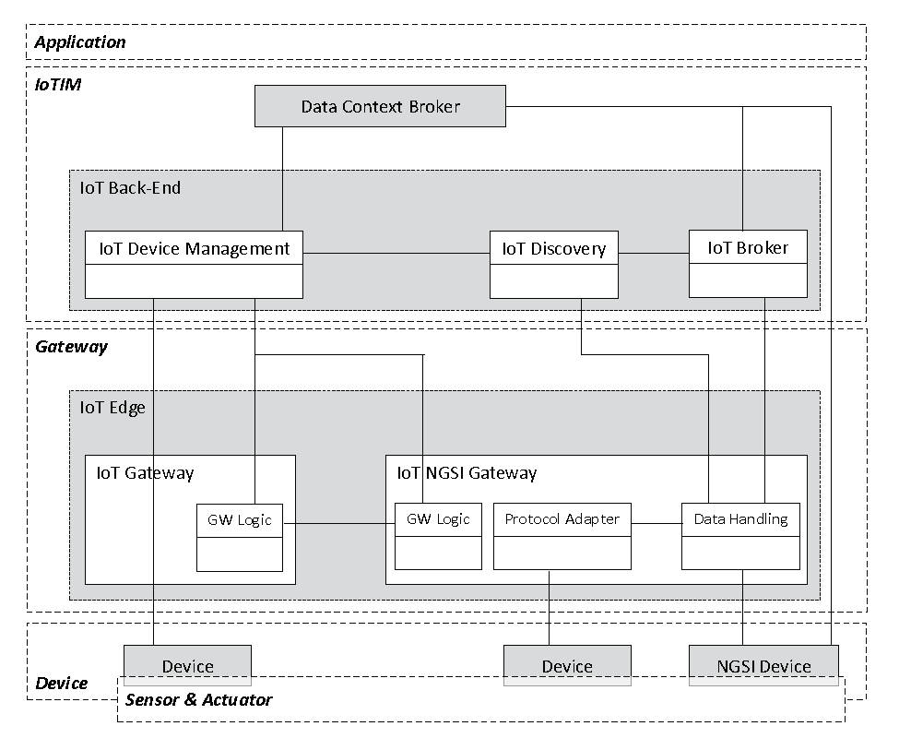
FiWARE refrence architeture
City Platform as a Service
Urban water management scenario
An automated deriving scenario

Slide 12
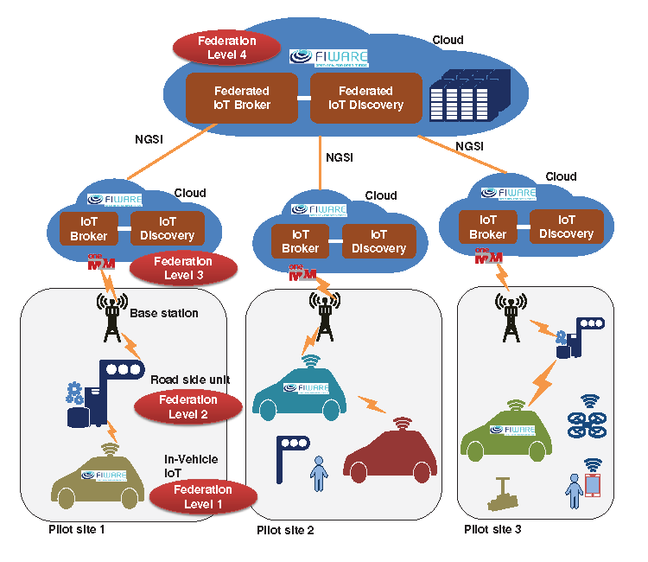
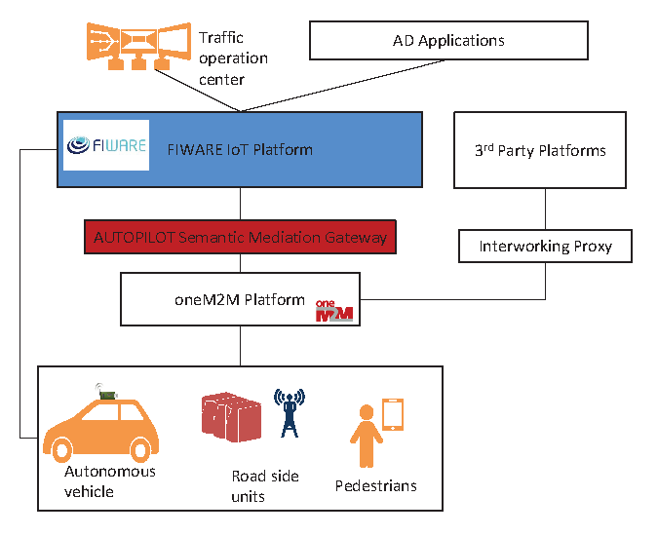
Fiware sample cases

Slide 13
OpenMTC Platform
OpenMTC7 is an open-source, cloud-enabled IoT platform.
OpenMTC is composed of the following components: The Front- and Back-End, the Sensors and Actuators component beneath the Front-End, the connectivity between the Front- and Back-End, Applications positioned on top of the Back-End and on the right side of the Front-End
Mobile tracking system, Forest fire detection, smart city, and ECG monitoring

Slide 14
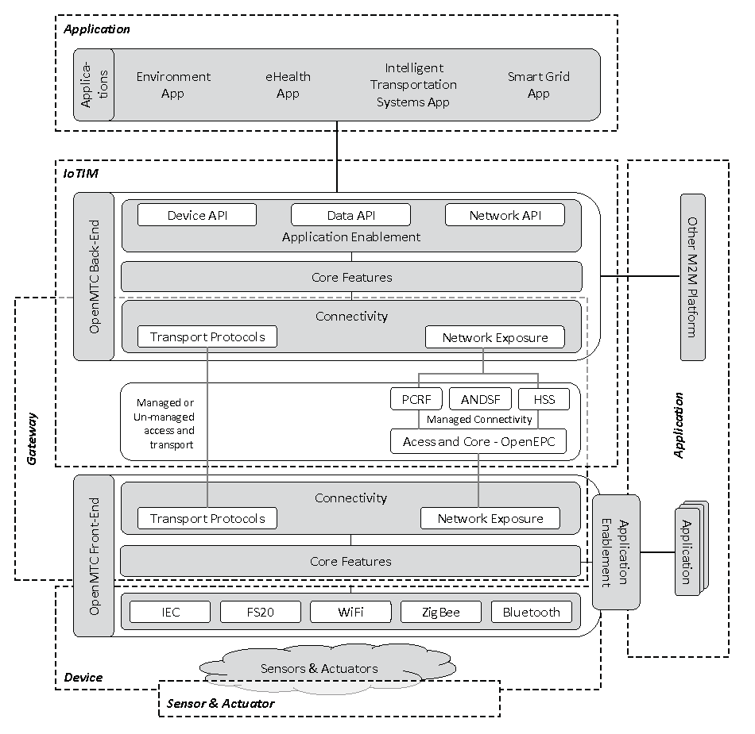
OpenMTC

Slide 15
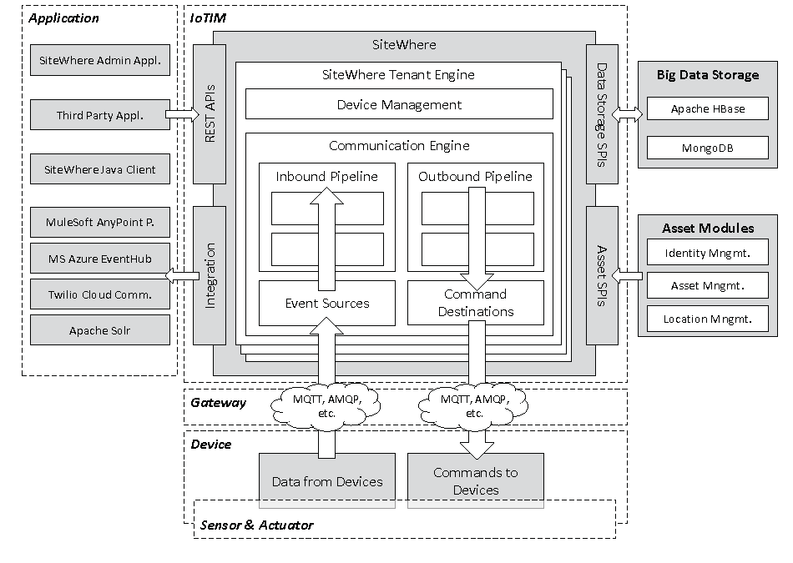
SiteWhere
SiteWhere is an open-source IoT platform
Connectivity: SiteWhere supports various IoT protocols such as Restful, MQTT, AMQP, Stomp, CoAP, Socket, and Web Socket.
Device management: SiteWhere provides device specifications, device groups, asset assignment and comprehensive administration GUI.
Data storage and visualization: SiteWhere support various databases such as MongoDB, HBase, and InfluxDB.
Data Analytics: can be obtained by integrating SiteWhere with a Siddhi software engine for Complex Event Processing (CEP) and Apache Spark.

Slide 16
Webinos
The Webinos is an open-source middleware for the IoT and mobile devices, sponsored by the European Union FP7 project.
The aim of Webinos is to provide a secure framework for personal devices to communicate and for individuals to publish data to third-parties and to other individuals.
The main components of the Webinos architecture are the Personal Zone Hub (PZH), and the Personal Zone Proxy (PZP).
  The PZH provides the Gateway, where each Device connects to. The PZH also provides local communications between devices by acting as a messaging hub.
  The PZP, that aggregates sensor data and actuator commands and communicates with the PZH.

Slide 17
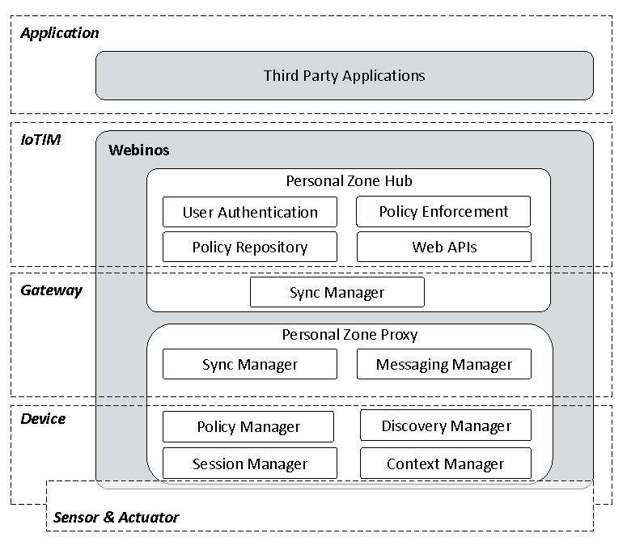
Webinos Architeture
Smart city

Slide 18
AmazonWeb Services IoT (AWS IoT)
AWS uses the concept of Things instead of devices.
The Things component is covered by our Device, Sensor, and Actuator components.
The Message Broker, Thing Shadows, Thing Registry, Rules Engine, and the Security and Identity components provide the main functionality of the platform.
Our Application component encapsulates the already integrated data processing services, such as AWSLambda or Amazon Kinesis.
It provides a virtual cluster of computers including CPUs, HDD/SDD storage, RAM memory, GPUs for processing.
AWS IoT supports both the MQTT, Websockets and HTTP protocol for data transfer

Slide 19
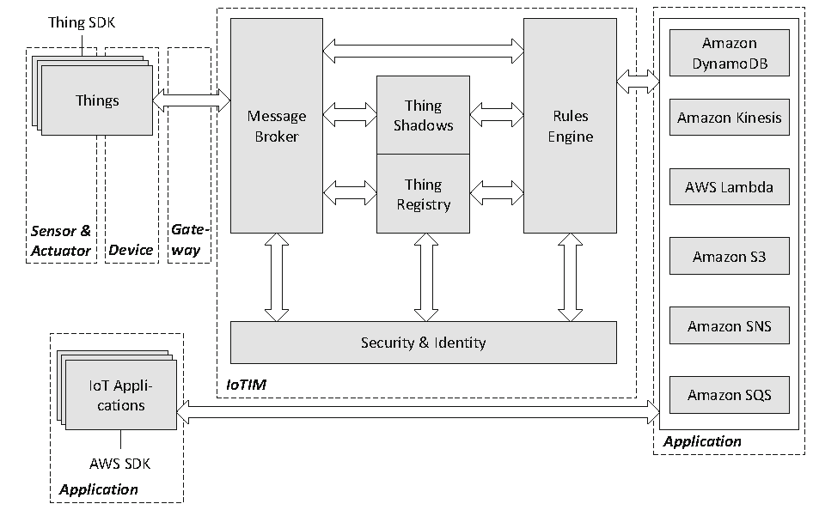
AWS-IOT platform
Hardware compatibility: Broadcom, Marvell, Renasas, Texas Instruments,
Microchip Intel

Slide 20
IBM Watson IoT Platform
It supports programing languages like java, php, Python, Node.js
Key features:
  Powerful web dashboard
  Device Registration
  Scalable connectivity
  Security of communication
  Storage of data
  Provided support if required
Pay according to number of devices, data traffic and data storage
ARM Embed, Texas Instruments, Raspberry Pi, Arduino Uno

Slide 21
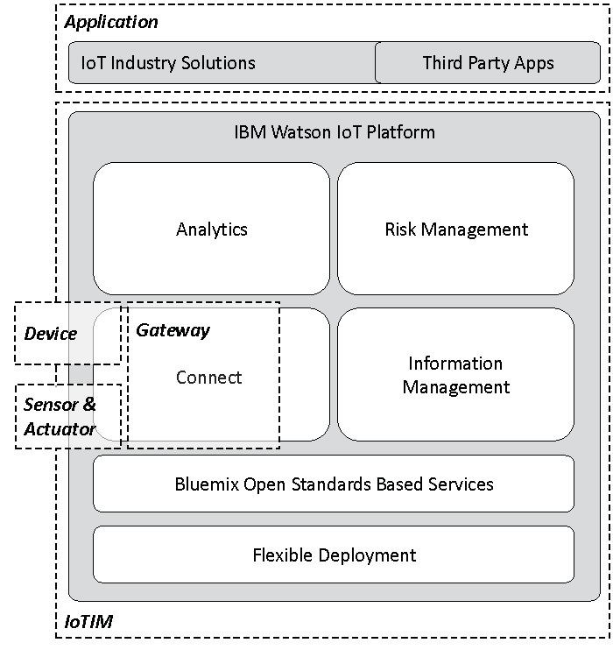
IBM Watson IoT Platform
MQTT and restfull support

Slide 22
Microsoft Azure IoT Hub
In Microsoft Azur opinion, IoT is Internet of Your things.
Azure IoT offerings are divided into two categories: SaaS and PaaS
IoT Central has three tiers to choose from: Free, Standard 1, and Standard 2.
The Free tier is only free for seven days with the first five devices free. Additional devices cost less than $1 per month and an additional 1 million messages cost $15 per month for a standard message size of 4 KB.
IoT Hub is a PaaS solution. It is called hub because it is a central unit for all of the Messages supporting bidirectional communication between device and cloud;
It manages billions of IoT devices.
There are two tiers available in IoT Hub: Basic and Standard.
Standard allows IoT Edge, streaming, and cloud-to-device communication.
IPv6 is currently not supported on IoT Hub.

Slide 23
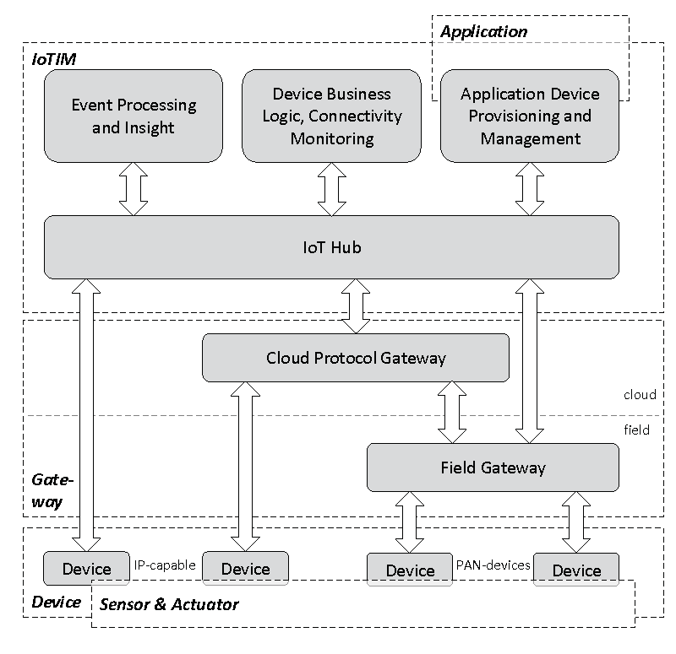
Microsoft Azure IoT Hub
Digital Twins is a PaaS service. This service represents the next generation of IoT, which models the world of devices in physical space.
It can maintain a graph of people and devices, so when a lot of people walk in a corner of the floor that no one had previously been in that day, the cooler or heater will start in that section of the floor.

Slide 24
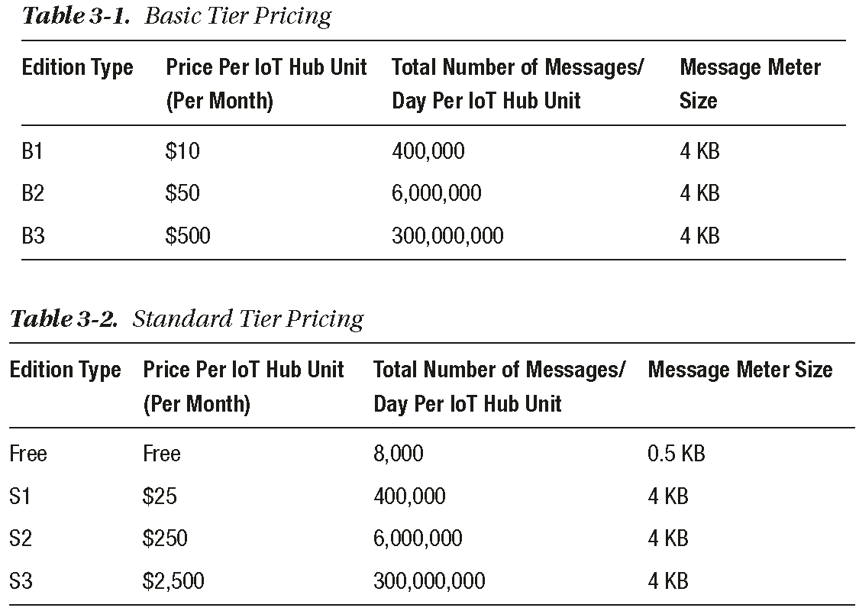
Microsoft Azure IoT Hub

Slide 25
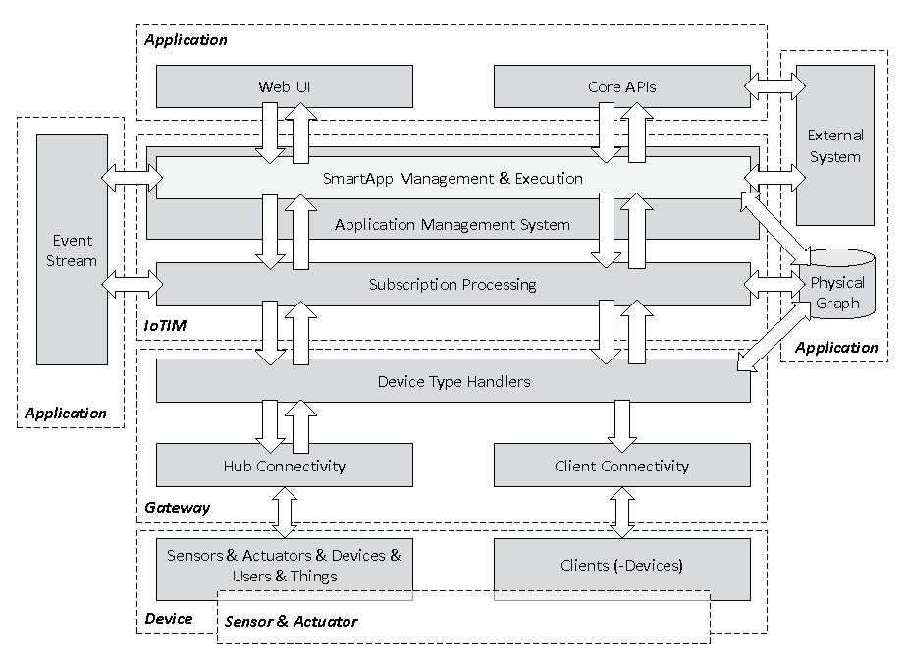
SmartThings
SmartThings is an IoT platform provided by Samsung for a smart home environment.
It is composed of three core elements, namely the Device Type Handlers, the Subscription Processing, and the Application Management System.
Zigbee, Zwave, Wifi
Access and control devices from the SmartThings app, available on all platforms and installed on more than 200 million Samsung mobile devices and TVs.

Slide 26
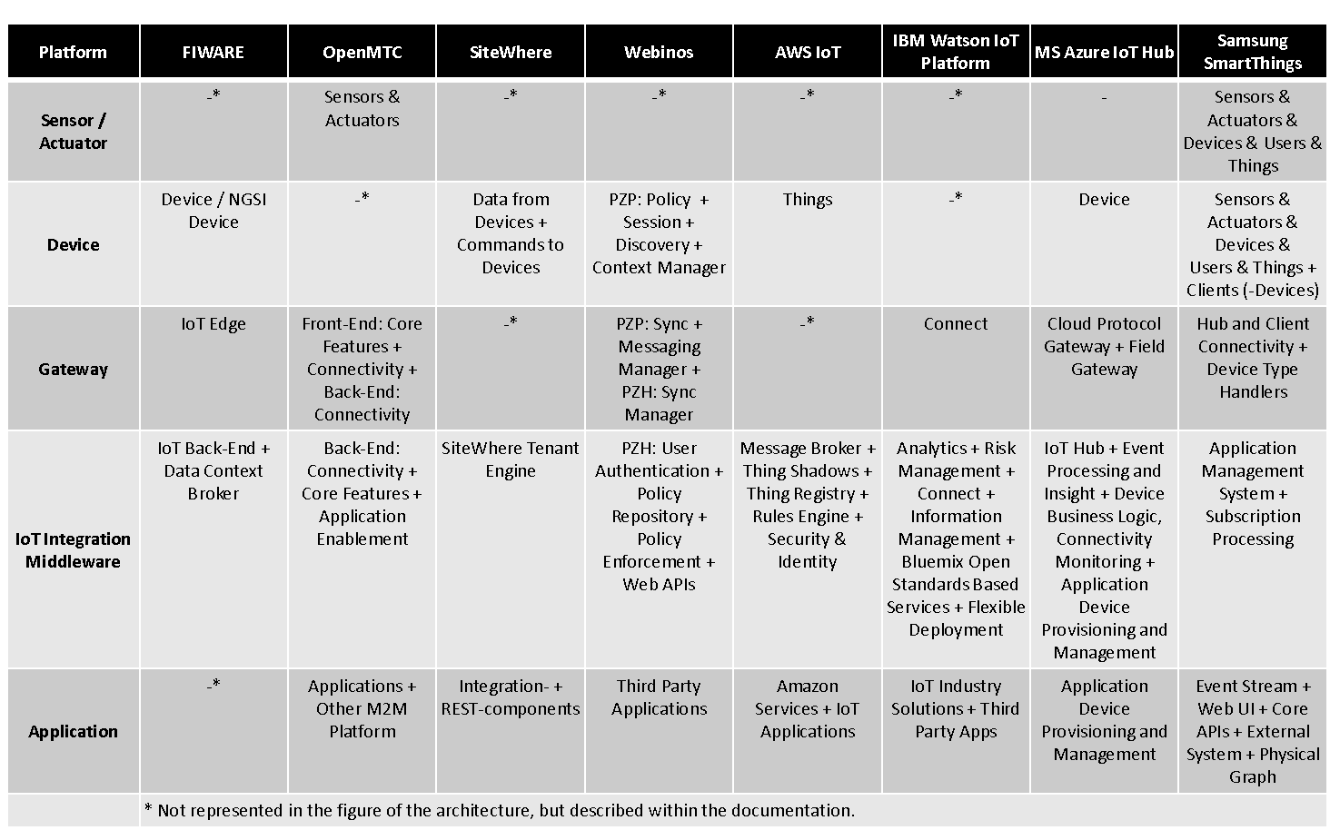
IoT platforms comparison

Slide 27
ThingSpeak
ThingSpeak is an open data platform for IoT application development.
ThingSpeak platform provides following functionality to support IoT system:
  Collect: Sends sensor and device data collected from it to the cloud
  Analyse: ThingSpeak can analyse the data received from sensors or devices
  Act: Based upon the analysis, it will trigger the action to enable functioning of IoT system and application.
Key features:
  It provides real time collection of data storage
  Data analytics and Visualization using MATLAB
  Device Communication
  Open API support
  Provides Geolocation data
  Facilitates plugins
  MQTT and HTTP
Arduino, Particle photon, ESP8266 wifi, Raspberry Pi

Slide 28
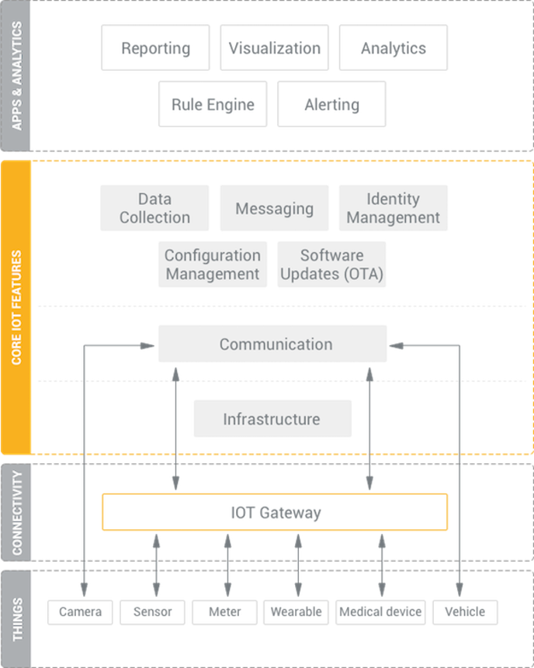
Kaa IoT Platform
All the features in Kaa are implemented with portable microservices.
Kaa provides a register of digital twins, which represent things, devices, and other entities managed by the platform.
Kaa tracks the device throughout its lifecycle.

Slide 29
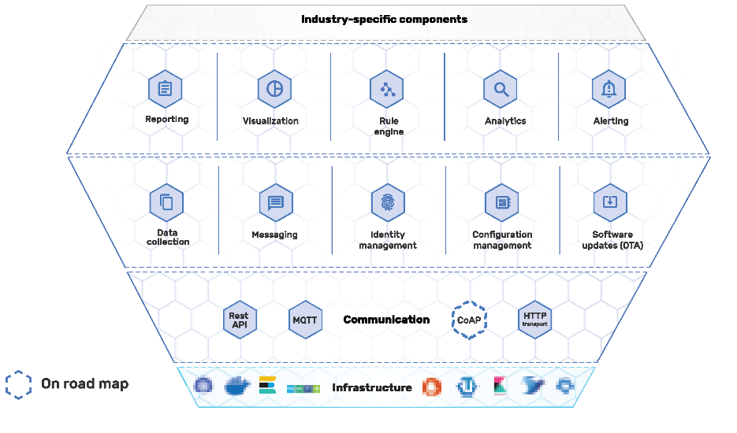
Kaa IoT platform
The Kaa platform supports advanced multitenancy, which means that a single Kaa instance may serve multiple independent tenants and each tenant’s data is completely isolated from other tenants.

Slide 30
Zetta IoT platform
Zetta is an open source platform.
It is developed in Node.js for creating IoT servers that run across geo-distributed servers and cloud.
Zetta runs everywhere: It means zetta runs in the cloud, on PCs and on single board computers.
Raspberry Pis, BwangleBones and PCs together can be linked with cloud platform like Heroku with the help of Zetta.
Architecture of Zetta is optimized for data intensive and real-time applications.
Provides streaming of data into machine analytics platforms like Splunk.
Zetta allows you to assemble smartphone apps, device apps and cloud apps together into large and complex systems. Example of such complex and large scale systems is home automation, smart transportation and wearable computing.

Slide 31
Nimbits
Nimbits is a PaaS that can be downloaded on any from Raspberry Pi, Web Server, Amazon EC2, or Google App Engine.
Nimbits is a platform for connecting people, sensors and software to the cloud and with one another.
Key features:
  Download Nimbits servers on chips, servers or on the cloud
  It is an Open-source platform
  Facilitates event triggers and alerts
  Process geo and time-stamped data
  Build provided for Google App Engine and Linux Systems for development
  Compatible with most J2EE servers

Slide 32
Yaler
Yaler is a pay-as-you use platform which provides a relay infrastructure which offers secure access to embedded systems and it works with any device with a TCP socket.
Key features:
  It provides plug-and-play functionality for end users
  Access via any browser or even phone
  Enables addressability and accessibility for devices blocked by firewalls, NAT or mobile routers
  It provides access to your device from a client such as a browser, Android, etc.

Slide 33
Axeda and Oracle Java Embedded
The Axeda Machine Cloud service provides M2M services, IoT connectivity services, software agents and toolkits that allow you to select communication method and hardware which is appropriate for your IoT solution.
The Axeda IoT platform provides end-to-end enterprise capabilities using Java EE technology and the Oracle Database.
Key features:
  Real time data capture
  Millions of device
  It is an M2M platform with proven middleware capabilities
  Also facilitate communications among devices

Slide 34
AerCloud
AerCloud is an IoT cloud platform for collecting, managing, and analyzing sensor data for IoT and M2M applications.
The key features:
  Secure, reliable collection, storage, analysis, and publishing of M2M and IoT data that scales to millions of users and billions of devices as needed.
  Industry standard protocols for collecting data from devices including CoAP and MQTT as well as support for custom protocols.
  REST API that supports both pushing data to applications and applications pulling data on-demand

Slide 35
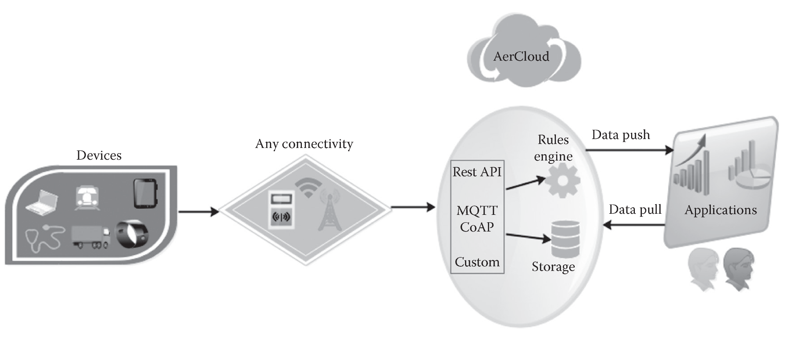
AerCloud

Slide 36
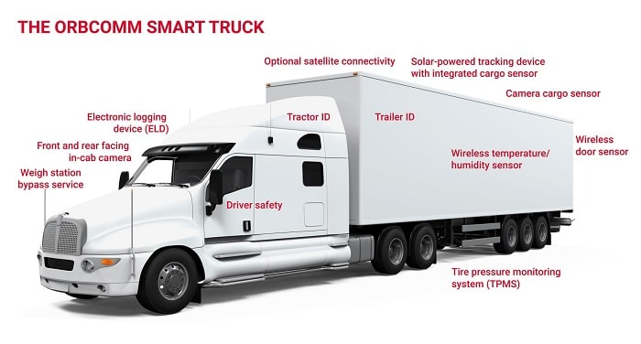
ORBCOMM IoT Platform
ORBCOMM is a single source provider of multi-network connectivity, leading edge devices and powerful applications for industries including transportation and distribution, heavy equipment, oil and gas, maritime and government.
Transportation: ORBCOMM's comprehensive truck management solutions enable simplified driver performance and communications, better fuel efficiency, enhanced fleet safety
Smart Agriculture, Mining Asset Tracking,
SCADA System Monitoring,
Oil & Gas Equipment & Pipeline Monitoring
Water Monitoring and Utilities Management

Slide 37
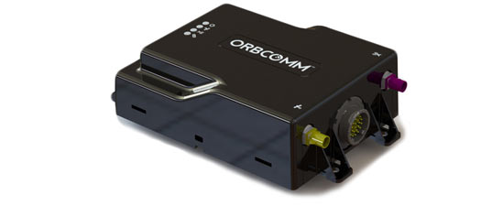
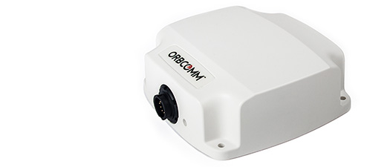
ORBCOMM IoT Platform
Mining: Fleet Management and Underground Mine Tracking
  ST 9100 (Dual-Mode)
    The fully programmable ST 9100 is a dual-mode satellite/cellular device, combining cellular network coverage and the two-way IsatData Pro satellite service. This versatile device enables asset tracking and monitoring for a wide variety of applications on land and at sea, in the most remote areas of the world.
Smart Agriculture Management
  ST 6100: Satellite Remote Monitoring
    Choose the ST 6100 for remote asset management. The IDP series of satellite devices offers customers a quick and smart way to integrate into agriculture solutions to enable sensor-based monitoring of environmental conditions, water consumption, soil moisture/temperature, irrigation parameters and more.

Slide 38
ParStream IoT Analytics Platform
ParStream is the first platform built for IoT that provides immediate insights from big data volumes and high bandwidth data streams.
ParStream delivers subsecond query response times even on hundreds of billions of data records.
It also includes innovative tools such as geodistributed analytics, alerts and actions, time series, advanced analytics, interfaces for the leading streaming or Extract, Transform and Load (ETL) technologies, and seamless integration of the leading visualization tools for IoT.
The functionality of Cisco ParStream is now part of Cisco Kinetic.

Slide 39
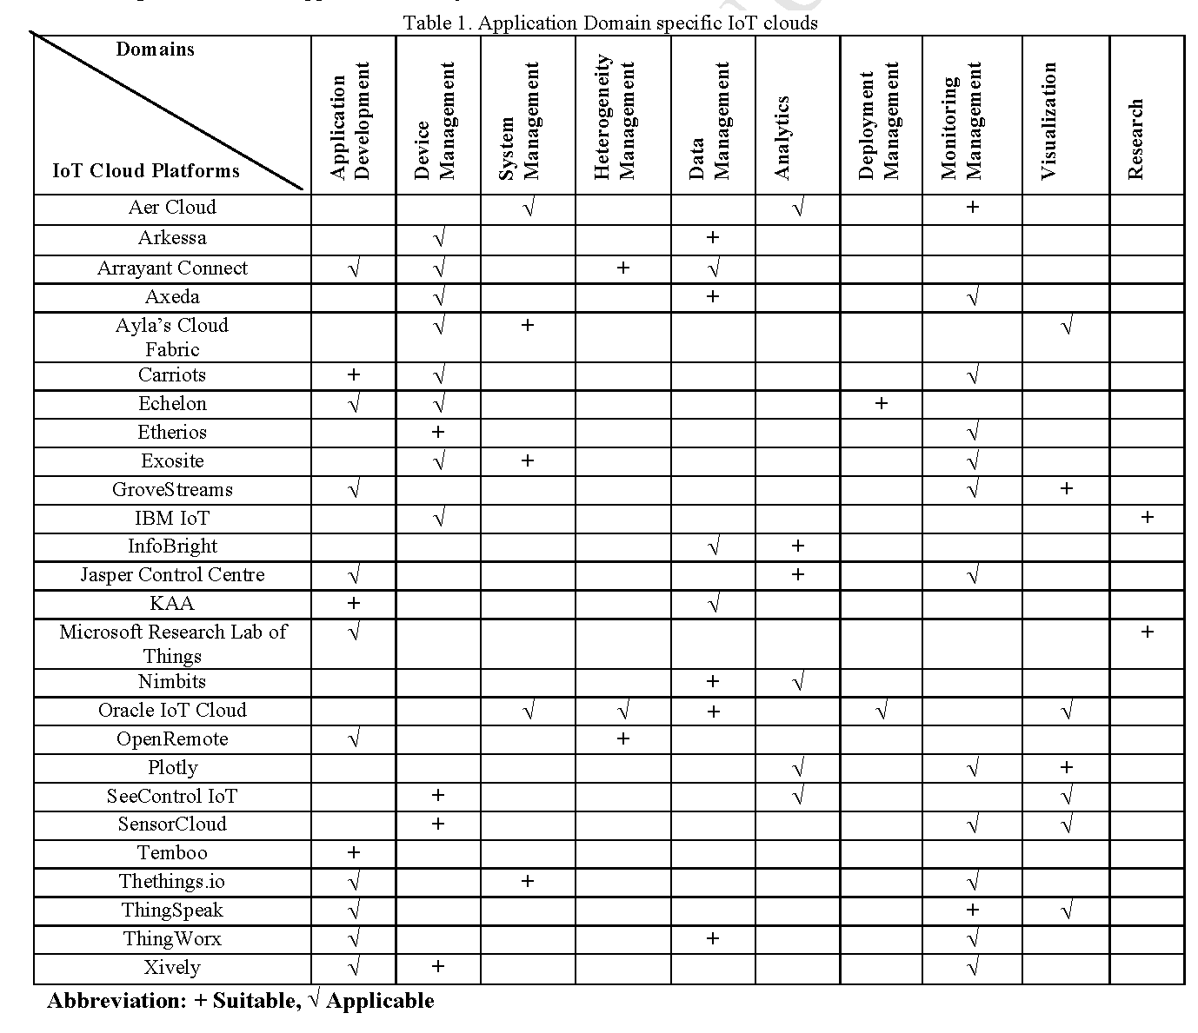
Application domain specifc
IOT clouds

Slide 40
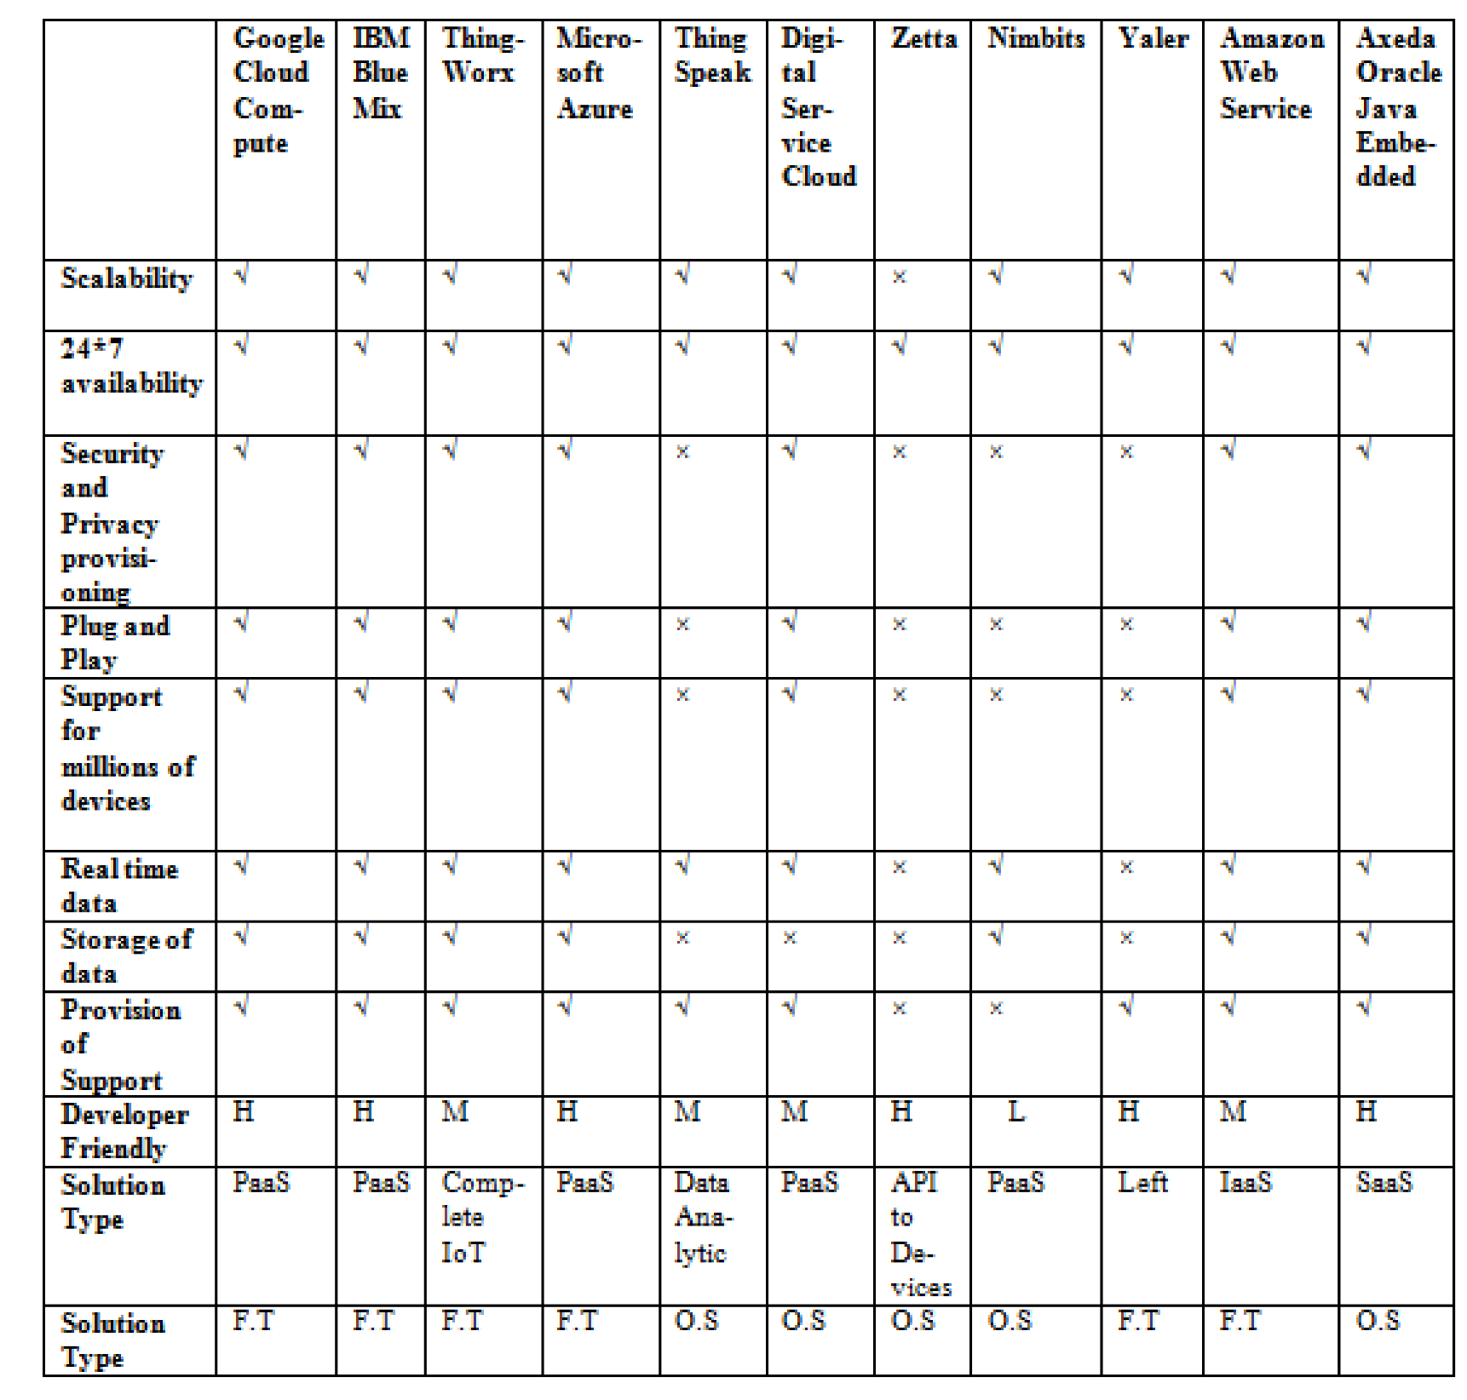
IoT Platforms Comparison

Slide 41
IoT platforms Sensing Features

Slide 42
IoT platforms Sensing Features

Slide 43
Communication Features Of Various IoT Middleware Platform

Slide 44
Communication Features Of Various IoT Middleware Platform

Slide 45
Application Development Support Features In Iot Middleware Platform

Slide 46
Application Development Support Features In Iot Middleware Platform

