Slide 1
Internet of things
By: Mahmood Ahmadi

Slide 2
References
1. Internet of Things for Architects, Architecting IoT solutions by implementing sensors, communication infrastructure, edge computing, analytics, and security, Perry Lea, 2018.
2. The Internet of Things Enabling Technologies, Platforms, and Use Cases, Pethuru Raj, Anupama C. Raman, CRCpress, 2017.
3. Internet of Things with the Arduino Yún, Marco Schwartz, Packt Publishing Ltd., 2014.
4. Internet of Things with Python, Interact with the world and rapidly prototype IoT applications using Python, Gastón C. Hillar, 2016
5. Practical Internet of Things with JavaScript Build standalone exciting IoT projects with Raspberry Pi 3 and JavaScript, Arvind Ravulavaru, 2017
  6. Chapter 7, Internet of Things Architectures, Protocols and Standards, Simone Cirani, Gianluigi Ferrari, Marco Picone, Luca Veltri, Wiley, 2019

Slide 3
Rererences
Papers:
  Guth J. et al. (2018) A Detailed Analysis of IoT Platform Architectures: Concepts, Similarities, and Differences. In: Di Martino B., Li KC., Yang L., Esposito A. (eds) Internet of Everything. Internet of Things (Technology, Communications and Computing). Springer, Singapore. https://doi.org/10.1007/978-981-10-5861-5_4
  Ray PP, A Survey of IoT Cloud Platforms, Future Computing and Informatics Journal (2017), https:/doi.org/ 10.1016/j.fcij.2017.02.001.
  Agarwal P., Alam M. (2020) Investigating IoT Middleware Platforms for Smart Application Development. In: Ahmed S., Abbas S., Zia H. (eds) Smart Cities—Opportunities and Challenges. Lecture Notes in Civil Engineering, vol 58. Springer, Singapore. https://doi.org/10.1007/978-981-15-2545-2_21
A chapter of book:
  Chapter 5, The Enablement Platforms for IoT Applications and Analytics, The Internet of Things Enabling Technologies, Platforms, and Use Cases, Pethuru Raj, Anupama C. Raman, Taylor an Francis, CRC press, 2017

Slide 4
Table of content
Chapter 1
  IO story
  History of IoT
  IOT potential
Chapter 2
  IoT Architecture and Core IoT Modules
  IoT ecosystem
  IoT versus machine to machine
  The value of a network and Metcalfe's and Beckstrom's law
  IoT architecture
  Role of an architect

Slide 5
Table of content
Chapter 3: Sensors, Endpoints, and Power Systems
Sensing devices
Thermocouples and temperature sensing
  Hall effect sensors and current sensors
  Photoelectric sensors
  PIR sensors
  LiDAR and active sensing systems
  MEMS sensors
Sensor fusion
Energy sources and power management

Slide 6
Table of content
Chapter 4
IoT Hardware Platforms
    Hardware Platforms: TelosB
    Zolertia Z1
    Arduino
    OpenMote
    Raspberry Pi
      Raspberry Pi 1,2, 3
    ESP Modules

Slide 7
Table of content
Chapter 5
Non-IP Based WPAN
  Wireless personal area network standards
    802.15 standards
    Bluetooth
    IEEE 802.15.4
    Zigbee
    Z-Wave
Chpater 6
  IP-Based WPAN and WLAN
  Internet protocol and transmission control protocol
  WPAN with IP – 6LoWPAN

Slide 8
Table of content
  WPAN with IP – Thread
  IEEE 802.11 protocols and WLAN
Chapter 7
Long-Range Communication Systems and Protocols (WAN)
  Cellular connectivity (3G, 4G LTE, NB-IoT)
  LoRa and LoRaWAN
Chapter 8
IoT Edge to Cloud Protocols
  Protocols MQTT
  MQTT-SN
  COAP
Chapter 9
The Platforms for IoT Applications and Analytics

Slide 9
Table of content
Chapter 9
IoT Application Enablement Platforms
Characterizing IoT or Machine-to-Machine Application Platforms
IoT AEPs—The Architectural Building-Blocks
IoT and M2M Sensor Data Platform by AerCloud
FIWARE
ThingWorx IoT AEP
ORBCOMM IoT Platform
Azure IoT Hub
Amazon Web Service IoT Platform
OpenMTC Platform
The IoT Data Analytics Platforms
IBM Watson IoT Platform
ParStream IoT Analytics Platform
Vitria IoT Analytics Platform
Pentaho IoT Analytics Platform
Splunk Software for IoT Data
Guavus IoT Analytics Platform
Virdata IoT Analytics Platform
The IoT Data Virtualization Platforms

Slide 10
Table of contents
Final Exam 110 points
Research topic 60 points
Homeworks 30 points

Slide 11
IOT Story
You wake up Tuesday, May 17, 2025, around 6:30 AM Everything about the world you live in will be different: energy, healthcare, farming, manufacturing, logistics, mass transit, environment, security, shopping, and even clothing.
This is the impact of connecting ordinary objects to the Internet, Internet of Things (IoT) or Internet of Everything.
Your smoke alarms, doorbell, irrigation systems, garage door, surveillance cameras, and security system.
Your bike jersey uses printable sensors, and monitors your heart rate and temperature.
Most people arrive at work via their car and are directed to the optimal parking space via smart sensors in each parking slot.

Slide 12
IOT definition
Internet of things (IoT) is the inter-networking of physical devices, vehicles (also referred to as "connected devices" and "smart devices"), buildings, and other items embedded with electronics, software, sensors, actuators, and network connectivity which enable these objects to collect and exchange data.

Slide 13
IOT history
The term IoT can most likely be attributed to Kevin Ashton in 1997 with his work at Proctor and Gamble using RFID tags to manage supply chains.
IoT has taken off from simple RFID tags to an ecosystem and industry that by 2020.
Five trillion out of one hundred trillion global GDP dollars

Slide 14
IoT history

Slide 15
IoT history

Slide 16
IoT history

Slide 17
IoT potential
The average of these 10 analyst forecasts is about 33.4 billion connected things by 2020-2021.
ARM recently conducted a study and forecast that by 2035 one trillion connected devices

Slide 18
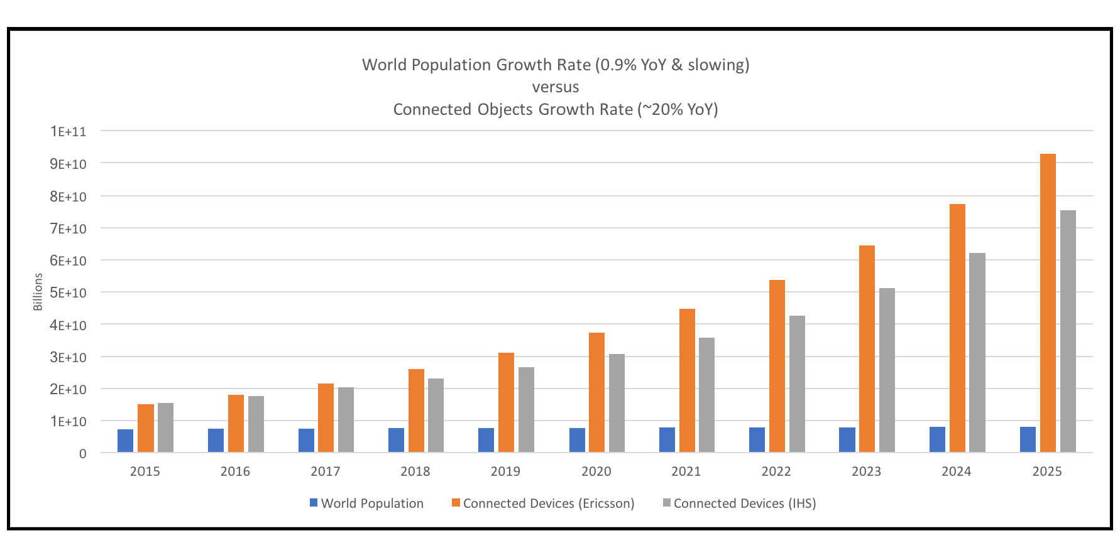
IoT Potential
Global GDP for 2016 was $75.64 trillion dollars
An estimate that by 2020 it will rise to $81.5 trillion
IoT solutions of $2.4 trillion to about $4.9 trillion

Slide 19
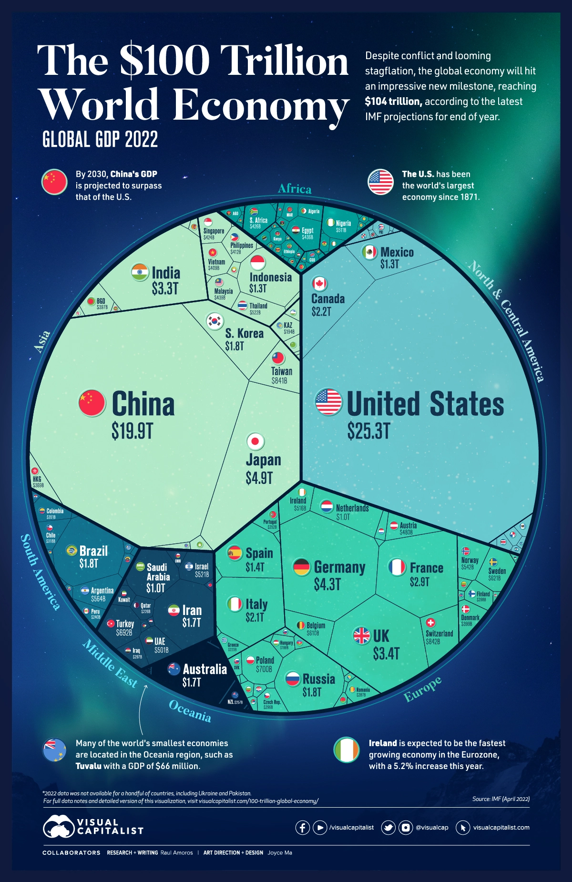
IoT potential

Slide 20
Industrial and manufacturing IoT use cases and impact
Preventative maintenance on new and pre-existing factory machinery
Throughput increase through real-time demand
Energy savings
Safety systems such as thermal sensing, pressure sensing, and gas leaks
Factory floor expert systems

Slide 21
IoT for consumer
The following are some of the consumer IoT use cases:
  Smart home gadgetry: Smart irrigation, smart garage doors, smart locks, smart lights, smart thermostats, and smart security.
  Wearables: Health and movement trackers, smart clothing/wearables.
  Pets: Pet location systems, smart dog doors.

Slide 22
IoT in Healthcare
In-home patient care
Learning models of predictive and preventative healthcare
Dementia and elderly care and tracking
Hospital equipment and supply asset tracking
Pharmaceutical tracking and security
Remote field medicine
Drug research
Patient fall indicators

Slide 23
Transportation and logistics IoT use cases
Fleet tracking and location awareness
Railcar identification and tracking
Asset and package tracking within fleets
Preventative maintenance of vehicles on the road

Slide 24
Agricultural and environmental IoT use cases
Smart irrigation and fertilization techniques to improve yield
Smart lighting in nesting or poultry farming to improve yield
Livestock health and asset tracking
Preventative maintenance on remote farming equipment via manufacturer
Drones-based land surveys
Farm-to-market supply chain efficiencies with asset tracking
Robotic farming
Volcanic and fault line monitoring for predictive disasters

Slide 25
Energy IoT use cases
Oil rig analysis of thousands of sensors and data points for efficiency gains
Remote solar panel monitoring and maintenance
Hazardous analysis of nuclear facilities
Smart electric meters in a citywide deployment to monitor energy usage and demand
Real-time blade adjustments as a function of weather on remote wind turbines

Slide 26
Smart city IoT use cases
Pollution control and regulatory analysis through environmental sensing
Microclimate weather predictions using citywide sensor networks
Efficiency gains and improved costs through waste management service on Demand
Improved traffic flow and fuel economy through smart traffic light control and patterning
Energy efficiency of city lighting on demand
Smart snow plowing based on real-time road demand, weather conditions, and nearby plows
Smart irrigation of parks and public spaces, depending on weather and current usage
Smart cameras to watch for crime and real-time automated AMBER Alerts
Smart parking lots to automatically find best space parking on demand
Bridge, street, and infrastructure wear and usage monitors to improve longevity and service

Slide 27
IoT
Remember, data is the new oil.

